Slide 1
Year 4 Maths 03.02.2021
LO: To solve problems involving converting between units of time

Slide 2
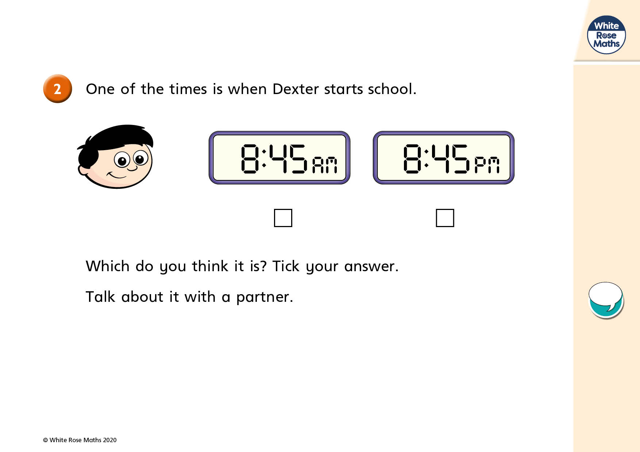


Slide 3
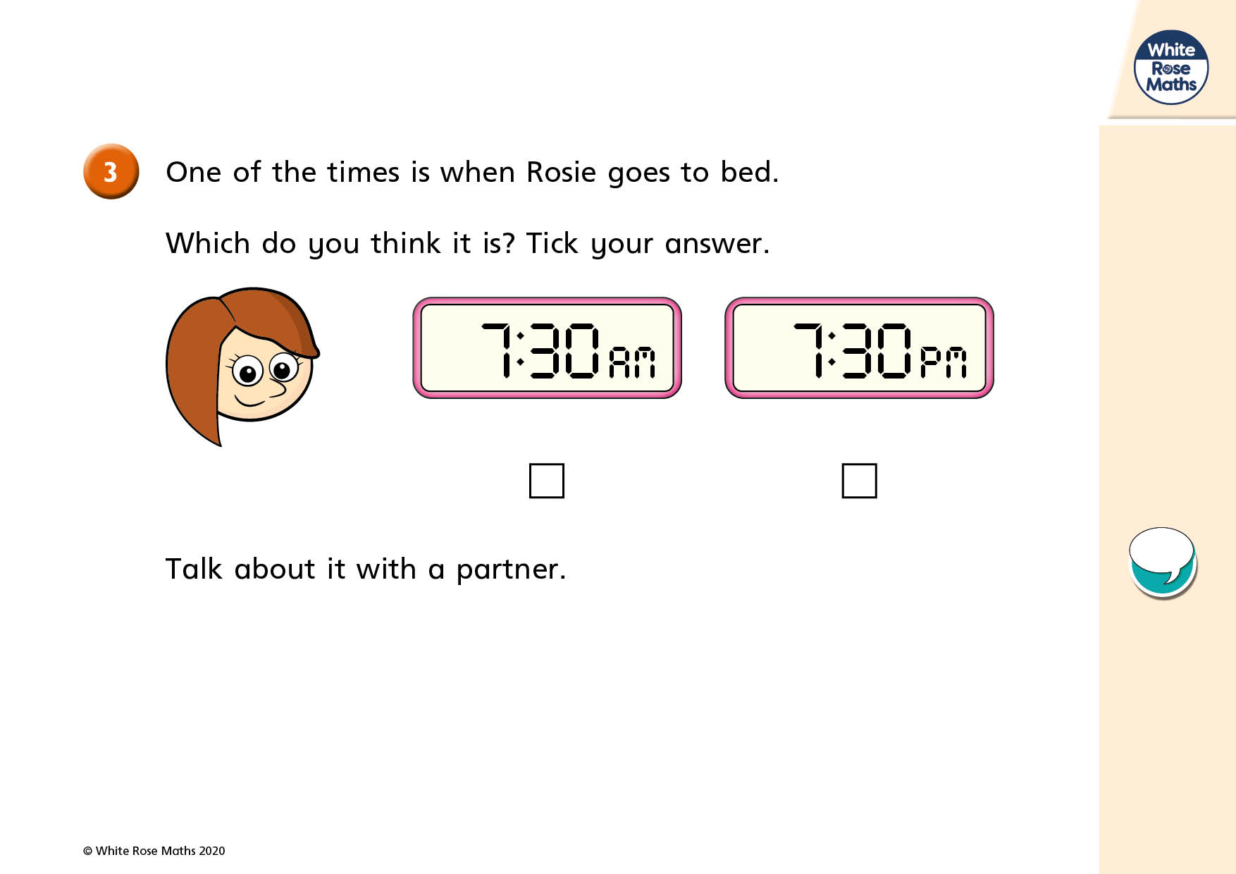

Slide 4
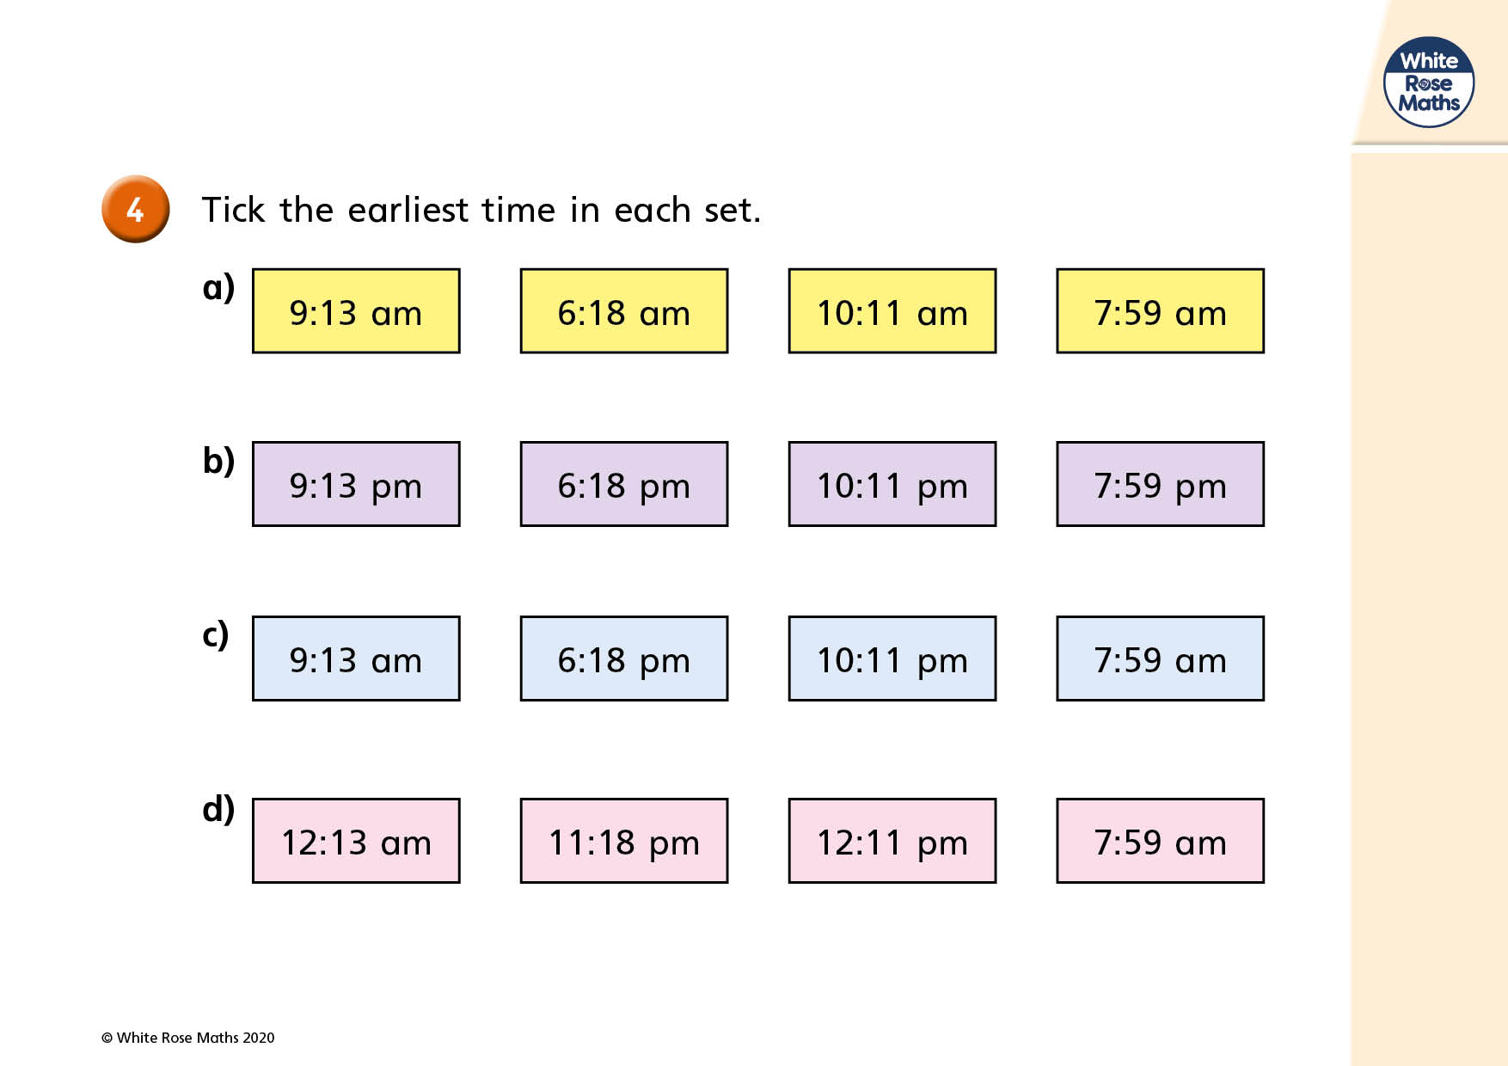

Slide 5
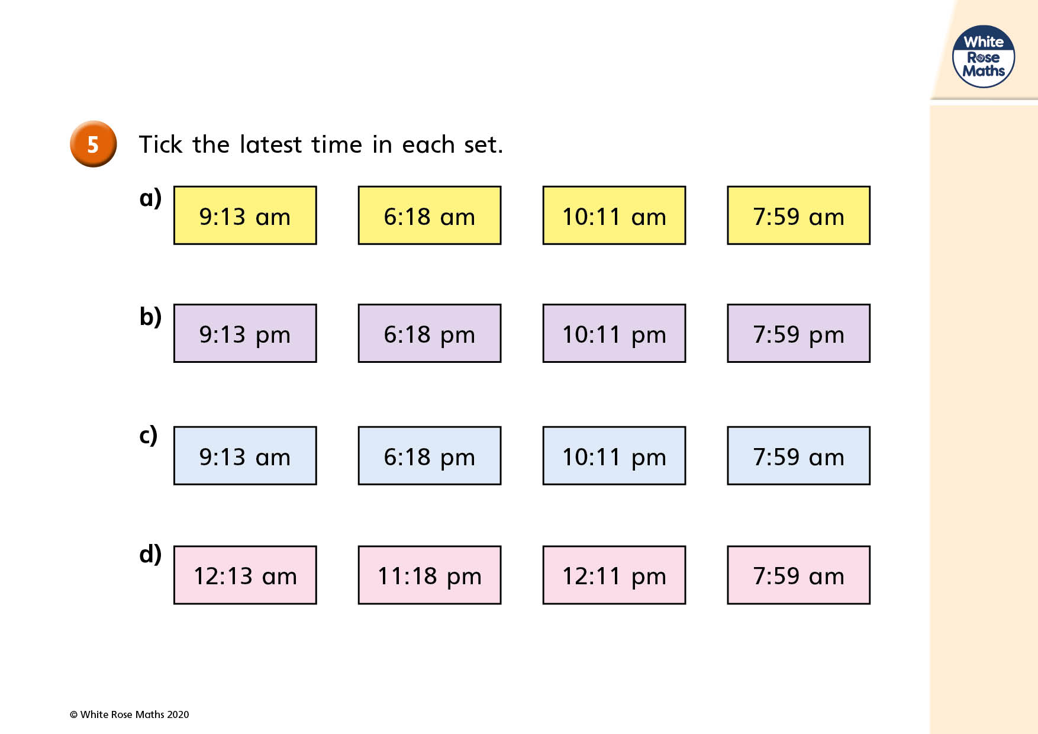

Slide 6
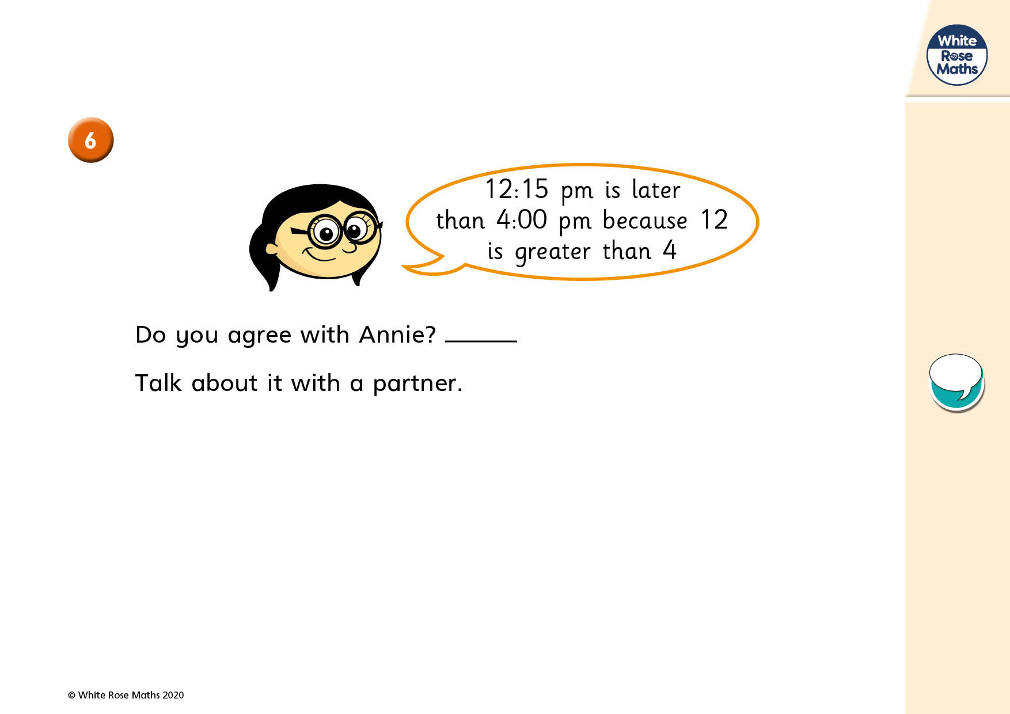

Slide 7
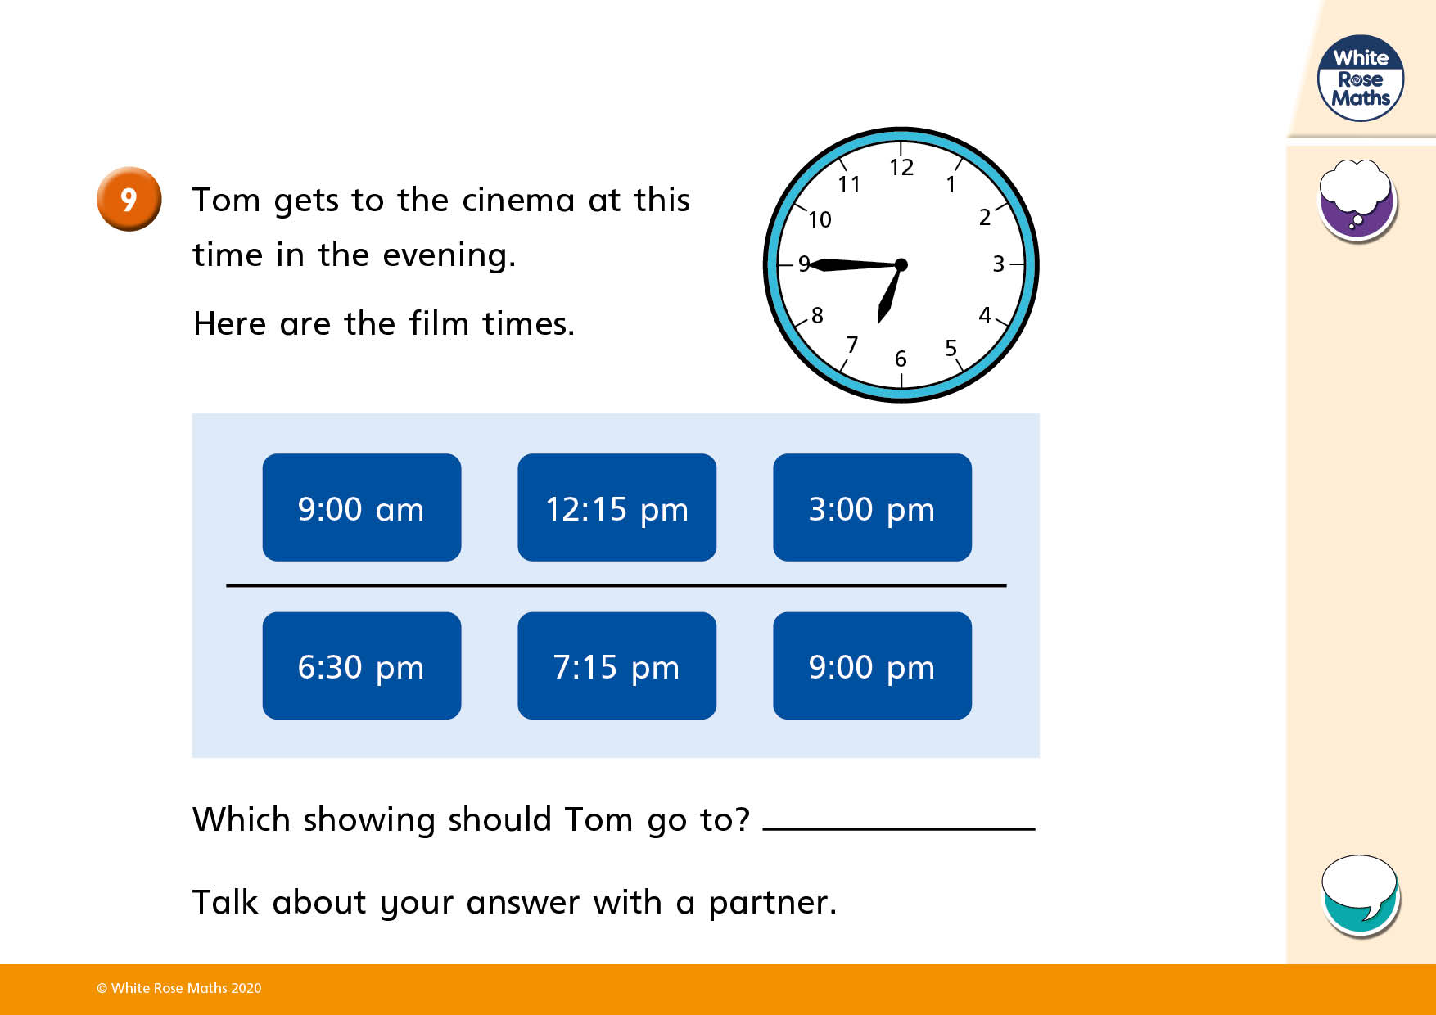

Slide 8


Which months have the most days?
Which month has the fewest days?
How many months have 28 days?
How many days are in one year?
How many weeks are in two years?
How often do leap years occur? Which month gets an extra day in a leap year?
© Classroom Secrets Limited 2018

Slide 9
Which months have the most days?
January, March, May, July, August, October and December
Which month has the fewest days?
February
How many months have 28 days?
All of them
How many days are in one year?
365
How many weeks are in two years?
104
How often do leap years occur?
Every four years Which month gets an extra day in a leap year?
February
© Classroom Secrets Limited 2018

Slide 10
Varied Fluency 1
Complete the statements.
There are |  | days in January.
There are |  | months in half a year.
There are |  | days in 5 weeks 3 days.
© Classroom Secrets Limited 2018

Slide 11
Varied Fluency 1
Complete the statements.
There are | 31 | days in January.
There are | 6 | months in half a year.
There are | 38 | days in 5 weeks 3 days.
© Classroom Secrets Limited 2018

Slide 12
Varied Fluency 2
Circle the true statement.
There are 17 days in 3 weeks.
There are 24 months in 2 years.
There are 50 weeks in 1 year.
© Classroom Secrets Limited 2018

Slide 13
Varied Fluency 2
Circle the true statement.
There are 17 days in 3 weeks.
There are 24 months in 2 years.
There are 50 weeks in 1 year.
© Classroom Secrets Limited 2018

Slide 14
Varied Fluency 3
Match the durations.
28 days
14 days
2 weeks
1 and a half years
18 months
4 weeks
© Classroom Secrets Limited 2018

Slide 15
Varied Fluency 3
Match the durations.
28 days
14 days
2 weeks
1 and a half years
18 months
4 weeks
© Classroom Secrets Limited 2018

Slide 16
Problem Solving 1
Amit is 8 years and 11 months old.
Jerry is 5 months older than Amit.
Alex is 6 months younger than Jerry.
How old is Alex?
Alex is |  | years and |  | months old.
© Classroom Secrets Limited 2018

Slide 17
Problem Solving 1
Amit is 8 years and 11 months old.
Jerry is 5 months older than Amit.
Alex is 6 months younger than Jerry.
How old is Alex?
Alex is | 8 | years and | 10 | months old.
© Classroom Secrets Limited 2018

Slide 18
Problem Solving 2
George is going camping.
He starts his trip on the 28th March.
He camps for 2 weeks in Cornwall, then camps for 5 days in Devon.
What date does he finish camping?
Mon | Tue | Wed | Thurs | Fri | Sat | Sun
 |  | 28 | 29 | 30 | 31
April
 |  |  |  |  |  | 1
2 | 3 | 4 | 5 | 6 | 7 | 8
9 | 10 | 11 | 12 | 13 | 14 | 15
16 | 17 | 18 | 19 | 20 | 21 | 22
© Classroom Secrets Limited 2018

Slide 19
Problem Solving 2
George is going camping.
He starts his trip on the 28th March.
He camps for 2 weeks in Cornwall, then camps for 5 days in Devon.
What date does he finish camping?
Jack finishes camping on Monday 16th April.
Mon | Tue | Wed | Thurs | Fri | Sat | Sun
 |  | 28 | 29 | 30 | 31
April
 |  |  |  |  |  | 1
2 | 3 | 4 | 5 | 6 | 7 | 8
9 | 10 | 11 | 12 | 13 | 14 | 15
16 | 17 | 18 | 19 | 20 | 21 | 22
© Classroom Secrets Limited 2018

Slide 20
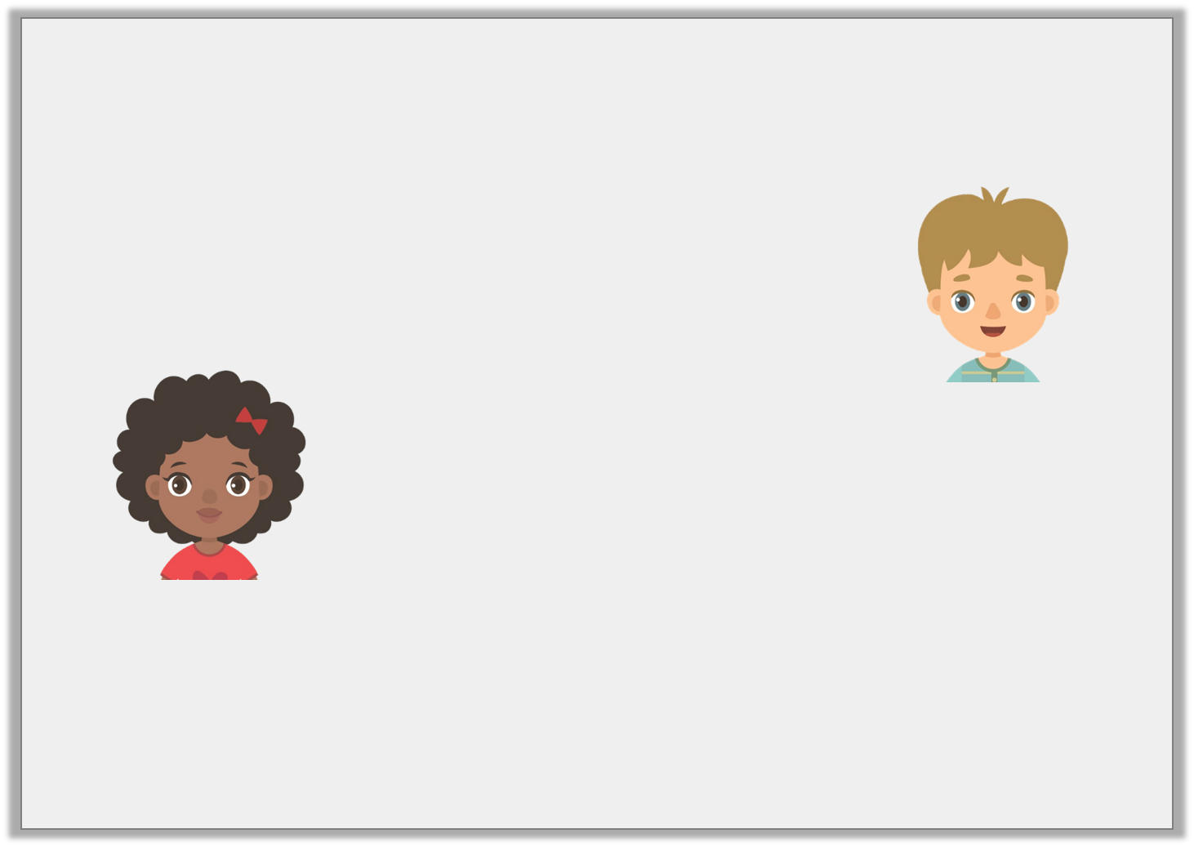
Reasoning 1
Erica and Elijah are discussing weeks.
Who is correct? Explain why.
There are 49 days in 7 weeks.
Elijah
There 50 days in 7 weeks.
Erica
© Classroom Secrets Limited 2018

Slide 21
Reasoning 1
Erica and Elijah are discussing weeks.
Who is correct? Explain why.
Elijah is correct because…
There are 49 days in 7 weeks.
Elijah
There 50 days in 7 weeks.
Erica
© Classroom Secrets Limited 2018

Slide 22
Reasoning 1
Erica and Elijah are discussing weeks.
Who is correct? Explain why.
Elijah is correct because there are 7 days in 1 week.
7 x 7 = 49 days.
There are 49 days in 7 weeks.
Elijah
There 50 days in 7 weeks.
Erica
© Classroom Secrets Limited 2018

