Slide 1
Year 4 Maths 04.03.2021
LO: To subtract two 4-digit numbers

Slide 2

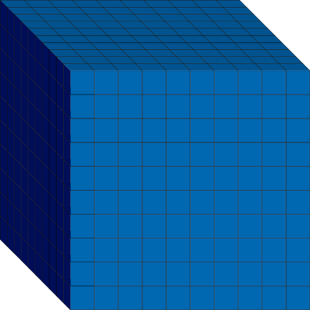


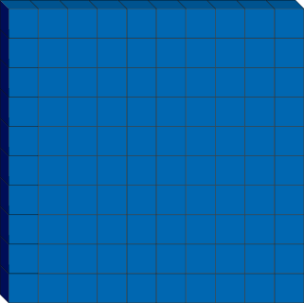

Introduction
Match the Base 10 with its equivalent value.
© Classroom Secrets Limited 2018

Slide 3
Introduction
Match the Base 10 with its equivalent value.
© Classroom Secrets Limited 2018

Slide 4
Varied Fluency 1
True or false? The difference between 6,452 and 4,414 is 2,041.
 | Th | H | T | O
–
© Classroom Secrets Limited 2018

Slide 5
Varied Fluency 1
True or false? The difference between 6,452 and 4,414 is 2,041.
False
 | Th | H | T | O
–
 | 2 | 0 | 3 | 8
10
© Classroom Secrets Limited 2018

Slide 6
Varied Fluency 2
Circle the correct answer to the question below.
 | 5 | 6 | 8 | 1
– | 3 | 9 | 7 | 0
A. 1,311 |  | B. 2,311 |  | C. 1,711
© Classroom Secrets Limited 2018

Slide 7
Varied Fluency 2
Circle the correct answer to the question below.
 | 5 | 6 | 8 | 1
– | 3 | 9 | 7 | 0
 | 1 | 7 | 1 | 1
4
1
A. 1,311 |  | B. 2,311 |  | C. 1,711
© Classroom Secrets Limited 2018

Slide 8
Varied Fluency 3
Complete the calculation below.
 | 9 | 2 | 8 | 5
– | 2 | 7 | 1 | 3
© Classroom Secrets Limited 2018

Slide 9
Varied Fluency 3
Complete the calculation below.
 | 9 | 2 | 8 | 5
– | 2 | 7 | 1 | 3
 | 6 | 5 | 7 | 2
8
1
© Classroom Secrets Limited 2018

Slide 10
Varied Fluency 4
If Andy has 3,409 stickers and he gives 1,265 of them to Tina, how many stickers does he have left?
 | 3 | 4 | 0 | 9
– | 1 | 2 | 6 | 5
© Classroom Secrets Limited 2018

Slide 11
Varied Fluency 4
If Andy has 3,409 stickers and he gives 1,265 of them to Tina, how many stickers does he have left?
2,144 stickers
 | 3 | 4 | 0 | 9
– | 1 | 2 | 6 | 5
 | 2 | 1 | 4 | 4
3
1
© Classroom Secrets Limited 2018

Slide 12
Problem Solving 1
Complete the calculation below.
 |  | 3 | 6 | 5
– | 2 | 1
 | 6 |  | 7 | 3
© Classroom Secrets Limited 2018

Slide 13
Problem Solving 1
Complete the calculation below.
 |  | 3 | 6 | 5
– | 2 | 1
 | 6 |  | 7 | 3
8
2
1
9
2
1
© Classroom Secrets Limited 2018

Slide 14
Problem Solving 2
Use digits from 0 - 9 to create a subtraction calculation with two 4-digit numbers and one exchange.
–
© Classroom Secrets Limited 2018

Slide 15
Problem Solving 2
Use digits from 0 - 9 to create a subtraction calculation with two 4-digit numbers and one exchange.
–
6
8
1
9
0
4
4
2
5
3
2
6
5
1
© Classroom Secrets Limited 2018

Slide 16
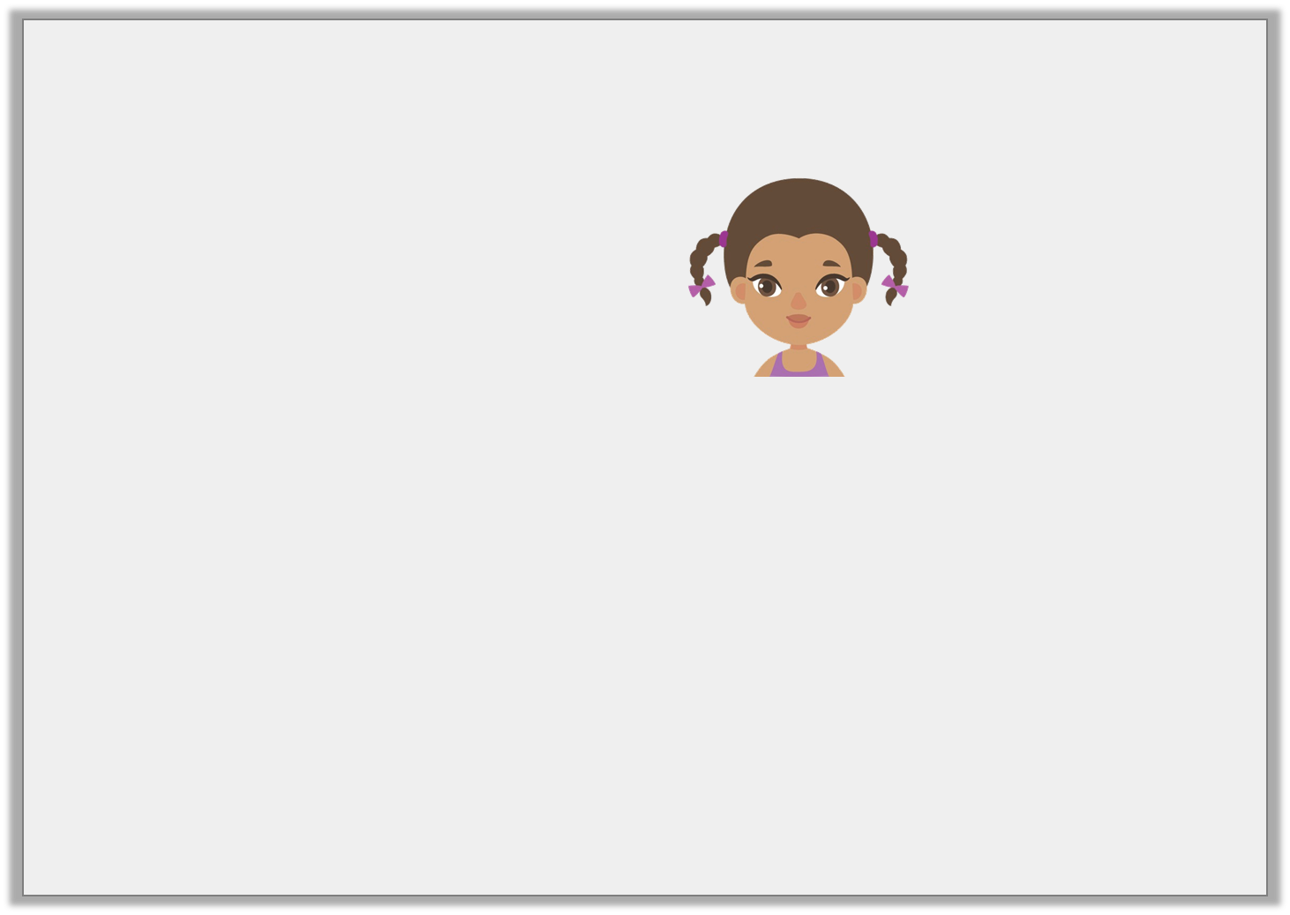
Reasoning 1
Class 4 are given the following calculation. Monica says,
We need to exchange one of the hundreds for ten tens.
 | 4 | 8 | 9 | 4
– | 1 | 8 | 3 | 7
© Classroom Secrets Limited 2018

Slide 17
Reasoning 1
Class 4 are given the following calculation. Monica says,
We need to exchange one of the hundreds for ten tens.
 | 4 | 8 | 9 | 4
– | 1 | 8 | 3 | 7
Monica is incorrect because...
© Classroom Secrets Limited 2018

Slide 18
Reasoning 1
Class 4 are given the following calculation. Monica says,
We need to exchange one of the hundreds for ten tens.
 | 4 | 8 | 9 | 4
– | 1 | 8 | 3 | 7
Monica is incorrect because they need to exchange one of the tens for ten ones.
© Classroom Secrets Limited 2018

