Slide 1
Mountain Pass
Exciting Writing 8.01.21

Slide 2
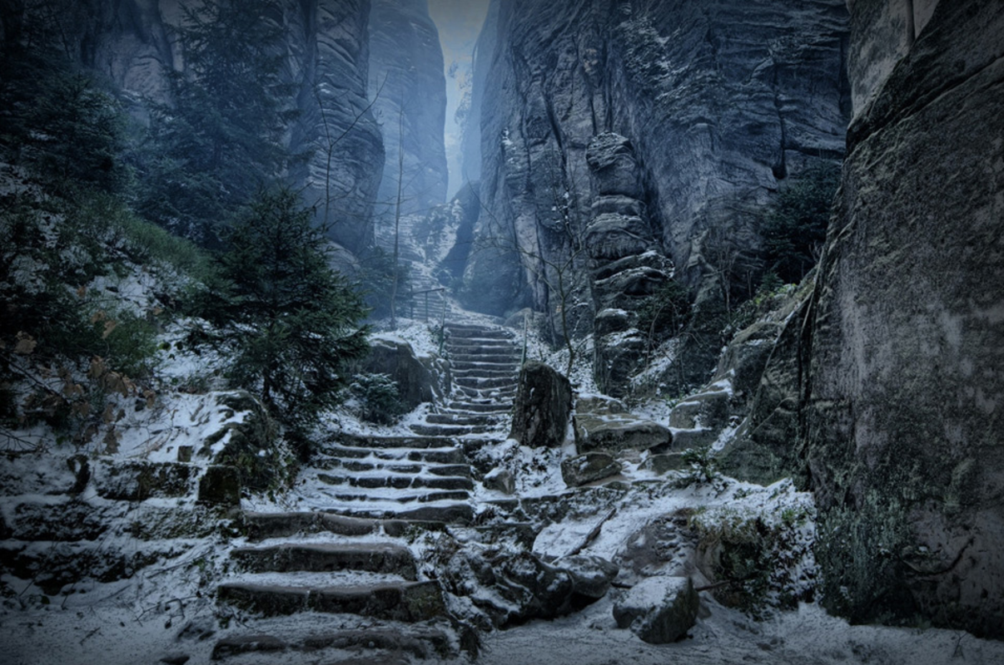

The mountain of High Hrothgar had stood proudly for thousands of years, casting a solemn shadow for miles around.
Few dared to venture close to its base, let alone scale its heights, fearing what awaited at the summit. For one brave adventurer, the folk lore surrounding the mysteries of High Hrothgar provided an opportunity just too tempting to resist. Some called him courageous, others foolish, but it mattered not to him now.
Bracing himself against the torrent of icy wind that rushed towards him down the narrow pass, the lone figure prepared himself for the challenge ahead. He took a deep breath, feeling the frozen air rush into his lungs, and took a bold step onto the path to High Hrothgar…

Slide 3
Mountain Pass
Who was the lone figure?
Why did he want to climb up the mountain pass to the summit of High Hrothgar?
What was lurking on High Hrothgar’s icy summit?
Write an exciting adventure story. Use your 5 senses to describe the hostile environment. Think about how you will use vocabulary to interest your reader and sentence length to create drama and suspense. Remember all the things we worked on last term and try to include them.

Slide 4
Mountain Pass – word bank
mountain slippery howling drifting blizzard darkness trembling
terrifying exhausted drenched fearful frightened watchful
suspicious petrified superstitious glacial glacier icicles frozen
High Hrothgar warrior knight armour sword slayed slain

Slide 5
Proof-reading & editing your work

