Slide 1


Year 5
LO: To calculate fractions
of a quantity
© Classroom Secrets Limited 2019

Slide 2
Introduction
Match the calculations to their answers.
36 ÷ 4 |  | 8
24 ÷ 3 |  | 6
35 ÷ 5 |  | 9
42 ÷ 7 |  | 7
© Classroom Secrets Limited 2019

Slide 3
Introduction
Match the calculations to their answers.
36 ÷ 4 |  | 8
24 ÷ 3 |  | 6
35 ÷ 5 |  | 9
42 ÷ 7 |  | 7
© Classroom Secrets Limited 2019

Slide 4
Varied Fluency 1
Complete the bar model and the sentences below.
One part equals so of 60 is .
Two parts equal so of 60 is .
60
1
5
2
5
© Classroom Secrets Limited 2019

Slide 5
Varied Fluency 1
Complete the bar model and the sentences below.
One part equals so of 60 is .
Two parts equal so of 60 is .
60
12
1
5
12
24
2
5
24
© Classroom Secrets Limited 2019

Slide 6
Varied Fluency 2
Complete the steps below.
54
 | of | 54 | =
 | of | 54 | =
1
6
5
6
© Classroom Secrets Limited 2019

Slide 7
Varied Fluency 2
Complete the steps below.
54
 | of | 54 | = | 9
 | of | 54 | = | 45
1
6
5
6
© Classroom Secrets Limited 2019

Slide 8
Varied Fluency 3
Circle the correct answer below.
3.2m
5
8
of 3.2m is…
20cm
200cm
240cm
© Classroom Secrets Limited 2019

Slide 9
Varied Fluency 3
Circle the correct answer below.
3.2m
5
8
of 3.2m is…
20cm
200cm
240cm
© Classroom Secrets Limited 2019

Slide 10
Varied Fluency 4
Complete the statement.
2.1kg
2
7
of 2.1kg is
© Classroom Secrets Limited 2019

Slide 11
Varied Fluency 4
Complete the statement.
2.1kg
2
7
of 2.1kg is | 0.6kg
or 600g
© Classroom Secrets Limited 2019

Slide 12
Problem Solving 1
Use the cards below to make the statement correct.
 | of |  |  | is
3
10
2
9
15
© Classroom Secrets Limited 2019

Slide 13
Problem Solving 1
Use the cards below to make the statement correct.
2 | of |  |  | is
3
15
10
3
10
2
9
15
© Classroom Secrets Limited 2019

Slide 14
Reasoning 1
Circle the odd one out.
Explain your reasoning.
A. | of 1.8L
B. | of 3L
C. | of 2L
5
6
1.8L
2
3
3L
3
4
2L
© Classroom Secrets Limited 2019

Slide 15
Reasoning 1
Circle the odd one out.
Explain your reasoning.
B is the odd one out because…
A. | of 1.8L
B. | of 3L
C. | of 2L
5
6
1.8L
2
3
3L
3
4
2L
© Classroom Secrets Limited 2019

Slide 16
Reasoning 1
Circle the odd one out.
Explain your reasoning.
B is the odd one out because the answer is 2L (2,000ml). A and C = 1.5L (1,500ml)
A. | of 1.8L
B. | of 3L
C. | of 2L
5
6
1.8L
2
3
3L
3
4
2L
© Classroom Secrets Limited 2019

Slide 17
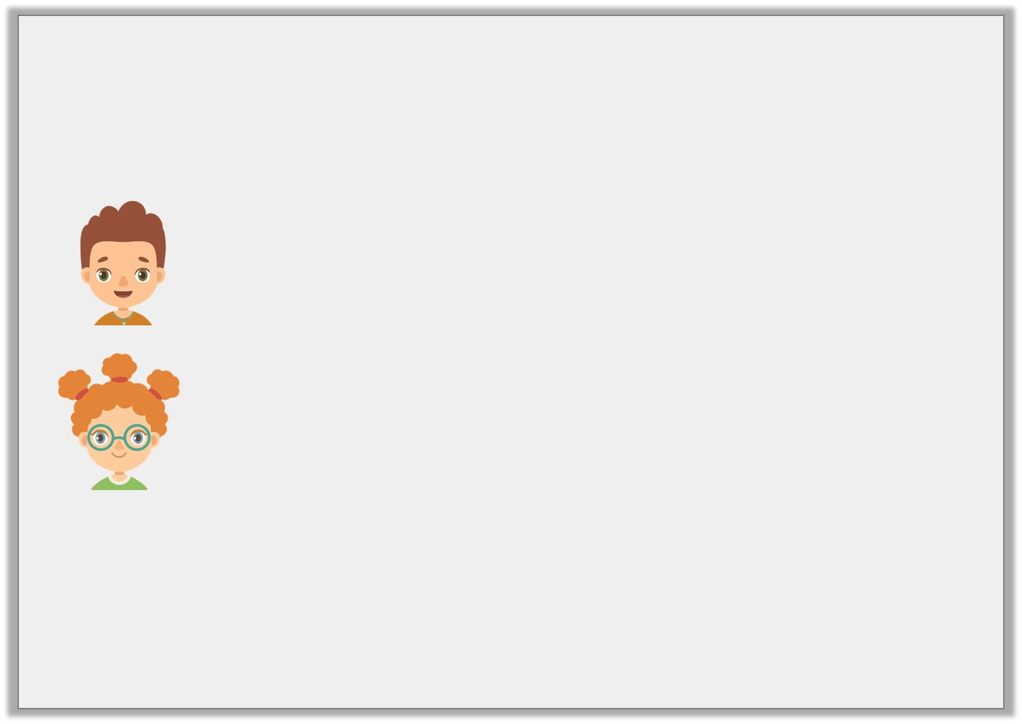
Problem Solving 2
There are 45 goats in a farm.
Jack feeds of them.
Lila feeds of them.
How many goats did they each feed?
How many goats have not been fed yet?
45 goats
2
9
5
9
© Classroom Secrets Limited 2019

Slide 18
Problem Solving 2
There are 45 goats in a farm.
Jack feeds of them.
Lila feeds of them.
How many goats did they each feed?
Jack feeds 10 goats and Lila feeds 25 goats.
How many goats have not been fed yet?
10 goats have not been fed yet.
45 goats
2
9
5
9
© Classroom Secrets Limited 2019

