Slide 1
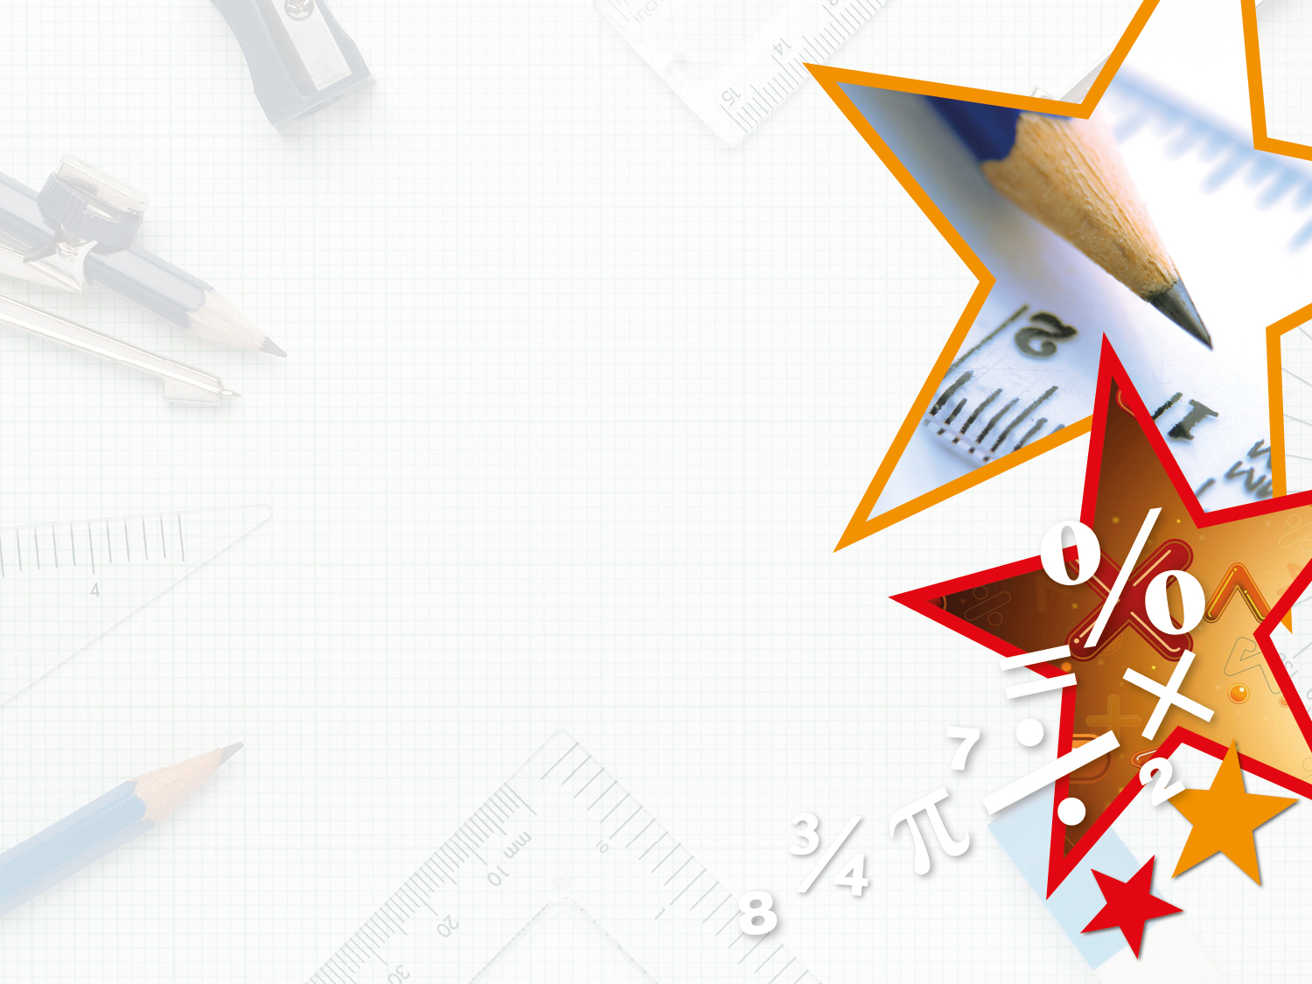

Year 5 – Spring Block 3 – Decimals and Percentages
Order and Compare Decimals
© Classroom Secrets Limited 2019

Slide 2
Introduction
Think of a number larger and a number smaller than this decimal.
1
0.1
0.01
0.001
1
0.1
0.01
0.001
0.1
0.01
0.01
© Classroom Secrets Limited 2019

Slide 3
Introduction
Think of a number larger and a number smaller than this decimal.
Various possible answers, for example:
Larger numbers: 2.489, 2.578, 3.521
Smaller numbers: 2.266, 1.789, 2.0
1
0.1
0.01
0.001
1
0.1
0.01
0.001
0.1
0.01
0.01
© Classroom Secrets Limited 2019

Slide 4
Varied Fluency 1
Tick the rows of decimals that are ordered correctly from smallest to largest.
1.709 | 1.719 | 1.83 | 1.904
3.48 | 3.5 | 3.508 | 3.099
6.039 | 6.531 | 6.635 | 6.75
© Classroom Secrets Limited 2019

Slide 5
Varied Fluency 1
Tick the rows of decimals that are ordered correctly from smallest to largest.
1.709 | 1.719 | 1.83 | 1.904 |  | ✓
3.48 | 3.5 | 3.508 | 3.099
6.039 | 6.531 | 6.635 | 6.75 |  | ✓
© Classroom Secrets Limited 2019

Slide 6
Varied Fluency 2
These decimals have been placed in descending order.
Circle the decimal that completes the sequence.
8.387 | 7.531 |  | 7.252
7.29 | seven and six tenths | 7.038 | 7.165
© Classroom Secrets Limited 2019

Slide 7
Varied Fluency 2
These decimals have been placed in descending order.
Circle the decimal that completes the sequence.
8.387 | 7.531 |  | 7.252
7.29 | seven and six tenths | 7.038 | 7.165
© Classroom Secrets Limited 2019

Slide 8
Varied Fluency 3
Complete the statement using >, < or = to make it correct.
852cm |  | 8.491m |  | 8.49m
© Classroom Secrets Limited 2019

Slide 9
Varied Fluency 3
Complete the statement using >, < or = to make it correct.
852cm | > | 8.491m | > | 8.49m
© Classroom Secrets Limited 2019

Slide 10
Varied Fluency 4
Place the numbers in ascending order.
3.581 | 3 | 561 |  | 3.658 | 3 | 165
 |  | 1000 |  |  |  | 1000
© Classroom Secrets Limited 2019

Slide 11
Varied Fluency 4
Place the numbers in ascending order.
3 | 165
 | 1000
3 | 561
 | 1000
3.581
3.658
3.581 | 3 | 561 |  | 3.658 | 3 | 165
 |  | 1000 |  |  |  | 1000
© Classroom Secrets Limited 2019

Slide 12
Problem Solving 1
Louise made a number between 5.81 and six and three tenths, using counters on a place value mat.
Six of the counters have fallen off.
List 3 possibilities of what Louise’s number could be.
1 | 0.1 | 0.01 | 0.001
© Classroom Secrets Limited 2019

Slide 13
Problem Solving 1
Louise made a number between 5.81 and six and three tenths, using counters on a place value mat.
Six of the counters have fallen off.
List 3 possibilities of what Louise’s number could be.
Various possible answers, for example:
6.023, 6.14, 6.212
1 | 0.1 | 0.01 | 0.001
© Classroom Secrets Limited 2019

Slide 14
Problem Solving 2
Look at this number sequence.
Use the number cards to make all the possible numbers with 3 decimal places that can complete the sequence.
5 | 508 |  | 5.67 |  | 5 | 961
 | 1000 |  |  |  |  | 1000
5
6
7
8
© Classroom Secrets Limited 2019

Slide 15
Problem Solving 2
Look at this number sequence.
Use the number cards to make all the possible numbers with 3 decimal places that can complete the sequence.
5.678, 5.687, 5.768, 5.786 5.867, 5.876
5 | 508 |  | 5.67 |  | 5 | 961
 | 1000 |  |  |  |  | 1000
5
6
7
8
© Classroom Secrets Limited 2019

Slide 16
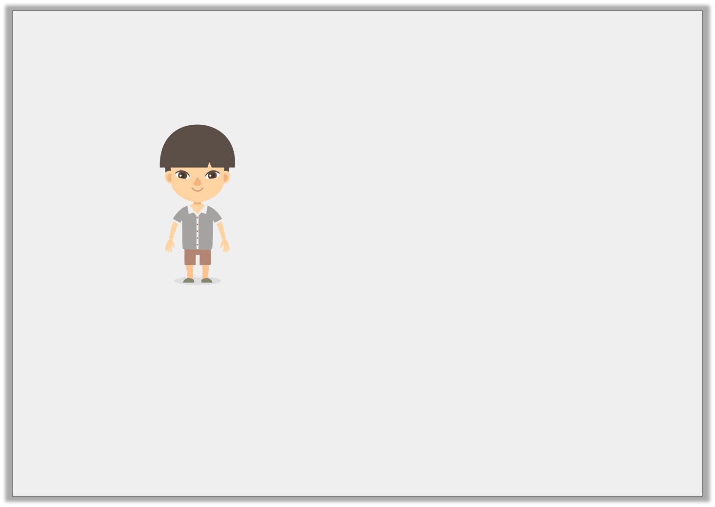
Reasoning 1
Jian is comparing numbers. He says,
Is Jian correct? Explain your answer.
I think that
9.218km > 9214m
© Classroom Secrets Limited 2019

Slide 17
Reasoning 1
Jian is comparing numbers. He says,
Is Jian correct? Explain your answer.
Jian is correct because…
I think that
9.218km > 9214m
© Classroom Secrets Limited 2019

Slide 18
Reasoning 1
Jian is comparing numbers. He says,
Is Jian correct? Explain your answer.
Jian is correct because 9,214 ÷ 1000 = 9.214 so 9,214m = 9.214km.
9.218 has 8 thousandths but 9.214 only has 4 so 9.218 is greater than 9.214.
I think that
9.218km > 9214m
© Classroom Secrets Limited 2019

