Slide 1
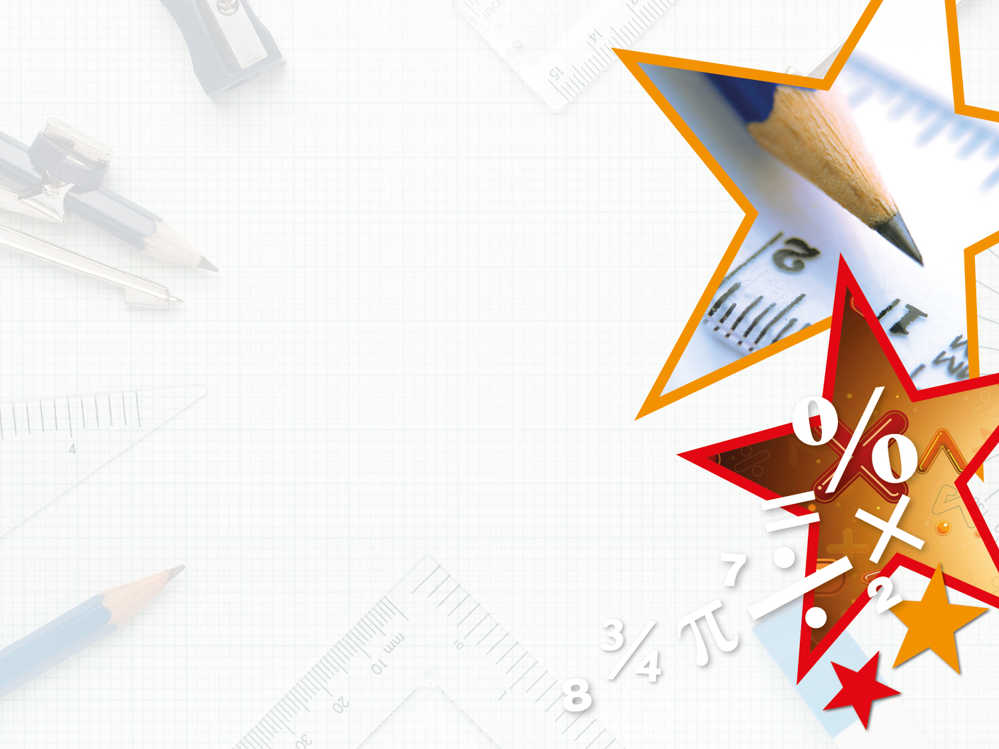

Year 5 – Spring Block 3 – Decimals and Percentages
Decimals up to 2d.p.
© Classroom Secrets Limited 2019

Slide 2
Introduction
Order the numbers below from smallest to largest.
26.2
25
24.9
26
26.7
20.9
© Classroom Secrets Limited 2019

Slide 3
Introduction
Order the numbers below from smallest to largest.
smallest largest
26.2
25
24.9
26
26.7
20.9
20.9
24.9
25
26
26.2
26.7
© Classroom Secrets Limited 2019

Slide 4
Varied Fluency 1
Circle the decimal number that is represented on the place value chart.
Ones | Tenths | Hundredths
1
0.1
0.01
0.01
0.1
0.1
1
0.01
0.1
0.1
0.01
A. 2.45 |  | B. 0.54 |  | C. 2.54
© Classroom Secrets Limited 2019

Slide 5
Varied Fluency 1
Circle the decimal number that is represented on the place value chart.
Ones | Tenths | Hundredths
1
0.1
0.01
0.01
0.1
0.1
1
0.01
0.1
0.1
0.01
A. 2.45 |  | B. 0.54 |  | C. 2.54
© Classroom Secrets Limited 2019

Slide 6
Varied Fluency 2
Match each decimal number to the correct visual representation.
A. | 1.28 | 1.
B. | 2.08 | 2.
C. | 1.11 | 3.
0.01
0.01
0.01
0.01
0.01
0.01
1
0.01
0.01
0.01
0.01
0.01
1
0.01
0.01
0.01
0.01
1
0.01
0.01
0.01
0.01
0.1
0.01
0.01
0.01
0.01
1
0.1
0.01
0.01
0.01
0.01
© Classroom Secrets Limited 2019

Slide 7
Varied Fluency 2
Match each decimal number to the correct visual representation.
A. | 1.28 | 1.
B. | 2.08 | 2.
C. | 1.11 | 3.
0.01
0.01
0.01
0.01
0.01
0.01
1
0.01
0.01
0.01
0.01
0.01
1
0.01
0.01
0.01
0.01
1
0.01
0.01
0.01
0.01
0.1
0.01
0.01
0.01
0.01
1
0.1
0.01
0.01
0.01
0.01
© Classroom Secrets Limited 2019

Slide 8
Varied Fluency 3
True or false?
0.42 = 3 tenths + 12 hundredths
0.1
0.1
0.01
0.01
0.01
0.1
0.01
0.01
0.01
0.01
0.01
0.01
0.01
0.01
0.01
© Classroom Secrets Limited 2019

Slide 9
Varied Fluency 3
True or false?
0.42 = 3 tenths + 12 hundredths
True
0.1
0.1
0.01
0.01
0.01
0.1
0.01
0.01
0.01
0.01
0.01
0.01
0.01
0.01
0.01
© Classroom Secrets Limited 2019

Slide 10
Varied Fluency 4
In which number does the 4 have the lowest value?
8.49 |  | 8.94 |  | 4.98
© Classroom Secrets Limited 2019

Slide 11
Varied Fluency 4
In which number does the 4 have the lowest value?
8.49 |  | 8.94 |  | 4.98
© Classroom Secrets Limited 2019

Slide 12
Reasoning 1
Spot the odd one out.
Explain your answer fully.
A.
3 + 0.1 + 0.15
D.
0.01
0.01
B.
0.01
three ones, 2 tenths and 5 hundredths.
0.01
0.01
0.01
0.1
0.1
C.
3.25
1
1
1
© Classroom Secrets Limited 2019

Slide 13
Reasoning 1
Spot the odd one out.
Explain your answer fully.
The odd one out is D because...
A.
3 + 0.1 + 0.15
D.
0.01
0.01
B.
0.01
three ones, 2 tenths and 5 hundredths.
0.01
0.01
0.01
0.1
0.1
C.
3.25
1
1
1
© Classroom Secrets Limited 2019

Slide 14
Reasoning 1
Spot the odd one out.
Explain your answer fully.
The odd one out is D because it represents 3.26. All of the others represent 3.25.
A.
3 + 0.1 + 0.15
D.
0.01
0.01
B.
0.01
three ones, 2 tenths and 5 hundredths.
0.01
0.01
0.01
0.1
0.1
C.
3.25
1
1
1
© Classroom Secrets Limited 2019

Slide 15
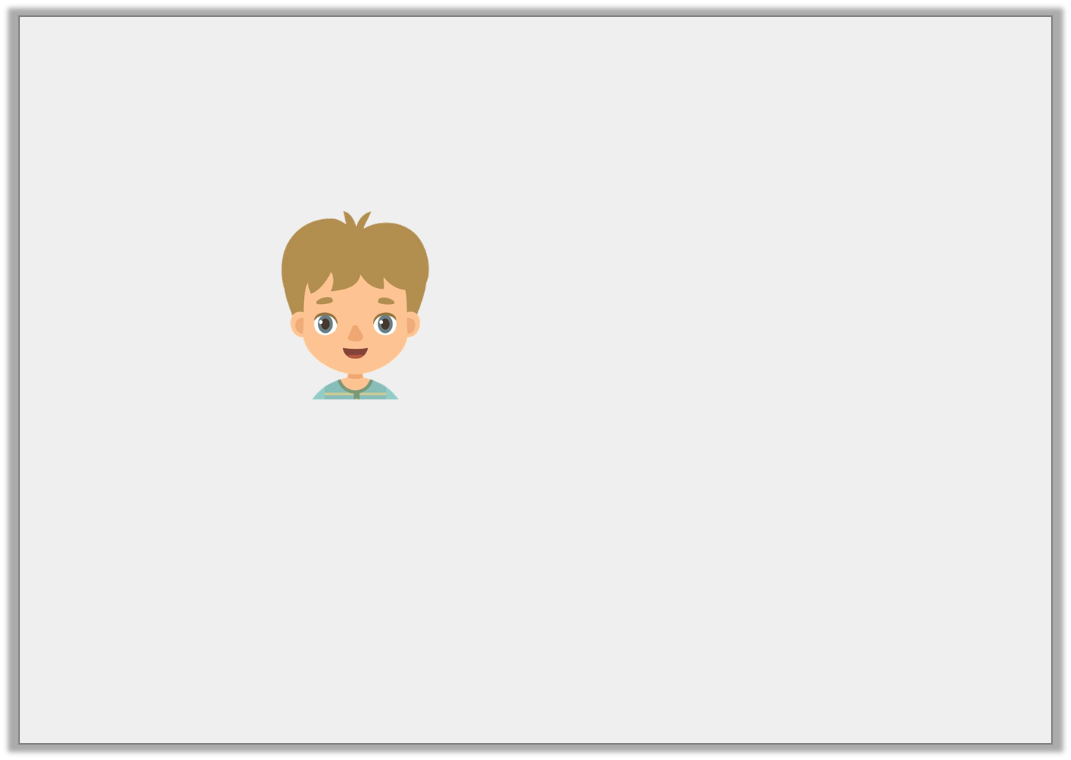
Problem Solving 1
Paul is thinking of a number.
What number is Paul thinking of? Is there more than one possible answer?
My number lies between
3 + 0.6 + 0.08
and 3 + 0.4 + 0.21
© Classroom Secrets Limited 2019

Slide 16
Problem Solving 1
Paul is thinking of a number.
What number is Paul thinking of? Is there more than one possible answer?
3.62, 3.63, 3.64, 3.65, 3.66 or 3.67
My number lies between
3 + 0.6 + 0.08
and 3 + 0.4 + 0.21
© Classroom Secrets Limited 2019

Slide 17
Reasoning 2
Harry has used place value counters to partition 3.06.
Is he correct? Prove it.
0.1
0.1
0.1
0.1
0.01
0.01
1
0.1
0.1
0.01
0.01
1
0.1
0.1
0.01
0.01
0.1
0.1
© Classroom Secrets Limited 2019

Slide 18
Reasoning 2
Harry has used place value counters to partition 3.06.
Is he correct? Prove it.
Harry is correct because...
0.1
0.1
0.1
0.1
0.01
0.01
1
0.1
0.1
0.01
0.01
1
0.1
0.1
0.01
0.01
0.1
0.1
© Classroom Secrets Limited 2019

Slide 19
Reasoning 2
Harry has used place value counters to partition 3.06.
Is he correct? Prove it.
Harry is correct because 10 tenths is the same as 1 one.
0.1
0.1
0.1
0.1
0.01
0.01
1
0.1
0.1
0.01
0.01
1
0.1
0.1
0.01
0.01
0.1
0.1
© Classroom Secrets Limited 2019

