Slide 1
English
Tuesday 9th February, 2021

Slide 2
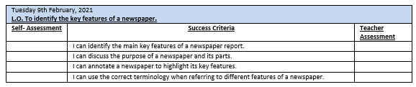

Slide 3
What is news?
‘News’ is not new – first to published by the Romans
Often associated with politics, war and natural disasters
But can be good news about sport, science or something silly or fun
First newspaper published 1621 ‘Corante’
In 1702 The Daily Courante was the first regular daily

Slide 4
Identifying the key features of a newspaper report:
Log on to Espresso.
Watch the following clip...
https://central.espresso.co.uk/espresso/primary_uk/subject/module/video/item858870/grade2/module858868/index.html
Annotate your newspaper report (see website for copy)
Use a ruler to draw straight lines

Slide 5
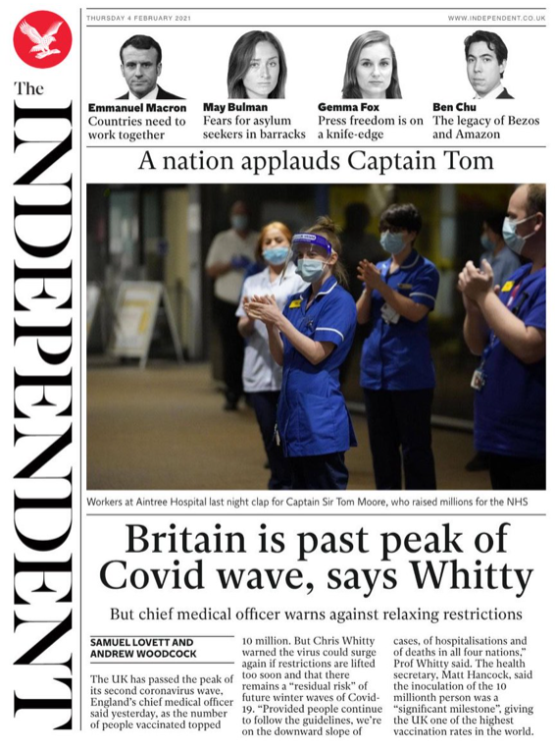
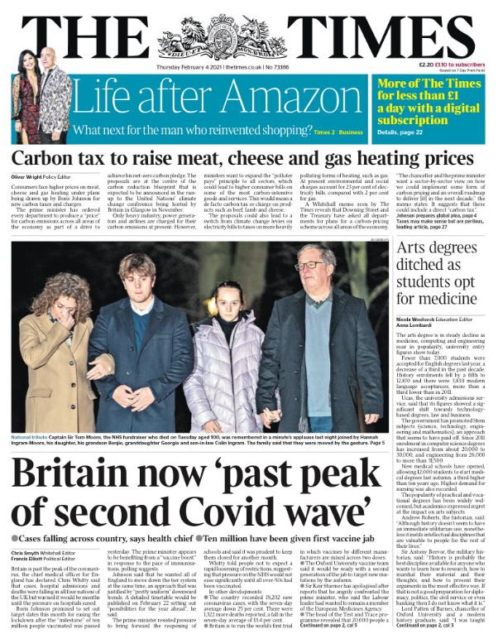
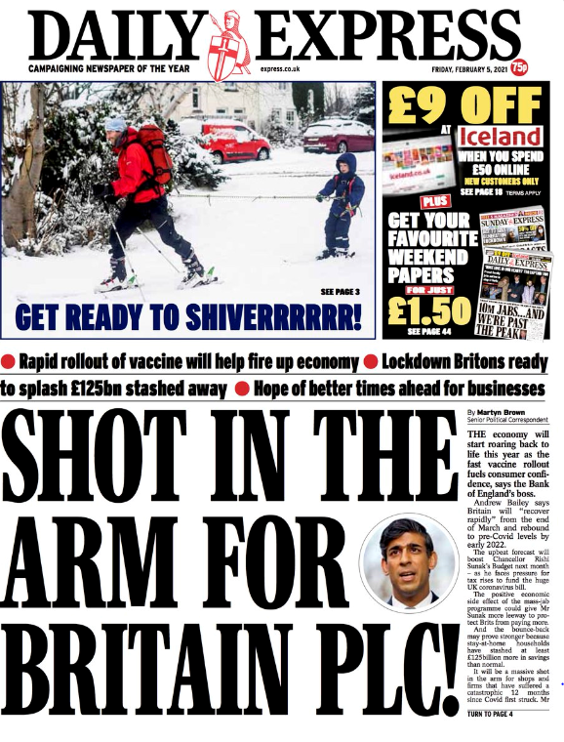
Current Front Pages

Slide 6
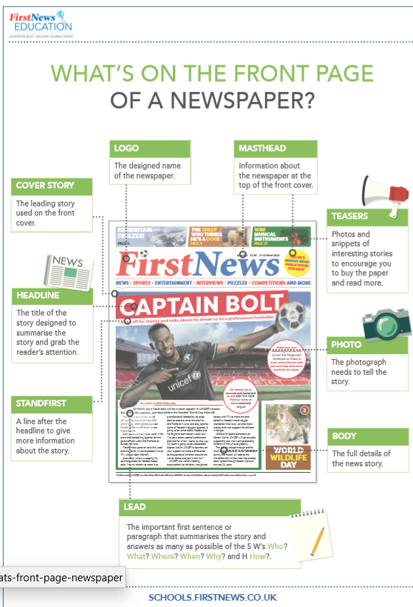
To recap…

Slide 7
Today’s Task:
Year 4: Match the names of parts of the newspaper with their definition. Stick the completed pairs in your books.
Year 5: Using the cards as a reminder, explain the role of the different parts of a newspaper. Can you find any other key features?
Year 6: Describe the different parts of the newspaper and their role. What other key features of this text type can you identify?

Slide 8
Plenary:
Log in to Espresso
Watch the following clip to find out more about the different type of newspapers
https://central.espresso.co.uk/espresso/primary_uk/subject/module/video/item874806/grade2/module858868/index.html
Make note of the different types of newspaper and their style and content in your books – we will discuss this in the next lesson.

