Slide 1
Year 5 Maths 09.02.2021
LO: To convert metric units of measure

Slide 2
Starter
What different units of measure do you know?

Slide 3
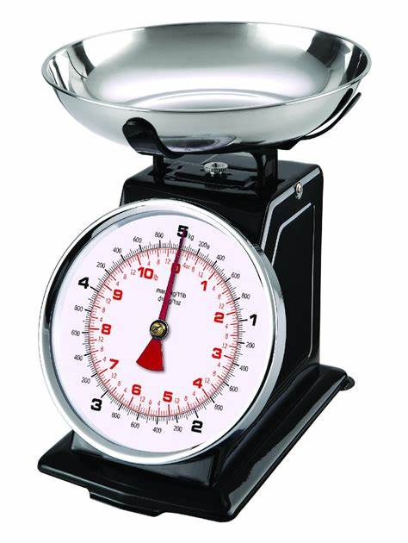
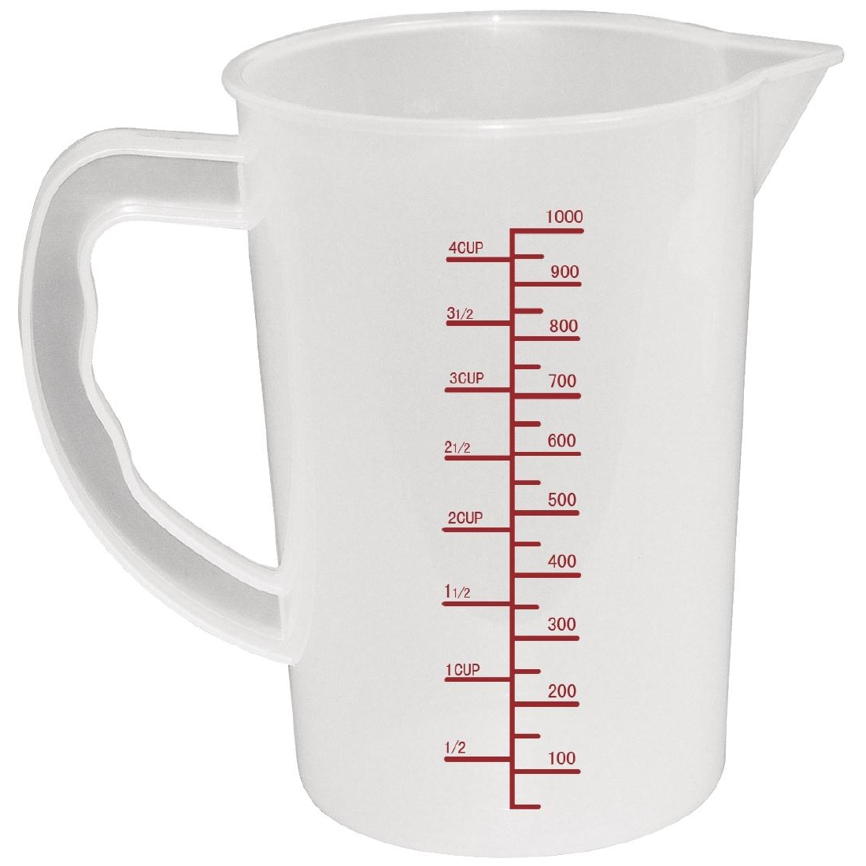
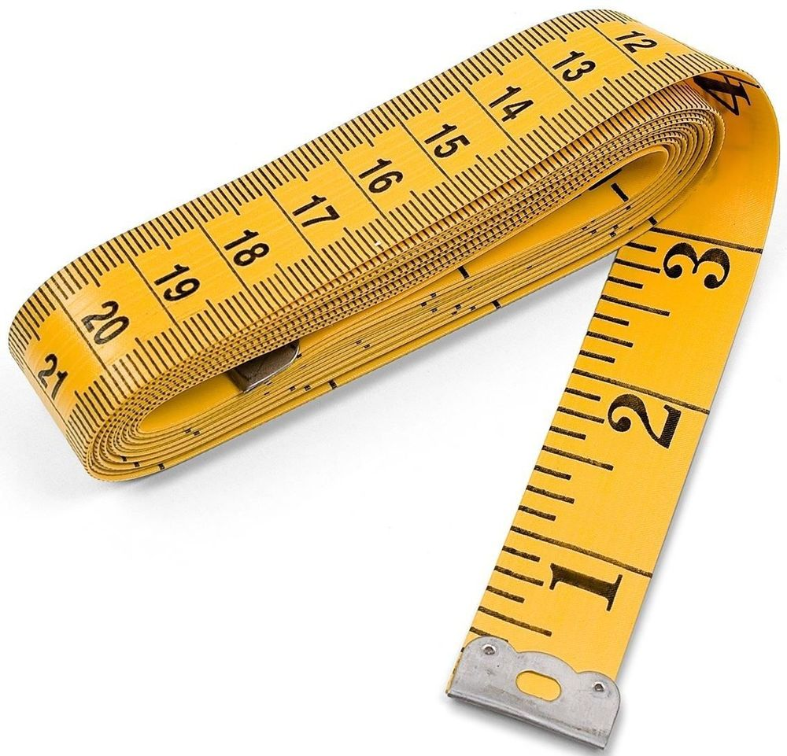
Starter
What different units of measure do you know?

Slide 4
Metric units of measure

Slide 5
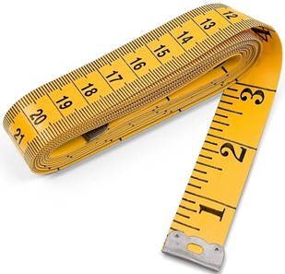
Metric units of measure
length:
mm, cm, m, km

Slide 6

Metric units of measure
length:
mm, cm, m, km
mass:
g, kg

Slide 7

Metric units of measure
length:
mm, cm, m, km
mass:
g, kg
capacity:
ml, l

Slide 8
What would you use to measure…?
A telephone
A mug
A book

Slide 9


What would you use to measure…?
A telephone
A mug
A book

Slide 10

What would you use to measure…?
A telephone
A mug
A book

Slide 11
What would you use to measure…?
A telephone
A mug
A book

Slide 12
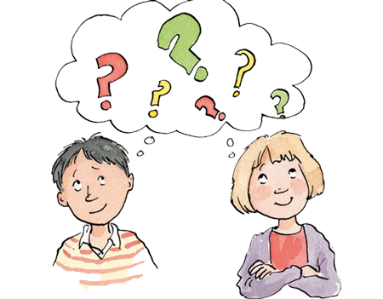
What metric facts do you know?

Slide 13
Length

Slide 14
Length
10mm = 1cm

Slide 15
Length
10mm = 1cm
100cm = 1m

Slide 16
Length
10mm = 1cm
100cm = 1m
1000m = 1km

Slide 17
Mass

Slide 18
Mass
1000g = 1kg

Slide 19
Capacity

Slide 20
Capacity
1000ml = 1l

Slide 22
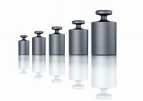
Mass or weight??
The difference between mass and weight is that mass is the amount of matter in a material, while weight is a measure of how the force of gravity acts upon that mass. Mass is the measure of the amount of matter in a body. Mass is denoted using m or M.

