Slide 1
Year 5 Maths 10.02.2021
LO: To convert metric units of measure

Slide 2


Introduction
Sort the lengths into matching pairs.
730cm
360mm
7.3m
3,600m
3.6km
730mm
36cm
73cm
© Classroom Secrets Limited 2018

Slide 3
Introduction
Sort the lengths into matching pairs.
730cm
360mm
7.3m
36cm
3,600m
730mm
3.6km
73cm
© Classroom Secrets Limited 2018

Slide 4
Varied Fluency 1
Write the missing lengths to make these sentences correct.
72,000mm | = | cm | = | m
m | = | 340cm | = | mm
© Classroom Secrets Limited 2018

Slide 5
Varied Fluency 1
Write the missing lengths to make these sentences correct.
72,000mm | = | 7,200cm | = | 72m
3.4m | = | 340cm | = | 3,400mm
© Classroom Secrets Limited 2018

Slide 6
Varied Fluency 2
Match the lengths to their conversions.
81m |  | 6,100mm
6,800cm |  | 68m
610cm |  | 0.081km
© Classroom Secrets Limited 2018

Slide 7
Varied Fluency 2
Match the lengths to their conversions.
81m |  | 6,100mm
6,800cm |  | 68m
610cm |  | 0.081km
© Classroom Secrets Limited 2018

Slide 8
Varied Fluency 3
Put these lengths in order from smallest to greatest.
5.9m |  | 29,500mm |  | 950cm
© Classroom Secrets Limited 2018

Slide 9
Varied Fluency 3
Put these lengths in order from smallest to greatest.
5.9m |  | 950cm |  | 29,500mm
© Classroom Secrets Limited 2018

Slide 10
Varied Fluency 4
Convert all these lengths to metres.
710cm | = | m
0.045km | = | m
4,300cm | = | m
© Classroom Secrets Limited 2018

Slide 11
Varied Fluency 4
Convert all these lengths to metres.
710cm | = | 7.1m
0.045km | = | 45m
4,300cm | = | 43m
© Classroom Secrets Limited 2018

Slide 12
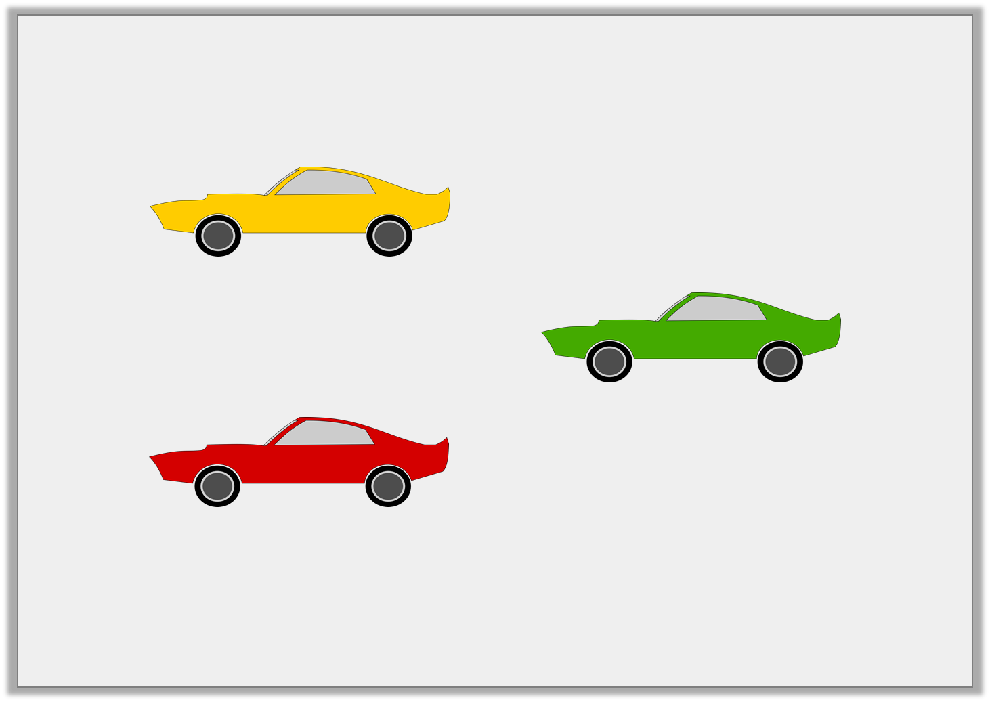
Problem Solving 1
Damon’s garage is 40m long. What combination of cars could he fit inside?
9.5m
600cm
450cm
© Classroom Secrets Limited 2018

Slide 13
Problem Solving 1
Damon’s garage is 40m long. What combination of cars could he fit inside?
Various possible answers where the total equals 40m or less, for example: 2 yellow cars, 2 green cars and 2 red cars = 9.5m + 9.5m + 600cm + 600cm + 450cm + 450cm = 40m
9.5m
600cm
450cm
© Classroom Secrets Limited 2018

Slide 14
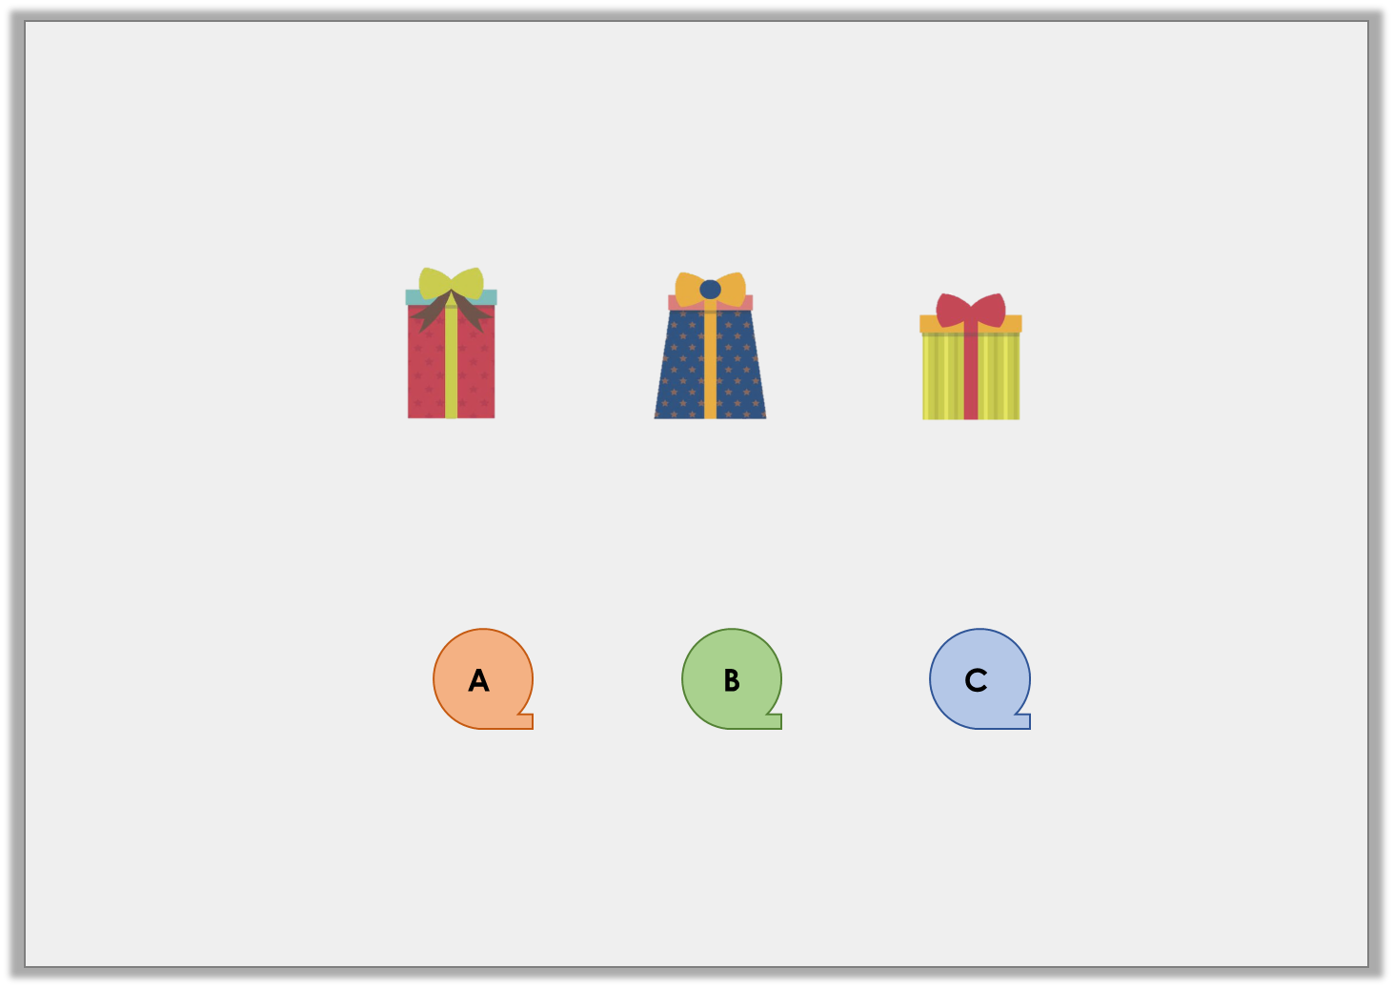
Reasoning 1
Brodie wrapped up three presents. He used the following amount of paper for each present:
Which roll of wrapping paper did he use to wrap all three presents? Prove it.
74cm
290mm
470mm
130cm
140cm
150cm
© Classroom Secrets Limited 2018

Slide 15
Reasoning 1
Brodie wrapped up three presents. He used the following amount of paper for each present:
Which roll of wrapping paper did he use to wrap all three presents? Prove it.
Brodie used roll C because…
74cm
290mm
470mm
130cm
140cm
150cm
© Classroom Secrets Limited 2018

Slide 16
Reasoning 1
Brodie wrapped up three presents. He used the following amount of paper for each present:
Which roll of wrapping paper did he use to wrap all three presents? Prove it.
Brodie used roll C because 290mm = 29cm and 470mm = 47cm. 74cm + 29cm + 47cm = 150cm
74cm
290mm
470mm
130cm
140cm
150cm
© Classroom Secrets Limited 2018

Slide 17
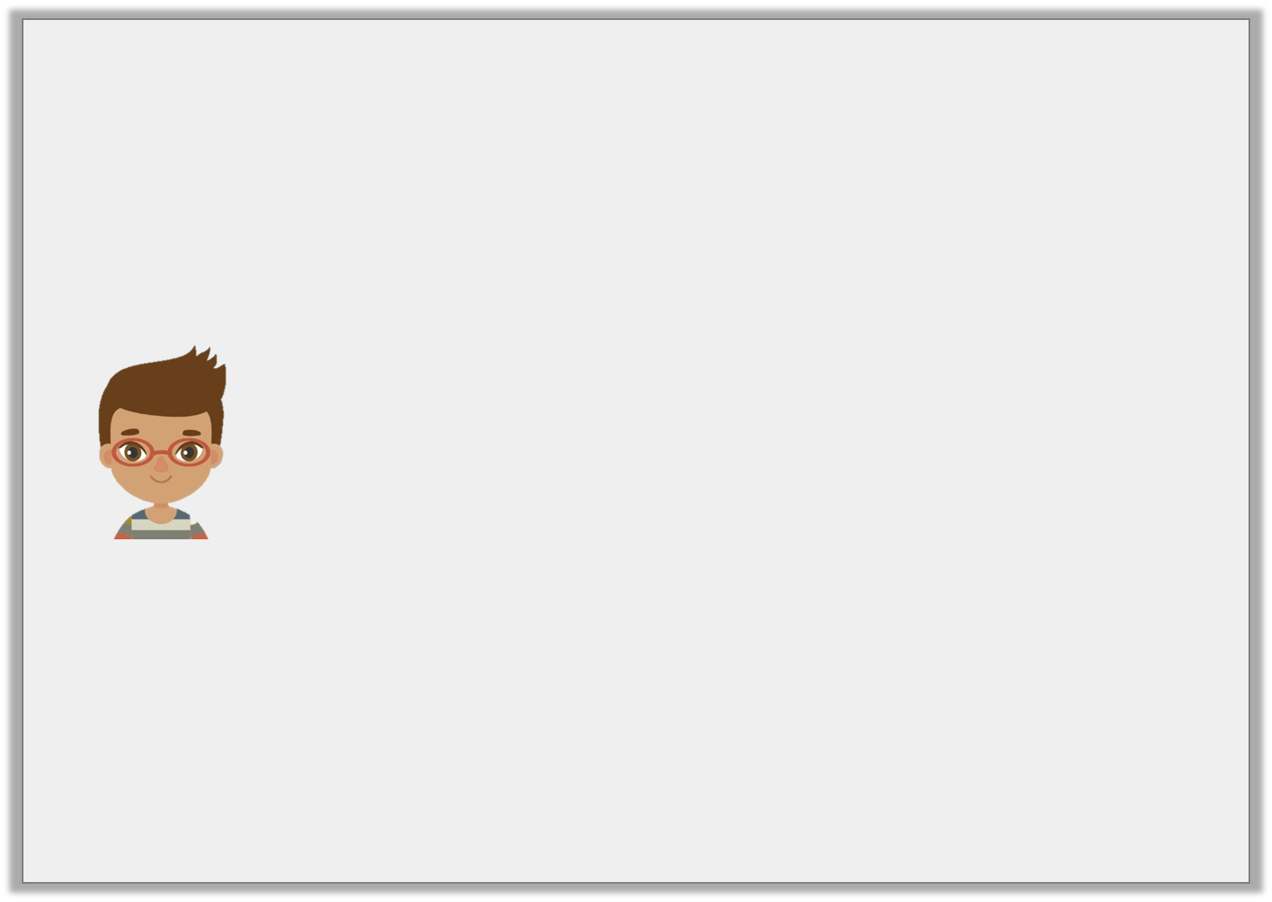
Reasoning 2
Todd is working out how much Christmas garland he will need to decorate the village hall.
He says,
Is he correct? Explain your answer.
I will need 20m of garland.
730cm
village hall
2.7m
2.7m
730cm
© Classroom Secrets Limited 2018

Slide 18
Reasoning 2
Todd is working out how much Christmas garland he will need to decorate the village hall.
He says,
Is he correct? Explain your answer.
Todd is correct because…
I will need 20m of garland.
730cm
village hall
2.7m
2.7m
730cm
© Classroom Secrets Limited 2018

