Slide 1


LO: To understand and complete inverse operation calculations
© Classroom Secrets Limited 2018

Slide 2
Introduction
Kian is thinking of a number.
If he multiplies the number by 8 and divides the answer by 2, he gets 28. What number is he thinking of?
© Classroom Secrets Limited 2018

Slide 3
Introduction
Kian is thinking of a number.
If he multiplies the number by 8 and divides the answer by 2, he gets 28. What number is he thinking of?
28 x 2 = 56
56 ÷ 8 = 7
Kian is thinking of the number 7.
© Classroom Secrets Limited 2018

Slide 4
Varied Fluency 1
Write two number sentences which could be used to check the answer to:
54 ÷ 9 = 6
 | ÷ |  | =
 | x |  | =
© Classroom Secrets Limited 2018

Slide 5
Varied Fluency 1
Write two number sentences which could be used to check the answer to:
54 ÷ 9 = 6
54 | ÷ | 6 | = | 9
6 | x | 9 | = | 54
© Classroom Secrets Limited 2018

Slide 6
Varied Fluency 2
Using the fact 7 x 5 = 35, work out:
A. 35 ÷ 5 = B. 10 x 7 =
© Classroom Secrets Limited 2018

Slide 7
Varied Fluency 2
Using the fact 7 x 5 = 35, work out:
A. 35 ÷ 5 = B. 10 x 7 =
7
70
© Classroom Secrets Limited 2018

Slide 8
Varied Fluency 3
Use the inverse to complete the calculations below.
A. |  | = | 12 | x | 4
B. | 6 | = | 42 | ÷
C. | 60 | = |  | x | 5
© Classroom Secrets Limited 2018

Slide 9
Varied Fluency 3
Use the inverse to complete the calculations below.
A. | 48 | = | 12 | x | 4
B. | 6 | = | 42 | ÷ | 7
C. | 60 | = | 12 | x | 5
© Classroom Secrets Limited 2018

Slide 10
Varied Fluency 4
Match the related facts.
A. | _______ ÷ 3 = 9 | 1.
B. | 36 ÷ 12 | 2. | 11 x 5 = ________
C. | 11 is a factor of 55. | 3. | _______ x 3 = 36
© Classroom Secrets Limited 2018

Slide 11
Varied Fluency 4
Match the related facts.
A = 1, B = 3 and C = 2
A. | _______ ÷ 3 = 9 | 1.
B. | 36 ÷ 12 | 2. | 11 x 5 = ________
C. | 11 is a factor of 55. | 3. | _______ x 3 = 36
© Classroom Secrets Limited 2018

Slide 12
Reasoning 1
Circle the incorrect statement in the fact family shown below.
Explain your reasoning.
48 ÷ 6 = 8
48 = 6 x 8
48 ÷ 8 = 8
8 x 6 = 48
6 x 8 = 48
48 = 8 x 6
© Classroom Secrets Limited 2018

Slide 13
Reasoning 1
Circle the incorrect statement in the fact family shown below.
Explain your reasoning.
48 ÷ 8 = 8 is incorrect because…
48 ÷ 6 = 8
48 = 6 x 8
48 ÷ 8 = 8
8 x 6 = 48
6 x 8 = 48
48 = 8 x 6
© Classroom Secrets Limited 2018

Slide 14
Reasoning 1
Circle the incorrect statement in the fact family shown below.
Explain your reasoning.
48 ÷ 8 = 8 is incorrect because 8 x 8 = 64, not 48.
48 ÷ 6 = 8
48 = 6 x 8
48 ÷ 8 = 8
8 x 6 = 48
6 x 8 = 48
48 = 8 x 6
© Classroom Secrets Limited 2018

Slide 15
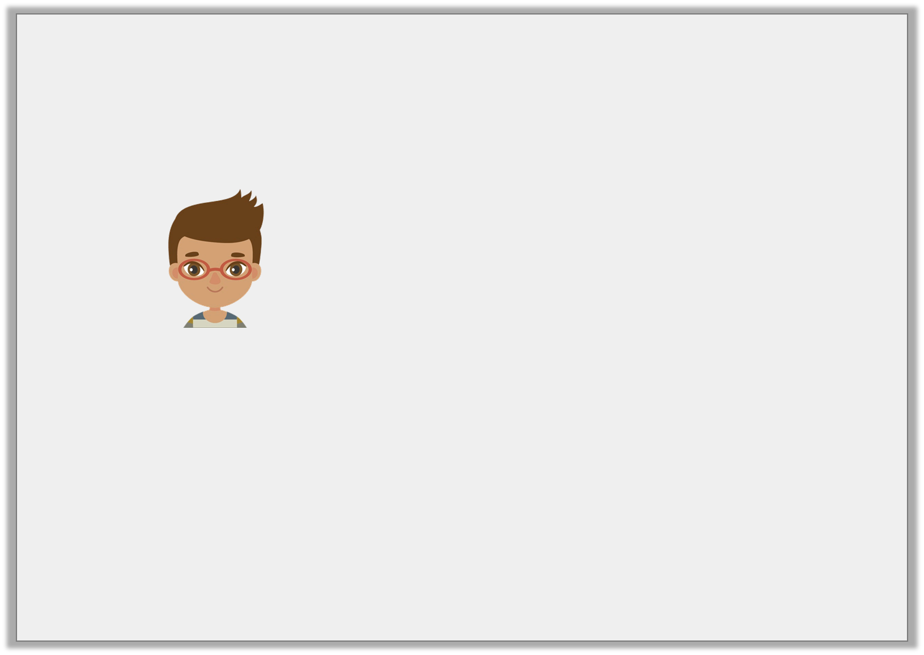
Reasoning 2
Jude says,
Is Jude correct? Explain how you know.
I know that 27 ÷ 3 = 9, so I also know that 9 ÷ 3 = 27.
© Classroom Secrets Limited 2018

Slide 16
Reasoning 2
Jude says,
Is Jude correct? Explain how you know.
Jude is incorrect because...
I know that 27 ÷ 3 = 9, so I also know that 9 ÷ 3 = 27.
© Classroom Secrets Limited 2018

Slide 17
Reasoning 2
Jude says,
Is Jude correct? Explain how you know.
Jude is incorrect because 9 ÷ 3 = 3. 9 x 3 = 27.
I know that 27 ÷ 3 = 9, so I also know that 9 ÷ 3 = 27.
© Classroom Secrets Limited 2018

Slide 18
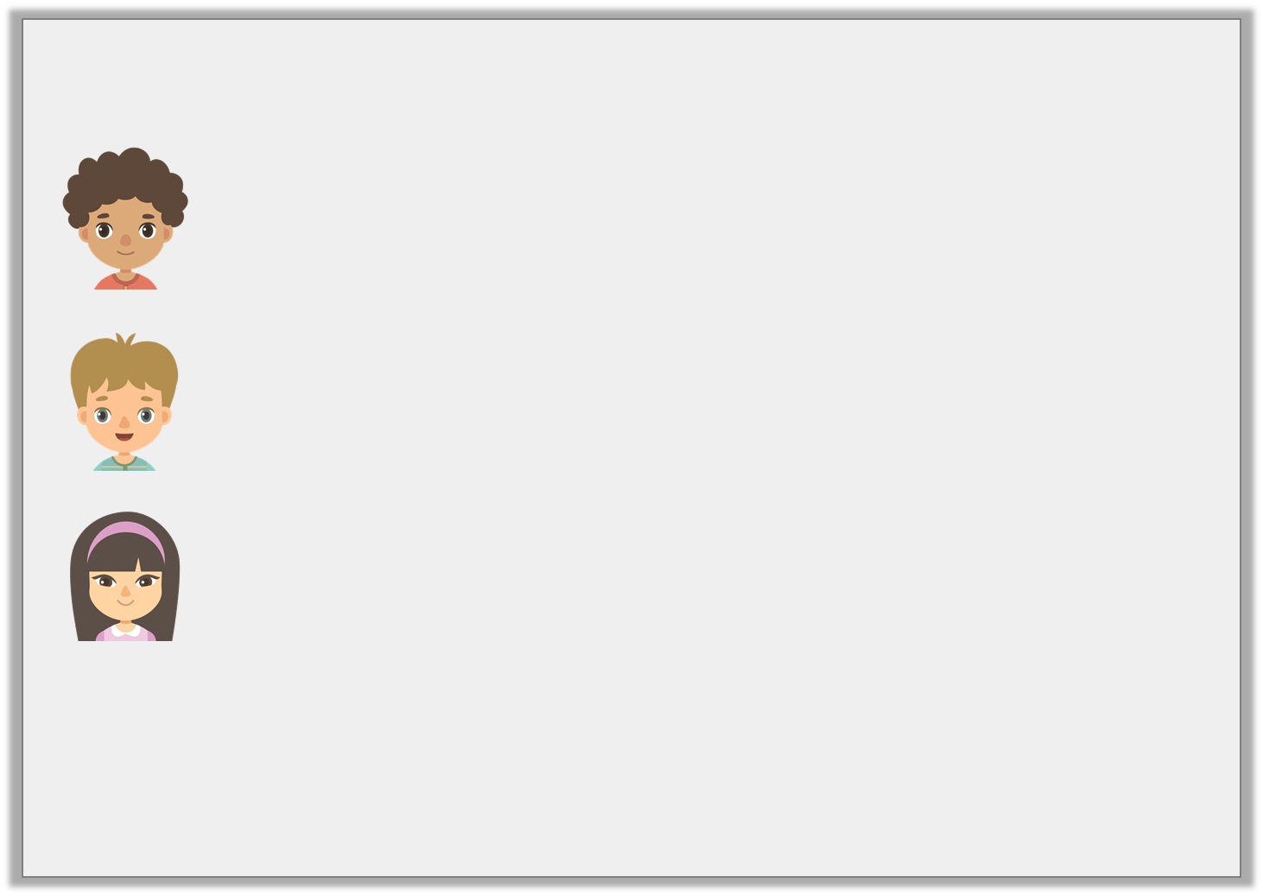
Problem Solving 1
Match each child to the numbers below.
When I divide my number into 9 equal parts, I get 7.
Gabriel
One of my factors is 12. My product is 48.
Jamie
When I multiply my number by 7, the product is 84.
Rosie
12 | 63 | 4
© Classroom Secrets Limited 2018

Slide 19
Problem Solving 1
Match each child to the numbers below.
Gabriel = 63, Jamie = 4 and Rosie = 12
When I divide my number into 9 equal parts, I get 7.
Gabriel
One of my factors is 12. My product is 48.
Jamie
When I multiply my number by 7, the product is 84.
Rosie
12 | 63 | 4
© Classroom Secrets Limited 2018

