Slide 1


Year 5 – Autumn Block 1 – Place Value
Step 8: Counting in Powers of 10
© Classroom Secrets Limited 2018

Slide 2
Introduction
Complete each sequence.
240
+10
4,200
+100
34,500
+1,000
980
– 10
© Classroom Secrets Limited 2018

Slide 3
Introduction
Complete each sequence.
240
250
260
270
280
+10
4,200
4,300
4,400
4,500
4,600
+100
34,500
35,500
36,500
37,500
38,500
+1,000
980
970
960
950
940
– 10
© Classroom Secrets Limited 2018

Slide 4
Varied Fluency 1
Starting at 993,456, count backwards through the maze to reach 977,456.
993,456 | 983,456 | 987,456 | 986,456 | 985,456
992,456 | 982,456 | 988,456 | 979,456 | 978,456
991,456 | 990,456 | 989,456 | 980,456 | 977,456
990,456 | 985,456 | 984,456 | 981,456 | 922,456
989,456 | 986,456 | 983,456 | 982,456 | 932,456
988,456 | 987,456 | 982,456 | 981,456 | 991,456
© Classroom Secrets Limited 2018

Slide 5
Varied Fluency 1
Starting at 993,456, count backwards through the maze to reach 977,456.
993,456 | 983,456 | 987,456 | 986,456 | 985,456
992,456 | 982,456 | 988,456 | 979,456 | 978,456
991,456 | 990,456 | 989,456 | 980,456 | 977,456
990,456 | 985,456 | 984,456 | 981,456 | 922,456
989,456 | 986,456 | 983,456 | 982,456 | 932,456
988,456 | 987,456 | 982,456 | 981,456 | 991,456
© Classroom Secrets Limited 2018

Slide 6

Varied Fluency 2
Archie is counting backwards.
Find and correct any mistakes.
345,678
445,678
455,678
655,678
755,678
855,678
© Classroom Secrets Limited 2018

Slide 7
Varied Fluency 2
Archie is counting backwards.
Find and correct any mistakes.
Archie began counting in 100,000s then switched to counting in 10,000s for the third number, returning to count in 100,000s.
To continue counting in 100,000s he should have counted 445,678; 545,678; 645,678; 745,678; 845,678
345,678
445,678
455,678
655,678
755,678
855,678
© Classroom Secrets Limited 2018

Slide 8
Varied Fluency 3
Put the numbers in ascending order and identify the power of 10 they have increased by.
78,345
78,445
78,145
78,245
© Classroom Secrets Limited 2018

Slide 9
Varied Fluency 3
Put the numbers in ascending order and identify the power of 10 they have increased by.
78,145; 78,245; 78,345; 78,445;
They have increased by 100.
78,345
78,445
78,145
78,245
© Classroom Secrets Limited 2018

Slide 10
Varied Fluency 4
What rule does this function machine follow?
Find the next 3 terms in this sequence.
3,964 |  | 2,964
?
© Classroom Secrets Limited 2018

Slide 11
Varied Fluency 4
What rule does this function machine follow? – 1,000
Find the next 3 terms in this sequence.
1,964; 964; -36
3,964 |  | 2,964
?
© Classroom Secrets Limited 2018

Slide 12
Problem Solving 1
Here are 3 numbers of a sequence:
1,764; 11,764; 21,764; 31,764
Use the digit cards to create a number which will be in this sequence.
4
1
7
3
6
5
© Classroom Secrets Limited 2018

Slide 13
Problem Solving 1
Here are 3 numbers of a sequence:
1,764; 11,764; 21,764; 31,764
Use the digit cards to create a number which will be in this sequence.
Various answers, for example: 41,764; 51,764; 341,764; 541,764 (any number ending in 1,764).
4
1
7
3
6
5
© Classroom Secrets Limited 2018

Slide 14
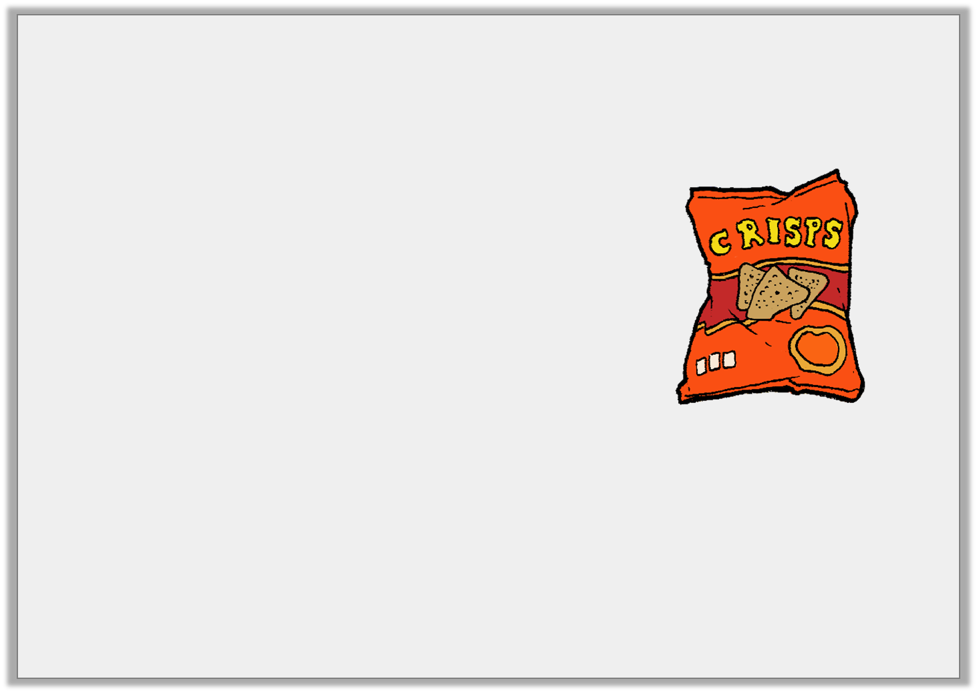
Problem Solving 2
A supermarket is ordering boxes of crisps. Each of the boxes holds 1,000 packets of sharing packs.
They have 16,009 packets of crisps but they
need 35,000 to replenish their stocks.
How many boxes should they order?
If they ordered 20 boxes, how many packets would they have?
© Classroom Secrets Limited 2018

Slide 15
Problem Solving 2
A supermarket is ordering boxes of crisps. Each of the boxes holds 1,000 packets of sharing packs.
They have 16,009 packets of crisps but they
need 35,000 to replenish their stocks.
How many boxes should they order?
19 boxes: 19 x 1,000 = 19,000; 19,000 + 16,009 = 35,009
If they ordered 20 boxes, how many packets would they have?
36,009
© Classroom Secrets Limited 2018

Slide 16
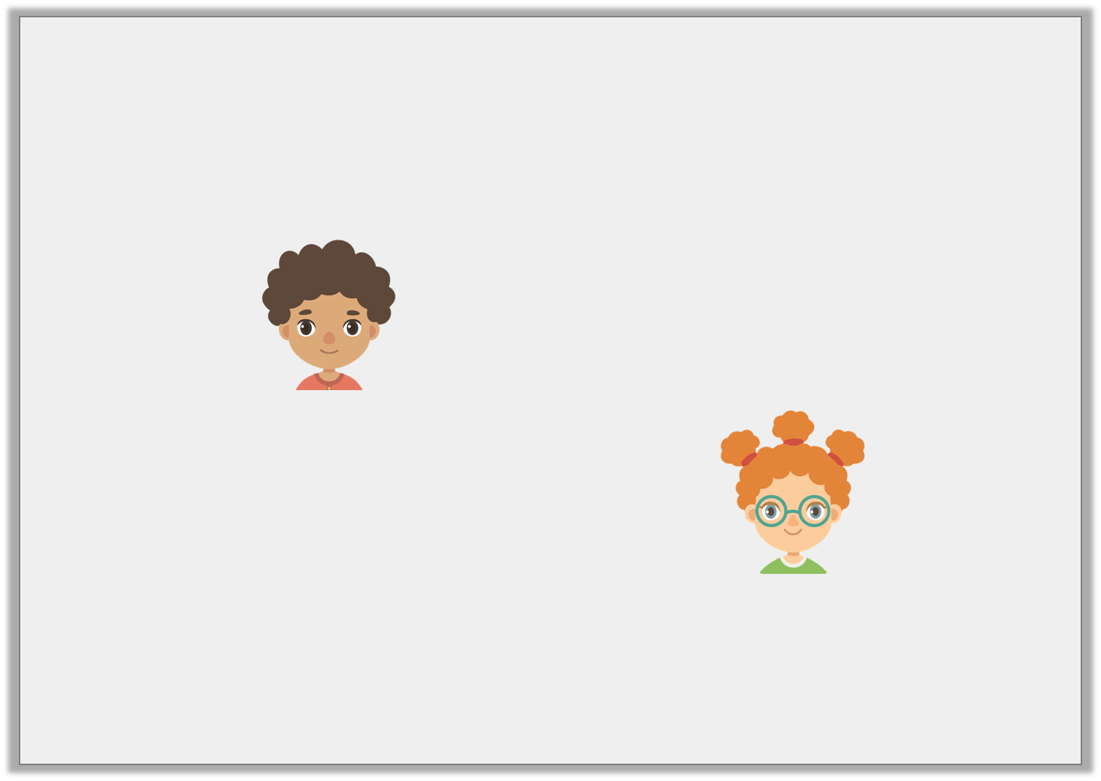
Reasoning 1
The children are discussing this sequence:
87,034; 86,034; 85,034; 84,034
Who is correct? Explain your answer.
The number 134 will be in this sequence.
Errol
There will be no hundreds in this number sequence.
Saffie
© Classroom Secrets Limited 2018

Slide 17
Reasoning 1
The children are discussing this sequence:
87,034; 86,034; 85,034; 84,034
Who is correct? Explain your answer.
Saffie is correct because…
The number 134 will be in this sequence.
Errol
There will be no hundreds in this number sequence.
Saffie
© Classroom Secrets Limited 2018

Slide 18
Reasoning 1
The children are discussing this sequence:
87,034; 86,034; 85,034; 84,034
Who is correct? Explain your answer.
Saffie is correct because the numbers are decreasing by 1,000 so only numbers in the 1,000s or above will change. (Correct for positive integers).
The number 134 will be in this sequence.
Errol
There will be no hundreds in this number sequence.
Saffie
© Classroom Secrets Limited 2018

