Slide 1
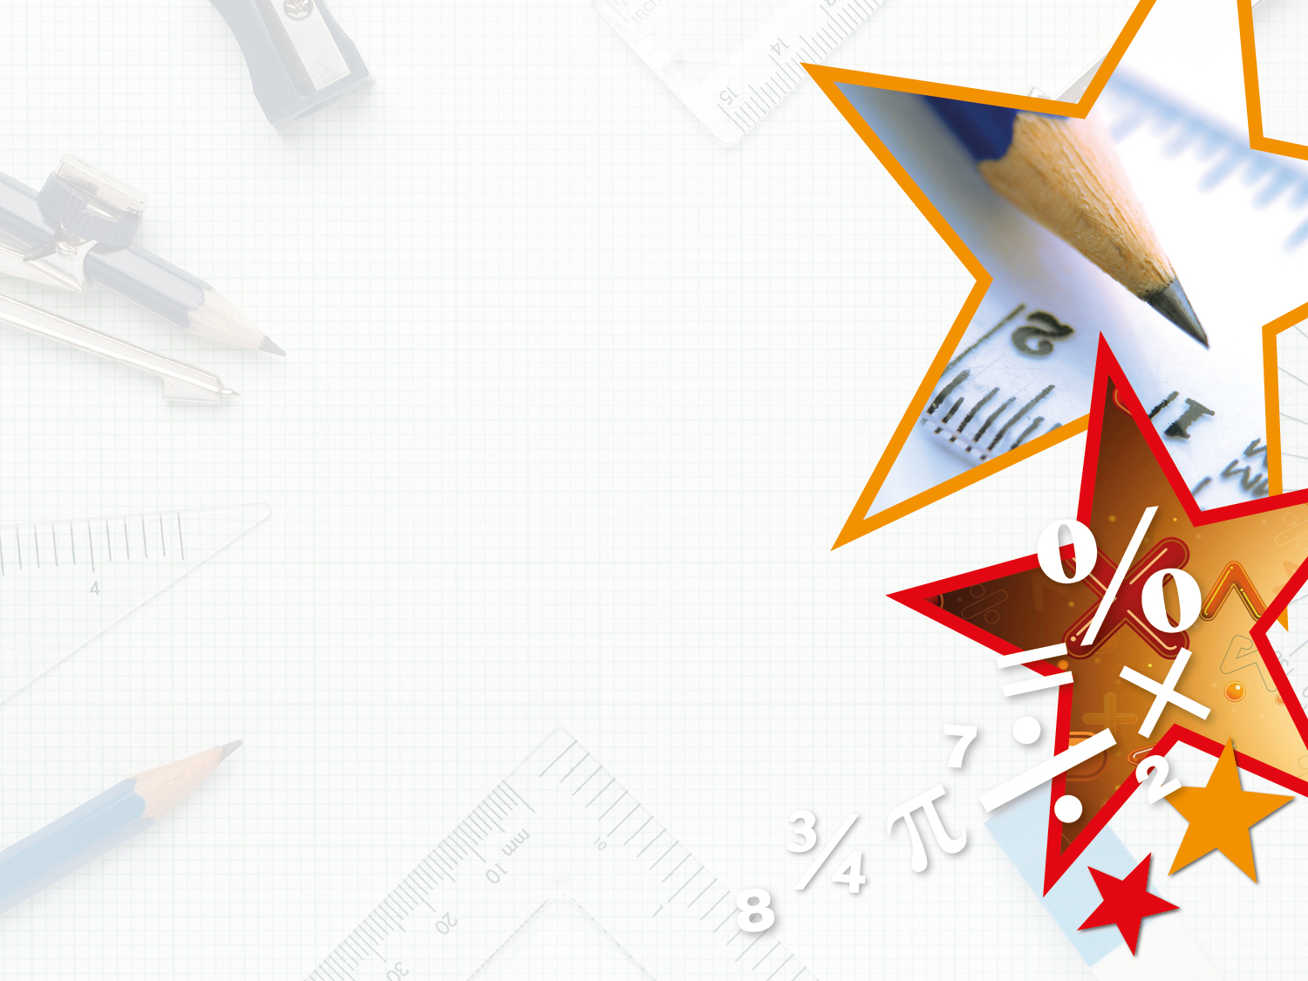

Year 5 – Autumn Block 1 – Place Value
Step 7: Numbers to a Million
© Classroom Secrets Limited 2018

Slide 2
Introduction
True or false? Explain your answer.
Any number starting with a 9, is larger than any other number.
© Classroom Secrets Limited 2018

Slide 3
Introduction
True or false? Explain your answer.
Any number starting with a 9, is larger than any other number.
False. This is false as although 9 is the largest digit, it depends on how many digits are in each number. For example, 999 is smaller than 2,510. This is because the first ‘9’ in 999 is only worth 900, whereas the ‘2’ in 2,510 is worth 2,000.
© Classroom Secrets Limited 2018

Slide 4
Varied Fluency 1
What is the value of the digit 6 in this number? Write you answer in words.
965,173
© Classroom Secrets Limited 2018

Slide 5
Varied Fluency 1
What is the value of the digit 6 in this number? Write you answer in words.
965,173
sixty thousand
© Classroom Secrets Limited 2018

Slide 6
Varied Fluency 2
Write the number below in numerals.
eight hundred and ninety one thousand, three hundred and eleven
© Classroom Secrets Limited 2018

Slide 7
Varied Fluency 2
Write the number below in numerals.
eight hundred and ninety one thousand, three hundred and eleven
891,311
© Classroom Secrets Limited 2018

Slide 8
Varied Fluency 3
Complete the place value chart for the number 703,998.
100,000s | 10,000s | 1,000s | 100s | 10s | 1s
© Classroom Secrets Limited 2018

Slide 9
Varied Fluency 3
Complete the place value chart for the number 703,998.
100,000s | 10,000s | 1,000s | 100s | 10s | 1s
© Classroom Secrets Limited 2018

Slide 10
Varied Fluency 4
Complete the bar model.
816,537
800,000 |  | 500 | 37
© Classroom Secrets Limited 2018

Slide 11
Varied Fluency 4
Complete the bar model.
816,537
800,000 | 16,000 | 500 | 37
© Classroom Secrets Limited 2018

Slide 12
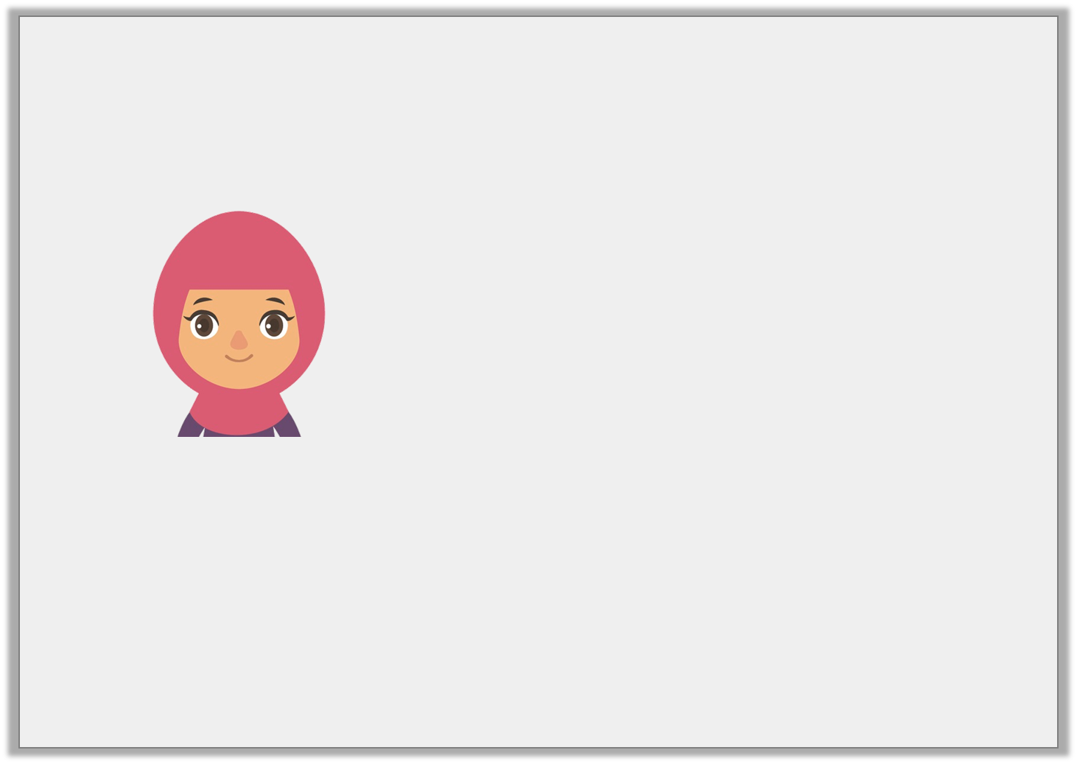
Reasoning 1
Sumaiya is reading the number 908,638.
Is she correct? Explain your answer.
nine hundred and eighty thousand, six hundred and thirty- eight
© Classroom Secrets Limited 2018

Slide 13
Reasoning 1
Sumaiya is reading the number 908,638.
Is she correct? Explain your answer.
Sumaiya is not correct because…
nine hundred and eighty thousand, six hundred and thirty- eight
© Classroom Secrets Limited 2018

Slide 14
Reasoning 1
Sumaiya is reading the number 908,638.
Is she correct? Explain your answer.
Sumaiya is not correct because she has mixed up the ten thousands and thousands column digits. She should have read it as ‘nine hundred and eight thousand, six hundred and thirty-eight’.
nine hundred and eighty thousand, six hundred and thirty- eight
© Classroom Secrets Limited 2018

Slide 15
Problem Solving 1
Complete the part whole model.
Find more than one way. Write your answer in words.
five hundred and twenty-six thousand, four hundred and seven
© Classroom Secrets Limited 2018

Slide 16
Problem Solving 1
Complete the part whole model.
Find more than one way. Write your answer in words.
five hundred and six thousand
five hundred and twenty-six thousand, four hundred and seven
twenty thousand, four hundred and seven
© Classroom Secrets Limited 2018

Slide 17
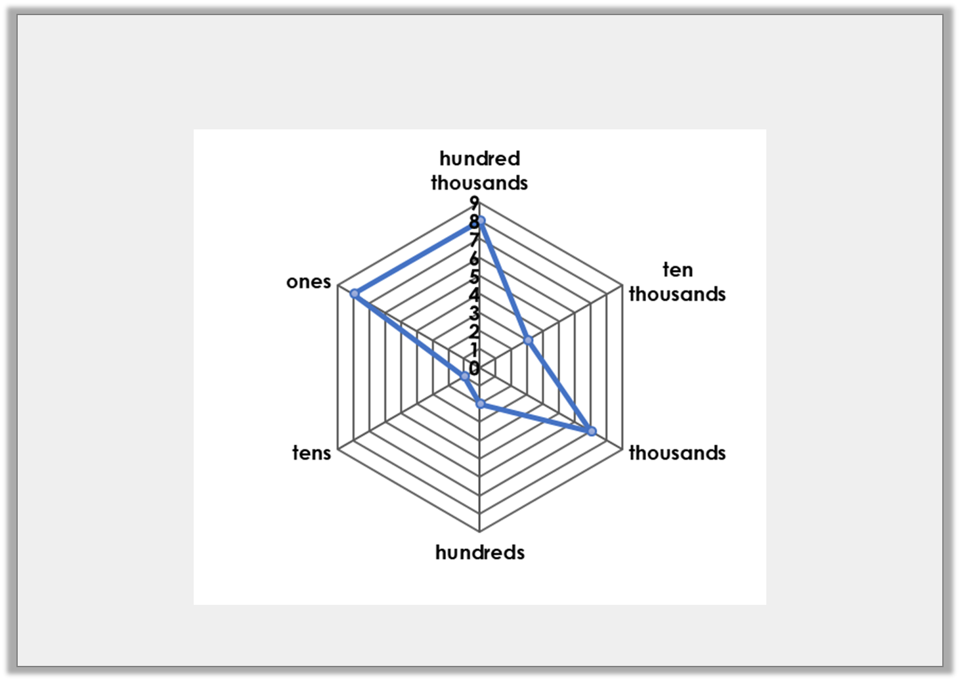
Problem Solving 2
Does the radar chart represent the number 925,218? If not, correct it.
© Classroom Secrets Limited 2018

Slide 18
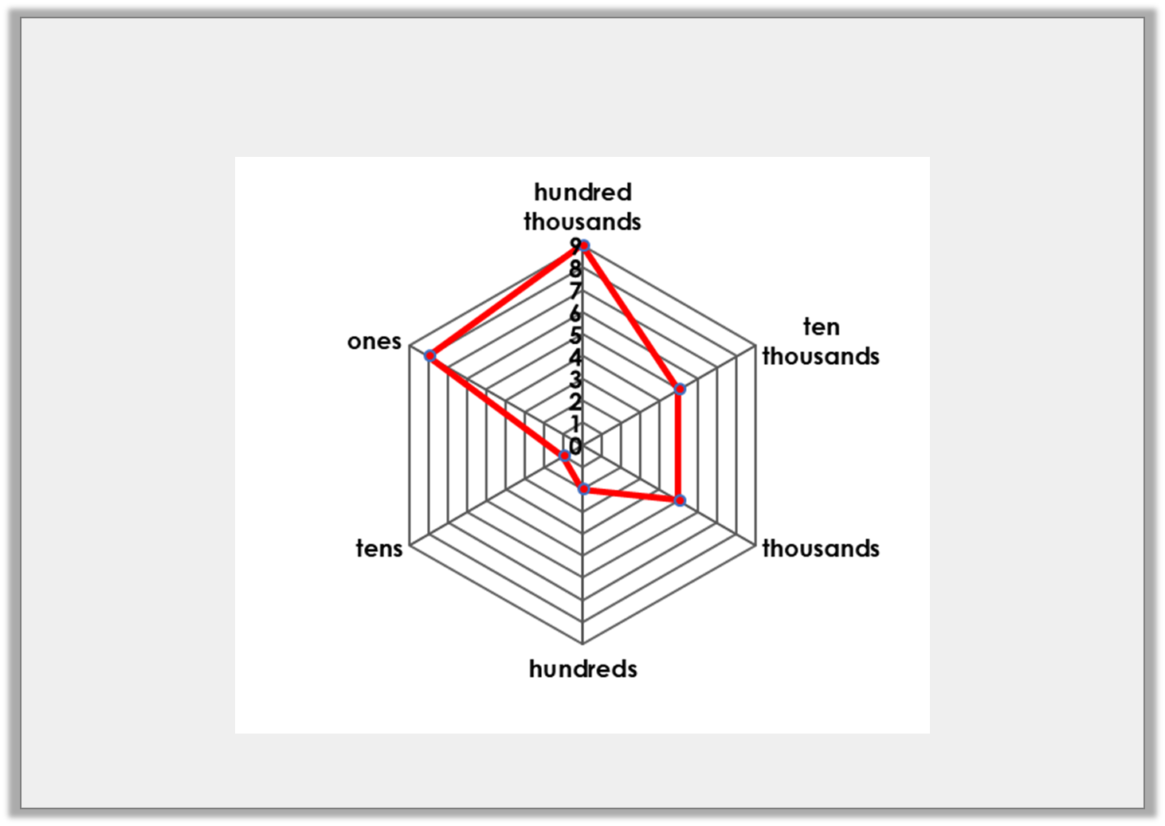
Problem Solving 2
Does the radar chart represent the number 925,218? If not, correct it.
No:
© Classroom Secrets Limited 2018

