Slide 1


Year 5 – Autumn Block 1 – Place Value – Compare and Order to a Million
About This Resource:
This PowerPoint has been designed to support your teaching of this small step. It includes a starter activity and an example of each question from the Varied Fluency and Reasoning and Problem Solving resources also provided in this pack. You can choose to work through all examples provided or a selection of them depending on the needs of your class.
National Curriculum Objectives:
Mathematics Year 5: (5N2) Read, write, order and compare numbers to at least 1,000,000
More resources which follow the same small steps as White Rose.
Did you like this resource? Don’t forget to review it on our website.
© Classroom Secrets Limited 2018

Slide 2
Year 5 – Autumn Block 1 – Place Value
Step 9: Compare and Order to a Million
© Classroom Secrets Limited 2018

Slide 3
Introduction
Use these digit cards to make the number with the greatest value.
Use these digit cards to make the number with the smallest value.
What is the value of 8 in each number?
6
8
9
1
4
3
© Classroom Secrets Limited 2018

Slide 4
Introduction
Use these digit cards to make the number with the greatest value.
Use these digit cards to make the number with the smallest value.
What is the value of 8 in each number?
6
8
9
1
4
3
986,431
134,689
8 ten thousands (80,000) and 8 tens (80)
© Classroom Secrets Limited 2018

Slide 5
Varied Fluency 1
Complete the statements using <, > or = to make them correct.
103,440 |  | 130,400
135,560 |  | 153,506
354,550 |  | 354,055
© Classroom Secrets Limited 2018

Slide 6
Varied Fluency 1
Complete the statements using <, > or = to make them correct.
103,440 | < | 130,400
135,560 | < | 153,506
354,550 | > | 354,055
© Classroom Secrets Limited 2018

Slide 7
Varied Fluency 2
Order the numbers from smallest to largest.
a. 902,346 |  | d. 920,546
b. 902,436 |  | e. 902,634
c. 920,643 |  | f. 920,463
© Classroom Secrets Limited 2018

Slide 8
Varied Fluency 2
Order the numbers from smallest to largest.
a, b, e, f, d, c
a. 902,346 |  | d. 920,546
b. 902,436 |  | e. 902,634
c. 920,643 |  | f. 920,463
© Classroom Secrets Limited 2018

Slide 9
Varied Fluency 3
Order the numbers from largest to smallest.
a.
b.
c.
100,000s | 10,000s | 1,000s | 100s | 10s | 1s
232,760
Two hundred and forty-one thousand and fifteen
© Classroom Secrets Limited 2018

Slide 10
Varied Fluency 3
Order the numbers from largest to smallest.
a.
b.
c.
a, c, b
100,000s | 10,000s | 1,000s | 100s | 10s | 1s
241,202
232,760
231,760
Two hundred and forty-one thousand and fifteen
241,015
© Classroom Secrets Limited 2018

Slide 11
Varied Fluency 4
The table shows the attendance at football matches last weekend. Write <, > or = to make the statement correct.
The attendance at Sheffield United FC was than the attendance at Leicester City FC.
Sheffield United FC | 23,445
Leicester City FC | 35,665
Aston Villa FC | 29,898
© Classroom Secrets Limited 2018

Slide 12
Varied Fluency 4
The table shows the attendance at football matches last weekend. Write <, > or = to make the statement correct.
The attendance at Sheffield United FC was than the attendance at Leicester City FC.
Sheffield United FC | 23,445
Leicester City FC | 35,665
Aston Villa FC | 29,898
<
© Classroom Secrets Limited 2018

Slide 13
Reasoning 1
True or false? Give reasons for your answer.
five hundred and twenty-six thousand, two hundred and fifty-one
 | < | 562,215
© Classroom Secrets Limited 2018

Slide 14
Reasoning 1
True or false? Give reasons for your answer.
True, it is less than…
five hundred and twenty-six thousand, two hundred and fifty-one
 | < | 562,215
© Classroom Secrets Limited 2018

Slide 15
Reasoning 1
True or false? Give reasons for your answer.
True, it is less than. The digit in the hundred thousands column is the same so we look at the digit in the next column and 6 is greater than 2.
five hundred and twenty-six thousand, two hundred and fifty-one
 | < | 562,215
© Classroom Secrets Limited 2018

Slide 16
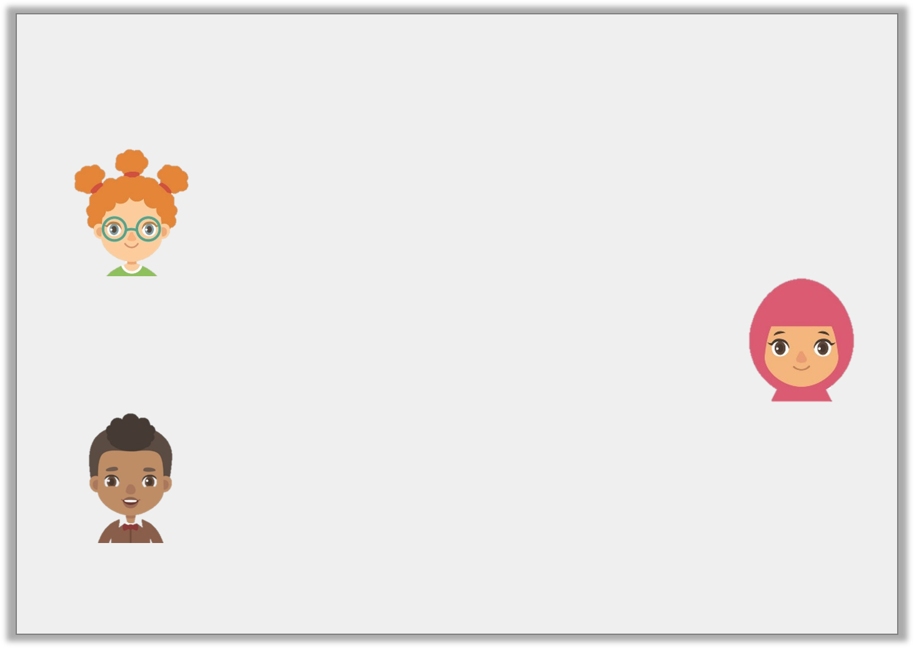
Problem Solving 1
Work out which child has the number card according to their statements.
742,039
My number has 7 hundreds and rounds to 740,000.
Lynn
My number has 9 ones and is less than 740,000.
Aleeza
My number rounds to 740,000 and has 0 hundreds.
Tyler
© Classroom Secrets Limited 2018

Slide 17
Problem Solving 1
Work out which child has the number card according to their statements.
Tyler
742,039
My number has 7 hundreds and rounds to 740,000.
Lynn
My number has 9 ones and is less than 740,000.
Aleeza
My number rounds to 740,000 and has 0 hundreds.
Tyler
© Classroom Secrets Limited 2018

Slide 18
Problem Solving 2
Use the digit cards to make the statement correct.
Is there more than one possible solution?
1
3
2
78 ___ ,20 ___ > 782,201
© Classroom Secrets Limited 2018

Slide 19
Problem Solving 2
Use the digit cards to make the statement correct.
Is there more than one possible solution?
Three solutions: 782,203, 783,201, 783,202
1
3
2
78 ___ ,20 ___ > 782,201
© Classroom Secrets Limited 2018

