Slide 1
Year 5 Maths 25.01.2021
LO: To write fractions and decimals as percentages

Slide 2

Starter
What do fractions, decimals and percentages have in common?

Slide 3

They all show parts of a whole number of amount.

Slide 4
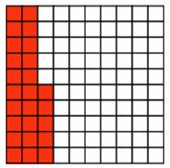
What does this image mean?

Slide 5
What does this image mean?
25 squares out of 100 have been coloured

Slide 6
What does this image mean?
25 squares out of 100 have been coloured
25/100

Slide 7
What does this image mean?
25 squares out of 100 have been coloured
25/100 = 1/4

Slide 8
What does this image mean?
25 squares out of 100 have been coloured
25/100 = 1/4
0.25

Slide 9
What does this image mean?
25 squares out of 100 have been coloured
25/100 = 1/4
0.25
25%

Slide 10
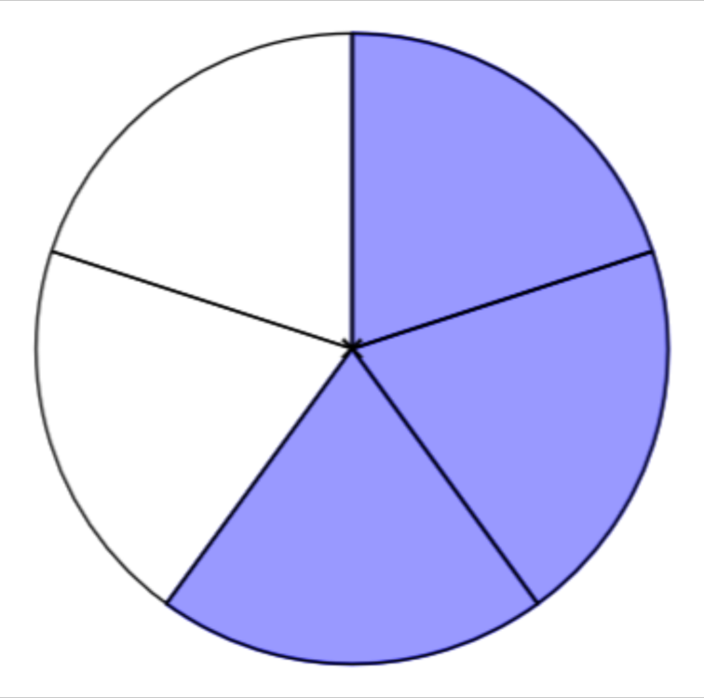
What does this image mean?

Slide 11
What does this image mean?
3 sections of 5 coloured

Slide 12
What does this image mean?
3 sections of 5 coloured
3/5

Slide 13
What does this image mean?
3 sections of 5 coloured
3/5 = 6/10

Slide 14
What does this image mean?
3 sections of 5 coloured
3/5 = 6/10
0.6

Slide 15
What does this image mean?
3 sections of 5 coloured
3/5 = 6/10
0.6
60%

