Slide 1
Year 5 Maths 28.01.2021
LO: To consolidate understanding of fractions, decimals and percentages (problem solving)

Slide 2
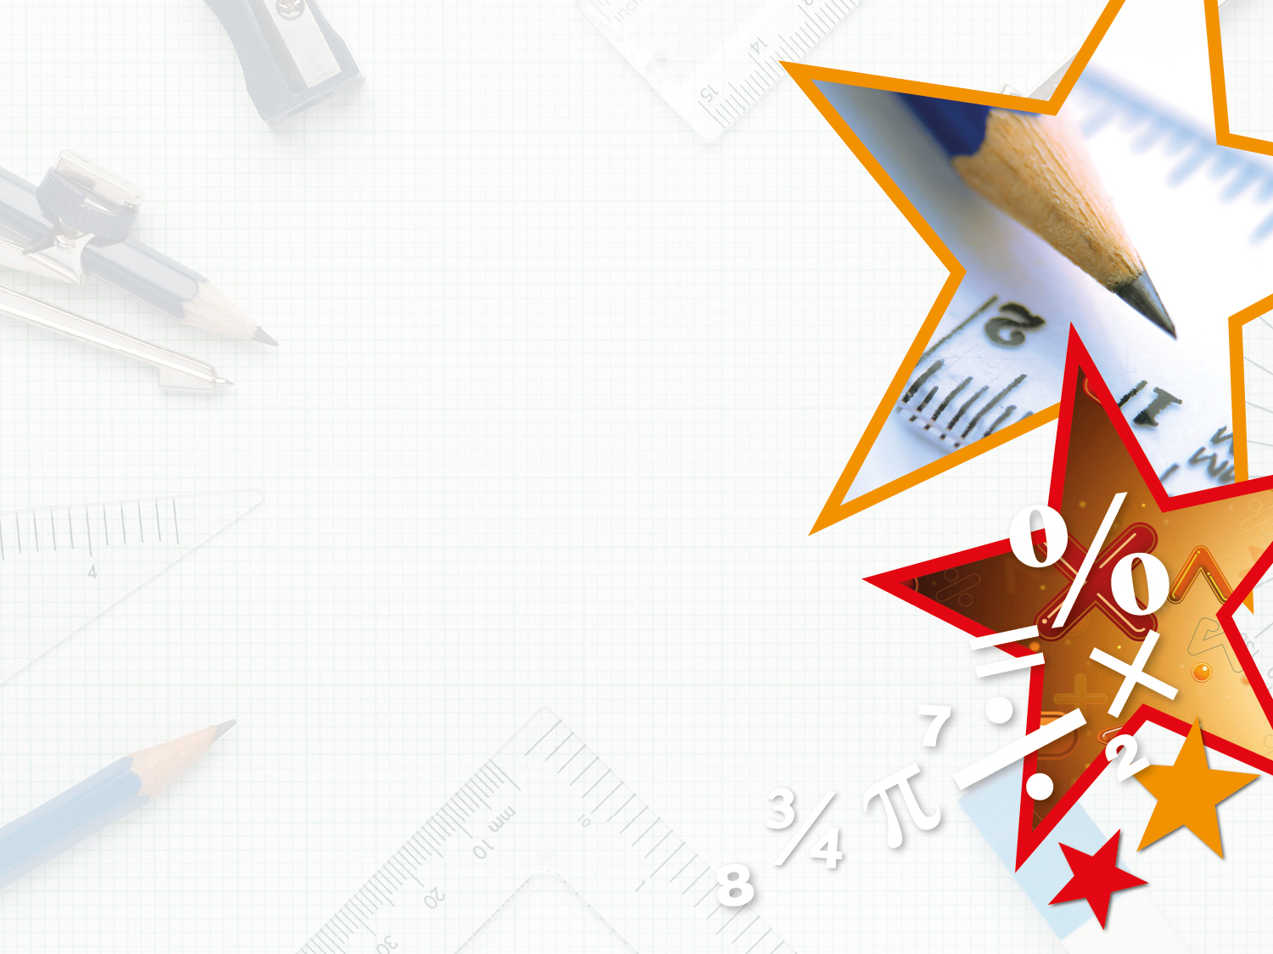

Introduction
Match the statement to the correct percentage.
Violet scored eighty-two out of one hundred on a recent maths test.
60%
Dante scored six out of ten on a recent spelling test.
82%
Genevieve scored forty out of fifty on a recent music exam.
80%
© Classroom Secrets Limited 2018

Slide 3
Introduction
Match the statement to the correct percentage.
Violet scored eighty-two out of one hundred on a recent maths test.
60%
Dante scored six out of ten on a recent spelling test.
82%
Genevieve scored forty out of fifty on a recent music exam.
80%
© Classroom Secrets Limited 2018

Slide 4
Varied Fluency 1
Match the fractions to the equivalent decimal and percentage.
A.
0.54
19%
62
100
B.
0.19
54%
54
100
C.
0.62
62%
38
200
© Classroom Secrets Limited 2018

Slide 5
Varied Fluency 1
Match the fractions to the equivalent decimal and percentage.
A.
0.54
19%
62
100
B.
0.19
54%
54
100
C.
0.62
62%
38
200
© Classroom Secrets Limited 2018

Slide 6
Varied Fluency 2
Circle the odd one out.
25%
0.1
0.1
0.01
0.01
0.01
0.01
0.01
25
200
0.25
© Classroom Secrets Limited 2018

Slide 7
Varied Fluency 2
Circle the odd one out.
25%
0.1
0.1
0.01
0.01
0.01
0.01
0.01
25
200
0.25
© Classroom Secrets Limited 2018

Slide 8
Varied Fluency 3
True or false?
68% is equivalent to 0.68
© Classroom Secrets Limited 2018

Slide 9
Varied Fluency 3
True or false?
True
68% is equivalent to 0.68
© Classroom Secrets Limited 2018

Slide 10
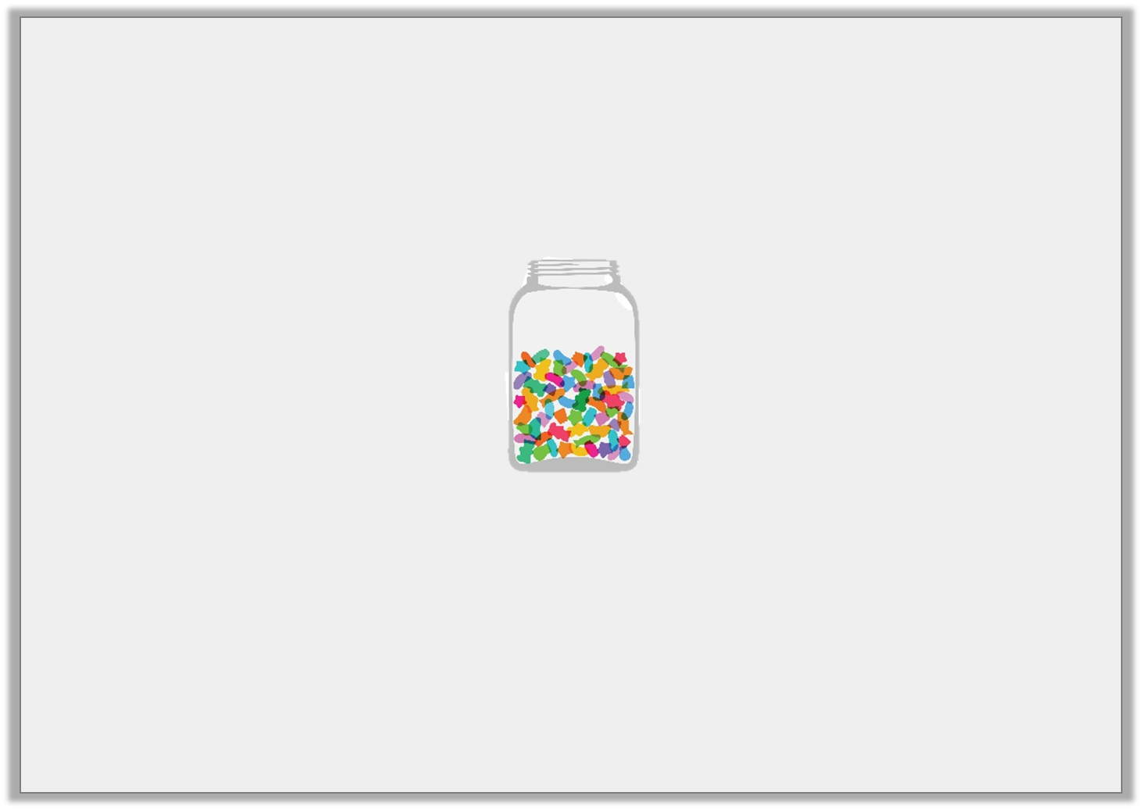
Problem Solving 1
There are 200 sweets in a jar.
Ben takes 2/5 of the sweets. Hannah takes 35% of the sweets.
How many does each child have?
How many sweet are left in the jar?
What percentage is this?
© Classroom Secrets Limited 2018

Slide 11
Problem Solving 1
There are 200 sweets in a jar.
Ben takes 2/5 of the sweets. Hannah takes 35% of the sweets.
How many does each child have?
How many sweet are left in the jar?
What percentage is this?
Ben has 80 sweets. Hannah has 70 sweets. There are 50 sweets left in the jar. There are 25% of the sweets left.
© Classroom Secrets Limited 2018

Slide 12
Problem Solving 2
Convert the fractions and decimals below into percentages.
Write the percentages in ascending order.
42
100
80
200
75
300
0.82
0.75
© Classroom Secrets Limited 2018

Slide 13
Problem Solving 2
Convert the fractions and decimals below into percentages.
Write the percentages in ascending order.
25%, 40%, 42%, 75%, 82%
42
100
80
200
75
300
0.82
0.75
© Classroom Secrets Limited 2018

Slide 14
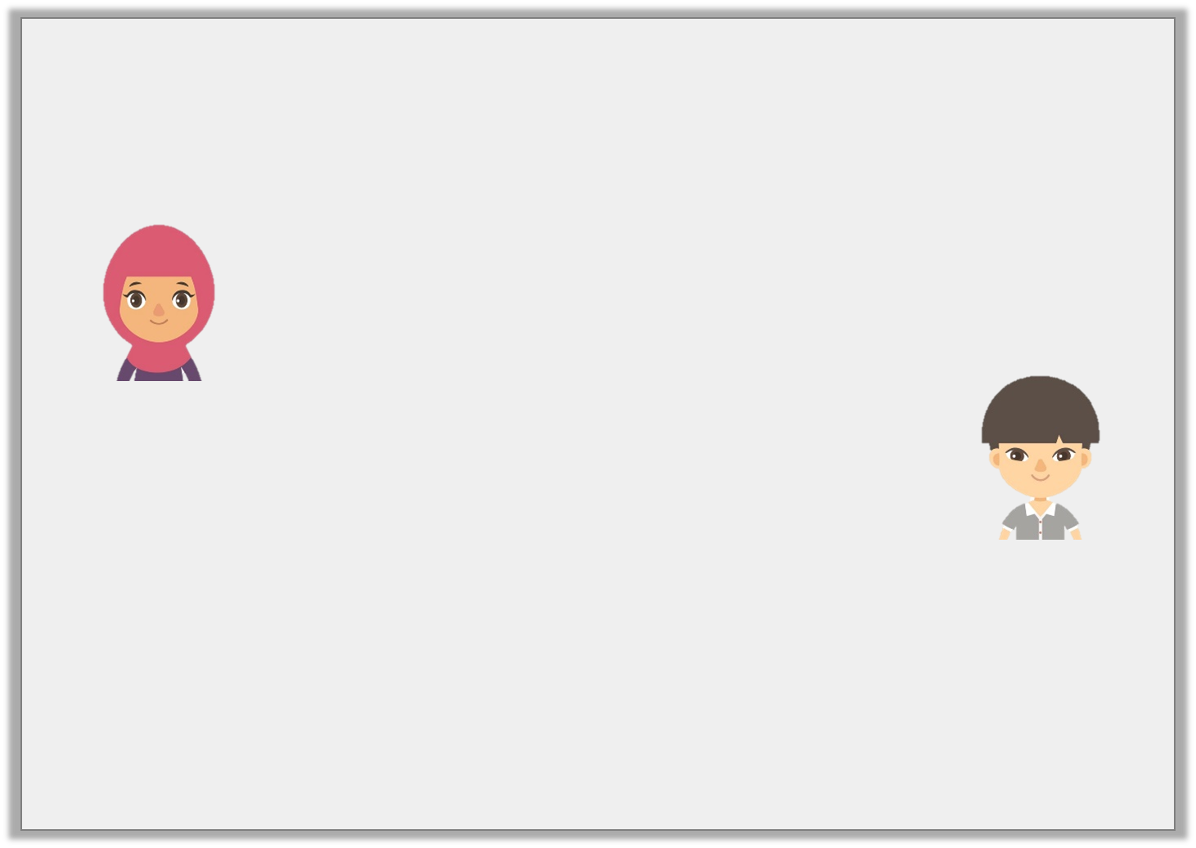
Reasoning 1
Hafsa and Chuan are converting fractions and decimals
into percentages.
Who is correct?
Explain how you know.
0.42 as a percentage is 42%.
Hafsa
as a percentage is 42%.
84
200
Chuan
© Classroom Secrets Limited 2018

Slide 15
Reasoning 1
Hafsa and Chuan are converting fractions and decimals
into percentages.
Who is correct?
Explain how you know.
They are both correct because …
0.42 as a percentage is 42%.
Hafsa
as a percentage is 42%.
84
200
Chuan
© Classroom Secrets Limited 2018

Slide 16
Reasoning 1
Hafsa and Chuan are converting fractions and decimals
into percentages.
Who is correct?
Explain how you know.
They are both correct because 0.42 and = 42%.
0.42 as a percentage is 42%.
Hafsa
as a percentage is 42%.
84
200
Chuan
84
200
© Classroom Secrets Limited 2018

Slide 17
