Slide 1
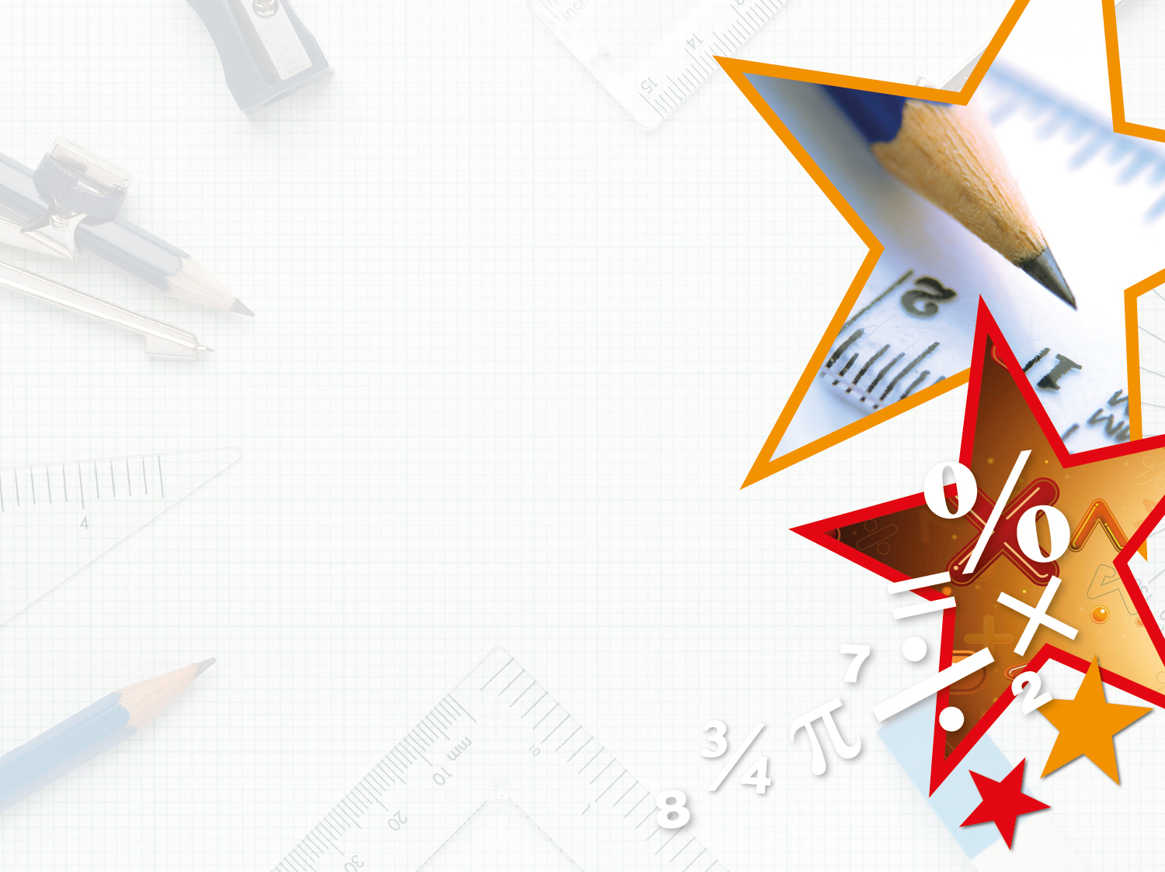

Year 6 – Spring Block 1 – Decimals
Step 1: Three Decimal Places
© Classroom Secrets Limited 2018

Slide 2
Introduction
Which column titles belong in the place value chart below?
Ones
Thousandths
Tens
Hundredths
Thousands
Tenths
© Classroom Secrets Limited 2018

Slide 3
Introduction
Which column titles belong in the place value chart below?
Ones
Thousandths
Tens
Hundredths
Thousands
Tenths
Tens | Ones | Tenths | Hundredths | Thousandths
© Classroom Secrets Limited 2018

Slide 4
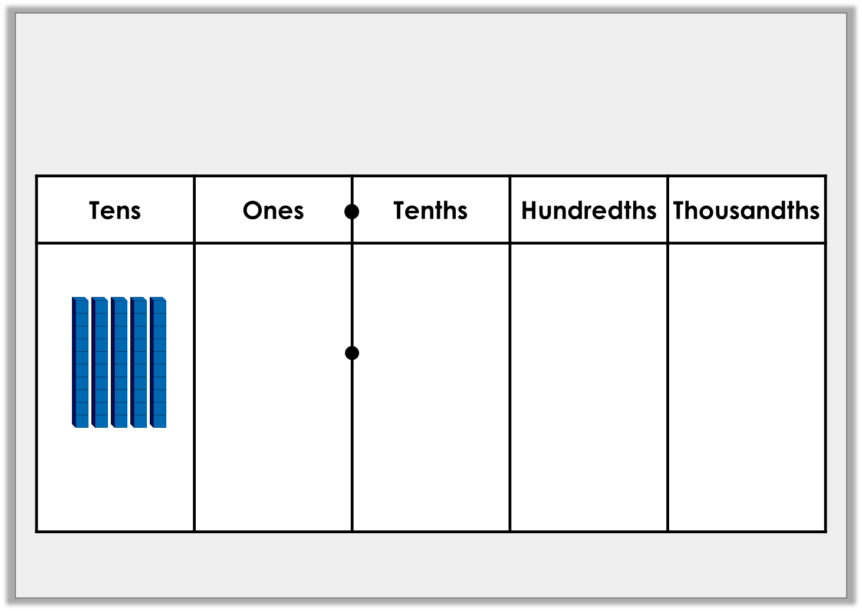
Varied Fluency 1
Convert the number in the place value chart to digits.
0.1
0.01
0.01
0.001
0.1
0.1
0.1
0.1
0.01
0.01
0.1
0.1
0.1
0.1
0.01
0.01
0.001
0.1
0.1
0.1
0.1
0.01
0.01
0.1
0.1
0.001
0.01
0.01
© Classroom Secrets Limited 2018

Slide 5
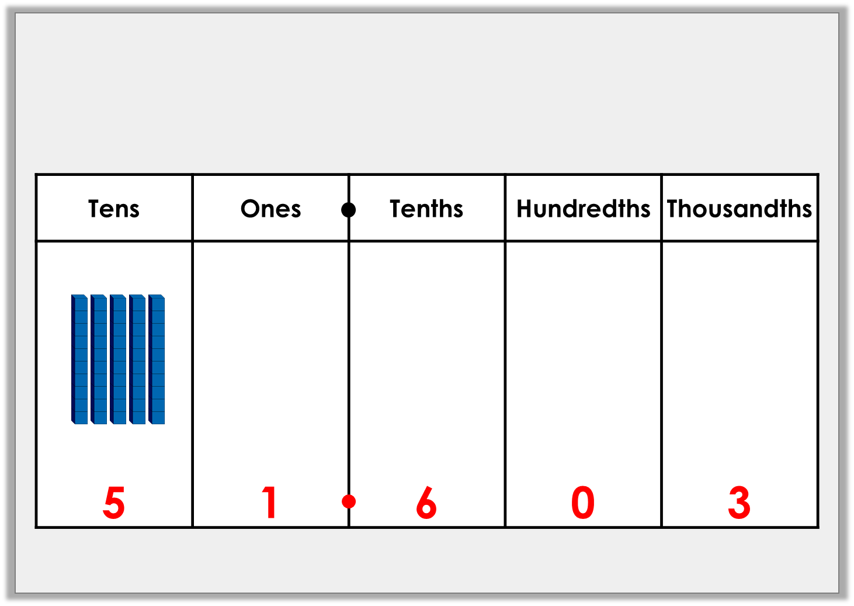
Varied Fluency 1
Convert the number in the place value chart to digits.
0.1
0.01
0.01
0.001
0.1
0.1
0.1
0.1
0.01
0.01
0.1
0.1
0.1
0.1
0.01
0.01
0.001
0.1
0.1
0.1
0.1
0.01
0.01
0.1
0.1
0.001
0.01
0.01
© Classroom Secrets Limited 2018

Slide 6
Varied Fluency 2
Use the place value chart to represent a number which has three tens no ones, three tenths, six hundredths and eight thousandths.
10s | 1s | 0.1s | 0.001s | 0.001s
© Classroom Secrets Limited 2018

Slide 7
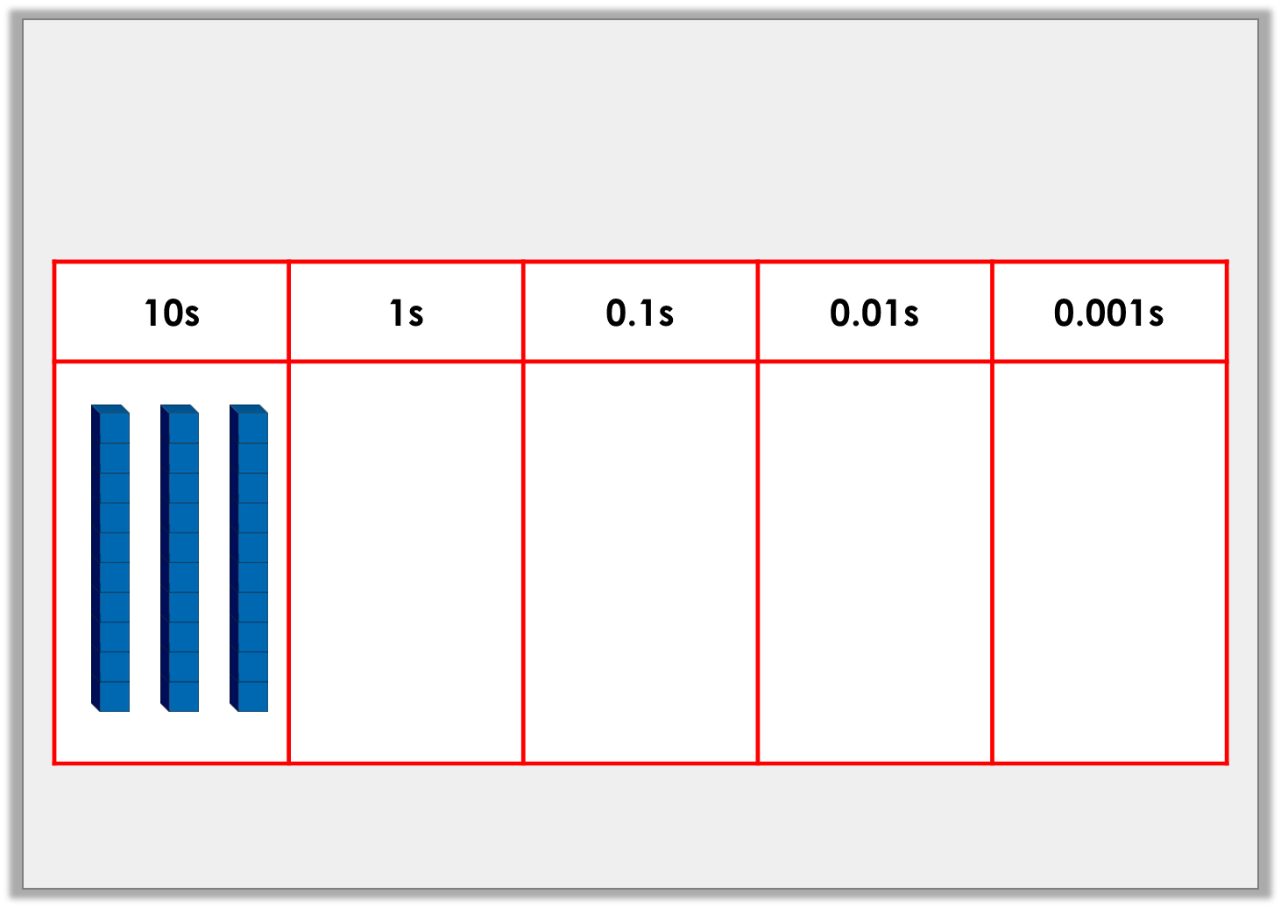
Varied Fluency 2
Use the place value chart to represent a number which has three tens no ones, three tenths, six hundredths and eight thousandths.
© Classroom Secrets Limited 2018

Slide 8
Varied Fluency 3
In which number does the digit 3 have the highest value?
217.03
0.399
109.431
© Classroom Secrets Limited 2018

Slide 9
Varied Fluency 3
In which number does the digit 3 have the highest value?
This represents 3 tenths.
217.03
0.399
109.431
© Classroom Secrets Limited 2018

Slide 10
Varied Fluency 4
Use the digit cards to create the greatest and smallest number possible.
5
2
4
6
7
Tens | Ones | Tenths | Hundredths | Thousandths
© Classroom Secrets Limited 2018

Slide 11
Varied Fluency 4
Use the digit cards to create the greatest and smallest number possible.
5
2
4
6
7
Tens | Ones | Tenths | Hundredths | Thousandths
7 | 6 | 5 | 4 | 2
2 | 4 | 5 | 6 | 7
© Classroom Secrets Limited 2018

Slide 12
Reasoning 1
Sort the numbers into the table.
Are there any empty boxes? Explain why.
8.293
8.586
8.219
8.189
 | > 8.291 | < 8.291
value > 7 in thousandths column
value < 7 in thousandths column
© Classroom Secrets Limited 2018

Slide 13
Reasoning 1
Sort the numbers into the table.
Are there any empty boxes? Explain why.
There are two empty boxes because…
8.293
8.586
8.219
8.189
 | > 8.291 | < 8.291
value > 7 in thousandths column
value < 7 in thousandths column
© Classroom Secrets Limited 2018

Slide 14
Reasoning 1
Sort the numbers into the table.
Are there any empty boxes? Explain why.
There are two empty boxes because there are no numbers with a value > 7 in the thousandths column that are > 8.291, and no numbers with a value of < 7 in the thousandths column that are < 8.291.
8.293
8.586
8.219
8.189
 | > 8.291 | < 8.291
value > 7 in thousandths column |  | 8.219 8.189
value < 7 in thousandths column | 8.293 8.586
© Classroom Secrets Limited 2018

Slide 15
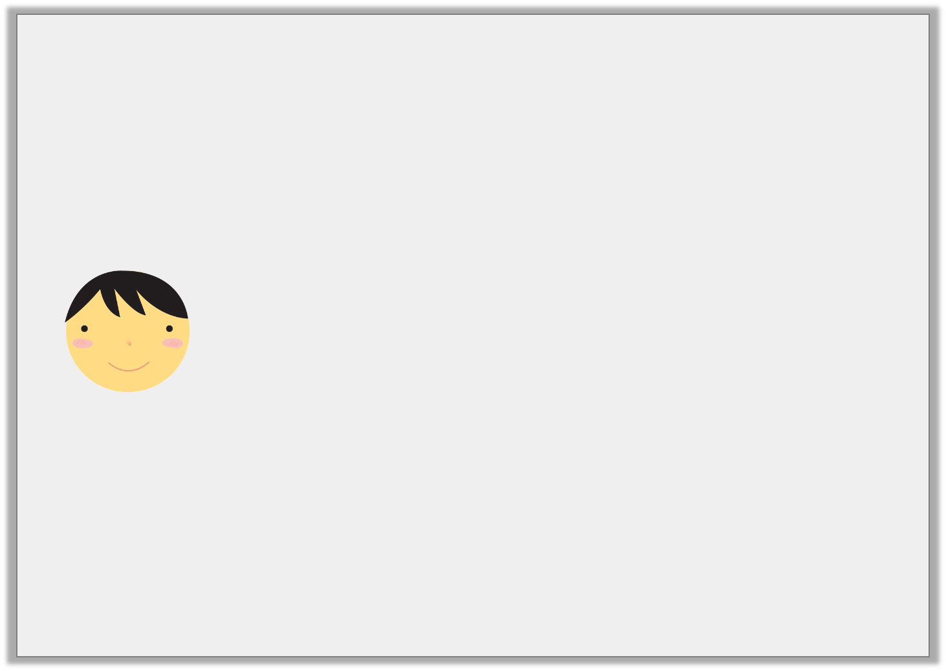
Problem Solving 1
Barney is thinking of a number.
What could Barney’s number be? Find eight possibilities.
My number has 3 decimal places.
The tenths digit is >6.
It is between 7.69 and 7.75
The hundredths digit is smaller than the thousandths digit.
© Classroom Secrets Limited 2018

Slide 16
Problem Solving 1
Barney is thinking of a number.
What could Barney’s number be? Find eight possibilities.
Various possible answers, for example:
7.701, 7.702, 7.712, 7.703, 7.713, 7.723, 7.704, 7.714, 7.724, 7.734
My number has 3 decimal places.
The tenths digit is >6.
It is between 7.69 and 7.75
The hundredths digit is smaller than the thousandths digit.
© Classroom Secrets Limited 2018

Slide 17
Reasoning 2
Which is the odd one out?
Give the number in digits and explain your answer.
A
B
5.055
5 ones, 5 hundredths and 5 thousandths
C
D
Five point five five
505 hundredths and 5 thousandths
© Classroom Secrets Limited 2018

Slide 18
Reasoning 2
Which is the odd one out?
Give the number in digits and explain your answer.
C is the odd one out because…
A
B
5.055
5 ones, 5 hundredths and 5 thousandths
C
D
Five point five five
505 hundredths and 5 thousandths
© Classroom Secrets Limited 2018

Slide 19
Reasoning 2
Which is the odd one out?
Give the number in digits and explain your answer.
C is the odd one out because C = 5.55 and the others describe 5.055
A
B
5.055
5 ones, 5 hundredths and 5 thousandths
C
D
Five point five five
505 hundredths and 5 thousandths
© Classroom Secrets Limited 2018

