Slide 1
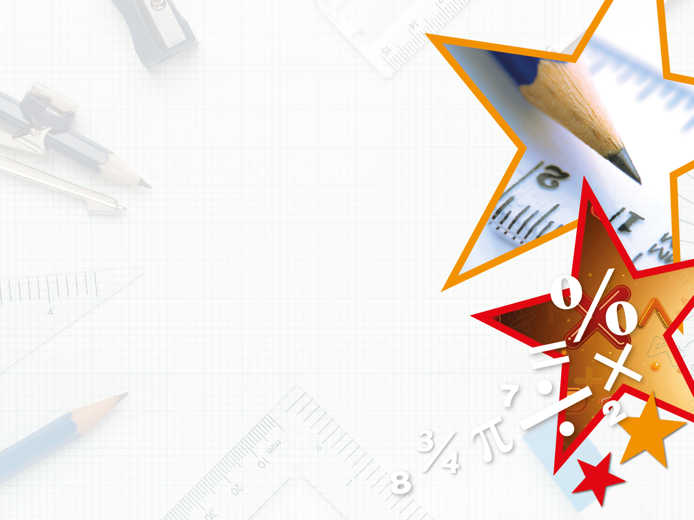

Year 6 – Spring Block 1 – Decimals
Step 2: Multiply by 10, 100 and 1,000
© Classroom Secrets Limited 2018

Slide 2
Introduction
What is the value of the 8 in the following numbers?
0.83 | 0.38 | 381.41 | 0.008 | 841,126
© Classroom Secrets Limited 2018

Slide 3
Introduction
What is the value of the 8 in the following numbers?
0.83 | 0.38 | 381.41 | 0.008 | 841,126
8 tenths | 8 hundredths | 8 tens | 8 thousandths | 8 hundred thousands
© Classroom Secrets Limited 2018

Slide 4
Varied Fluency 1
Multiply the following number.
72.916
x 10
x 100
x 1,000
© Classroom Secrets Limited 2018

Slide 5
Varied Fluency 1
Multiply the following number.
72.916
x 10 | 729.16
x 100 | 7,291.6
x 1,000 | 72,916
© Classroom Secrets Limited 2018

Slide 6
Varied Fluency 2
Select the correct answer.
38.134 | x | 100 | =
3,813.4
38,134
38,314
© Classroom Secrets Limited 2018

Slide 7
Varied Fluency 2
Select the correct answer.
38.134 | x | 100 | =
3,813.4
38,134
38,314
© Classroom Secrets Limited 2018

Slide 8
Varied Fluency 3
Which calculation is incorrect?
A. | 774.9 | x | 10 | = | 7,749
B. | 8.327 | x | 100 | = | 832.7
C. | 43.8 | x | 1,000 | = | 4,380
© Classroom Secrets Limited 2018

Slide 9
Varied Fluency 3
Which calculation is incorrect?
A. | 774.9 | x | 10 | = | 7,749
B. | 8.327 | x | 100 | = | 832.7
C. | 43.8 | x | 1,000 | = | 4,380
© Classroom Secrets Limited 2018

Slide 10
Varied Fluency 4
Use the multiplication cards to complete the following calculations.
x 10
x 100
x 1,000
93.56 |  | = | 93,560
154.63 |  | = | 1,546.3
37.93 |  | = | 3,793
© Classroom Secrets Limited 2018

Slide 11
Varied Fluency 4
Use the multiplication cards to complete the following calculations.
x 10
x 100
x 1,000
93.56 | x 1,000 | = | 93,560
154.63 | x 10 | = | 1,546.3
37.93 | x 100 | = | 3,793
© Classroom Secrets Limited 2018

Slide 12
Reasoning 1
Look at the following number sequences.
Explain the pattern.
Write the next 2 numbers in each sequence.
A. | 0.078 | 7.8 | 780
B. | 0.01 | 1 | 100
C. | 0.013 | 1.3 | 130
© Classroom Secrets Limited 2018

Slide 13
Reasoning 1
Look at the following number sequences.
Explain the pattern.
Write the next 2 numbers in each sequence.
The pattern is multiply by 100…
A. | 0.078 | 7.8 | 780
B. | 0.01 | 1 | 100
C. | 0.013 | 1.3 | 130
© Classroom Secrets Limited 2018

Slide 14
Reasoning 1
Look at the following number sequences.
Explain the pattern.
Write the next 2 numbers in each sequence.
The pattern is multiply by 100 the next two numbers are:
A. 78,000 and 7,800,000
B. 10,000 and 1,000,000
C. 13,000 and 1,300,000
A. | 0.078 | 7.8 | 780
B. | 0.01 | 1 | 100
C. | 0.013 | 1.3 | 130
© Classroom Secrets Limited 2018

Slide 15
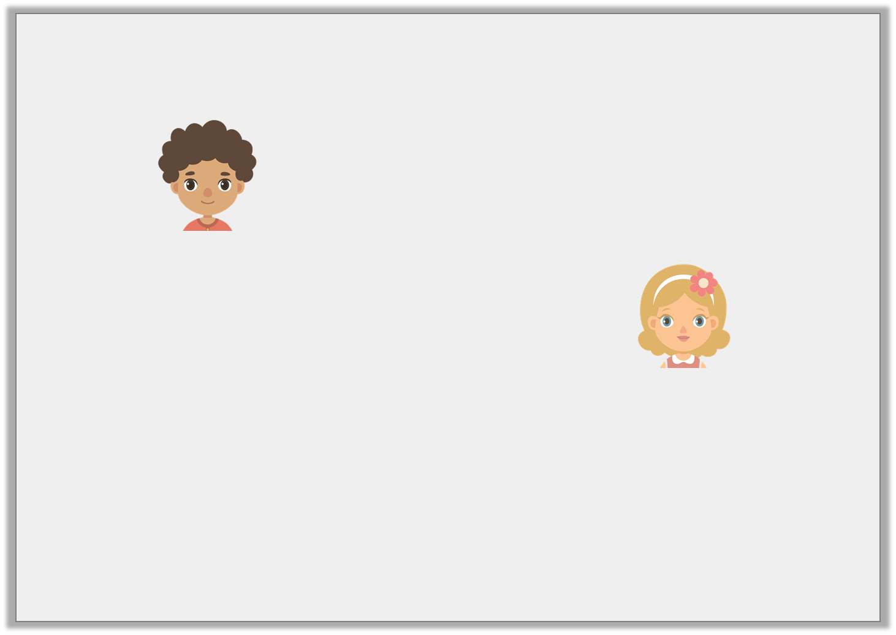
Reasoning 2
Johnny and Alice are multiplying numbers by 20.
Who is correct?
Explain your answer.
If I multiply the number 0.15 by 30 I get 0.45
Johnny
If I multiply the number 0.15 by 30 I get 4.5
Alice
© Classroom Secrets Limited 2018

Slide 16
Reasoning 2
Johnny and Alice are multiplying numbers by 20.
Who is correct?
Explain your answer.
Alice is correct because…
If I multiply the number 0.15 by 30 I get 0.45
Johnny
If I multiply the number 0.15 by 30 I get 4.5
Alice
© Classroom Secrets Limited 2018

Slide 17
Reasoning 2
Johnny and Alice are multiplying numbers by 20.
Who is correct?
Explain your answer.
Alice is correct because Johnny has only multiplied by 3 instead of 30.
If I multiply the number 0.15 by 30 I get 0.45
Johnny
If I multiply the number 0.15 by 30 I get 4.5
Alice
© Classroom Secrets Limited 2018

Slide 18
Problem Solving 1
Create a calculation using the operation and number cards below.
How many combinations can you make using only one operation per calculation.
3.2
0.32
320
3,200
x 100
x 10
x 1,000
© Classroom Secrets Limited 2018

Slide 19
Problem Solving 1
Create a calculation using the operation and number cards below.
How many combinations can you make using only one operation per calculation.
Possible combinations include 0.32 x 10 = 3.2, 0.32 x 1,000 = 320, 3.2 x 100 = 320, 3.2 x 1,000 = 3,200, 320 x 10 = 3,200
3.2
0.32
320
3,200
x 100
x 10
x 1,000
© Classroom Secrets Limited 2018

