Slide 1



LIFE/work balance
We have started a #LIFEworkbalance campaign and we need your help to complete our LIFE/work balance survey.
We hope to publish the results soon, so please give 15 minutes of your time to help us get a true picture of school life.
Want to be a part of this campaign? Take the survey on our website and share it with your colleagues!
© Classroom Secrets Limited 2019

Slide 2
Year 6 – Autumn Block 3 – Fractions – Multiply Fractions by Integers
About This Resource:
This PowerPoint has been designed to support your teaching of this small step. It includes a starter activity and an example of each question from the Varied Fluency and Reasoning and Problem Solving resources also provided in this pack. You can choose to work through all examples provided or a selection of them depending on the needs of your class.
National Curriculum Objectives:
Mathematics Year 6: (6F2) Use common factors to simplify fractions; use common multiples to express fractions in the same denomination
Mathematics Year 6: (6F3) Compare and order fractions, including fractions > 1
Mathematics Year 6: (6F4) Add and subtract fractions with different denominators and mixed numbers, using the concept of equivalent fractions
Mathematics Year 6: (6F5a) Multiply simple pairs of proper fractions, writing the answer in its simplest form [for example, 1/4 x 1/2 = 1/8
More Year 6 Fractions resources.
Did you like this resource? Don’t forget to review it on our website.
© Classroom Secrets Limited 2018

Slide 3
Year 6 – Autumn Block 3 – Fractions
Step 10: Multiply Fractions by Integers
© Classroom Secrets Limited 2018

Slide 4
Introduction
Complete the calculation and then convert your answer to its simplest form.
2 | + | 12 | = |  | = |  |  |  | =
7 |  | 14
© Classroom Secrets Limited 2018

Slide 5
Introduction
Complete the calculation and then convert your answer to its simplest form.
2 | + | 12 | = | 16 | = | 1 |  | 2 | = | 1 |  | 1
7 |  | 14 |  | 14 |  |  |  | 14 |  |  |  | 7
© Classroom Secrets Limited 2018

Slide 6
Varied Fluency 1
Which calculation is represented by the image below?
A |  | 5 | x | 3
 |  | 12
B |  | 5 | x | 3
 |  | 10
© Classroom Secrets Limited 2018

Slide 7
Varied Fluency 1
Which calculation is represented by the image below?
A |  | 5 | x | 3
 |  | 12
B |  | 5 | x | 3
 |  | 10
© Classroom Secrets Limited 2018

Slide 8
Varied Fluency 2
Shade in the image below to find the answer to the calculation.
1 | 3 | x | 4 | =
 | 5
© Classroom Secrets Limited 2018

Slide 9
Varied Fluency 2
Shade in the image below to find the answer to the calculation.
1 | 3 | x | 4 | = | 6 | 2 | or | 32
 | 5 |  |  |  |  | 5 |  | 5
© Classroom Secrets Limited 2018

Slide 10
Varied Fluency 3
Answer the question below.
What are 5 lots of 4 | 2 | ?
 | 7
© Classroom Secrets Limited 2018

Slide 11
Varied Fluency 3
Answer the question below.
What are 5 lots of 4 | 2 | ?
 | 7
21 | 3 | or | 150
 | 7 |  | 7
© Classroom Secrets Limited 2018

Slide 12
Varied Fluency 4
True or false?
6 | x | 2 | 9 | < | 3 | 2 | x | 7
 |  |  | 10 |  |  | 9
© Classroom Secrets Limited 2018

Slide 13
Varied Fluency 4
True or false?
6 | x | 2 | 9 | < | 3 | 2 | x | 7
 |  |  | 10 |  |  | 9
17 | 2 | or | 174 | < | 22 | 5 | or | 203
 | 5 |  | 10 |  |  | 9 |  | 9
True
© Classroom Secrets Limited 2018

Slide 14
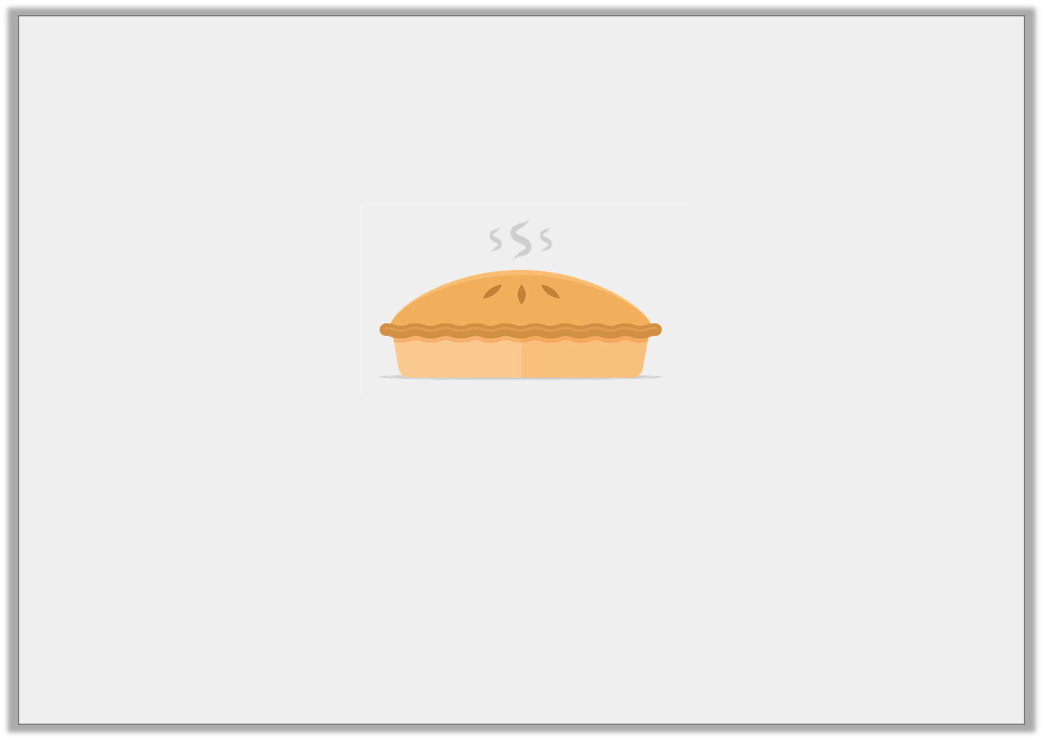
Problem Solving 1
There are 5 children at a party.
Each child needs 1 pie plus an extra of another pie.
How many pies need to be ordered?
Prove it.
3
10
© Classroom Secrets Limited 2018

Slide 15
Problem Solving 1
There are 5 children at a party.
Each child needs 1 pie plus an extra of another pie.
How many pies need to be ordered?
Prove it.
7 pies need to be ordered (half a pie will be spare).
3
10
5 | x | 1 | 3 | = | 6 | 1 | or | 65
 |  |  | 10 |  |  | 2 |  | 10
© Classroom Secrets Limited 2018

Slide 16
Reasoning 1
Trevor created an image to represent his calculation.
Find and correct Trevor’s mistake.
2 | 5 | x | 5 | = | 14 | 1
 | 6 |  |  |  |  | 6
© Classroom Secrets Limited 2018

Slide 17
Reasoning 1
Trevor created an image to represent his calculation.
Find and correct Trevor’s mistake.
Trevor has not shown…
2 | 5 | x | 5 | = | 14 | 1
 | 6 |  |  |  |  | 6
© Classroom Secrets Limited 2018

Slide 18
Reasoning 1
Trevor created an image to represent his calculation.
Find and correct Trevor’s mistake.
Trevor has not shown 5 lots of . He needs to add one more lot of for the representation to be correct.
2 | 5 | x | 5 | = | 14 | 1
 | 6 |  |  |  |  | 6
2 | 5
 | 6
2 | 5
 | 6
© Classroom Secrets Limited 2018

Slide 19
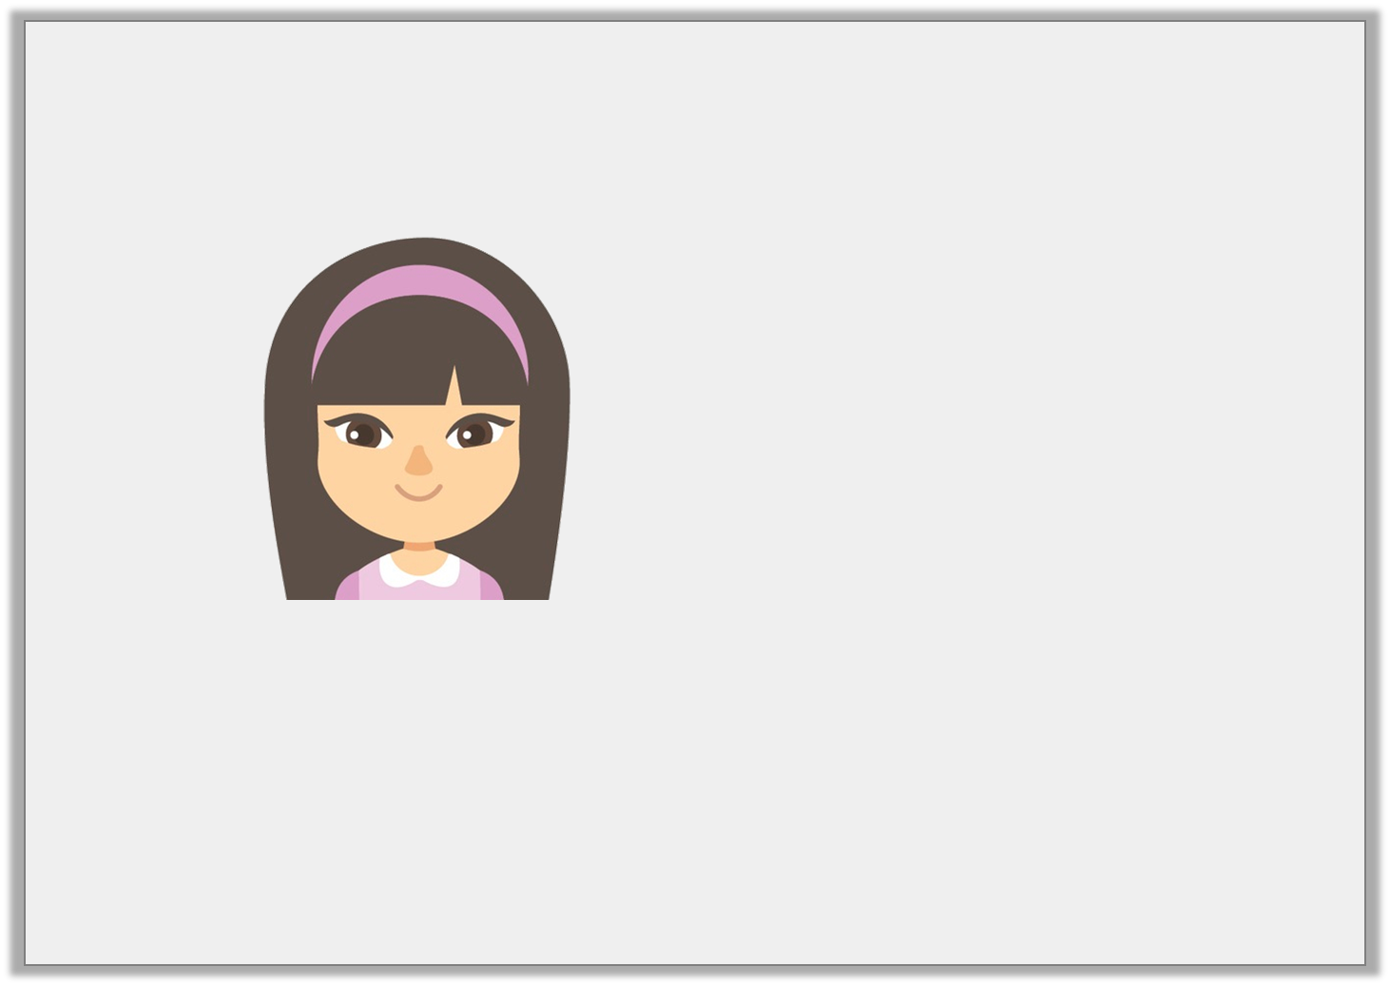
Problem Solving 2
Frances is practising for a school concert.
What is the minimum number of weeks Frances should practise for?
Explain your answer.
I need to practise for more than 15 hours.
I can practise for
hours a week.
3 | 4
 | 7
© Classroom Secrets Limited 2018

Slide 20
Problem Solving 2
Frances is practising for a school concert.
What is the minimum number of weeks Frances should practise for?
Explain your answer.
hours x 4 weeks = hours. hours x 5 weeks =
hours. Frances needs to practise for 5 weeks.
I need to practise for more than 15 hours.
I can practise for
hours a week.
3 | 4
 | 7
3 | 4
 | 7
14 | 2
 | 7
3 | 4
 | 7
17 | 6
 | 7
© Classroom Secrets Limited 2018

