Slide 1
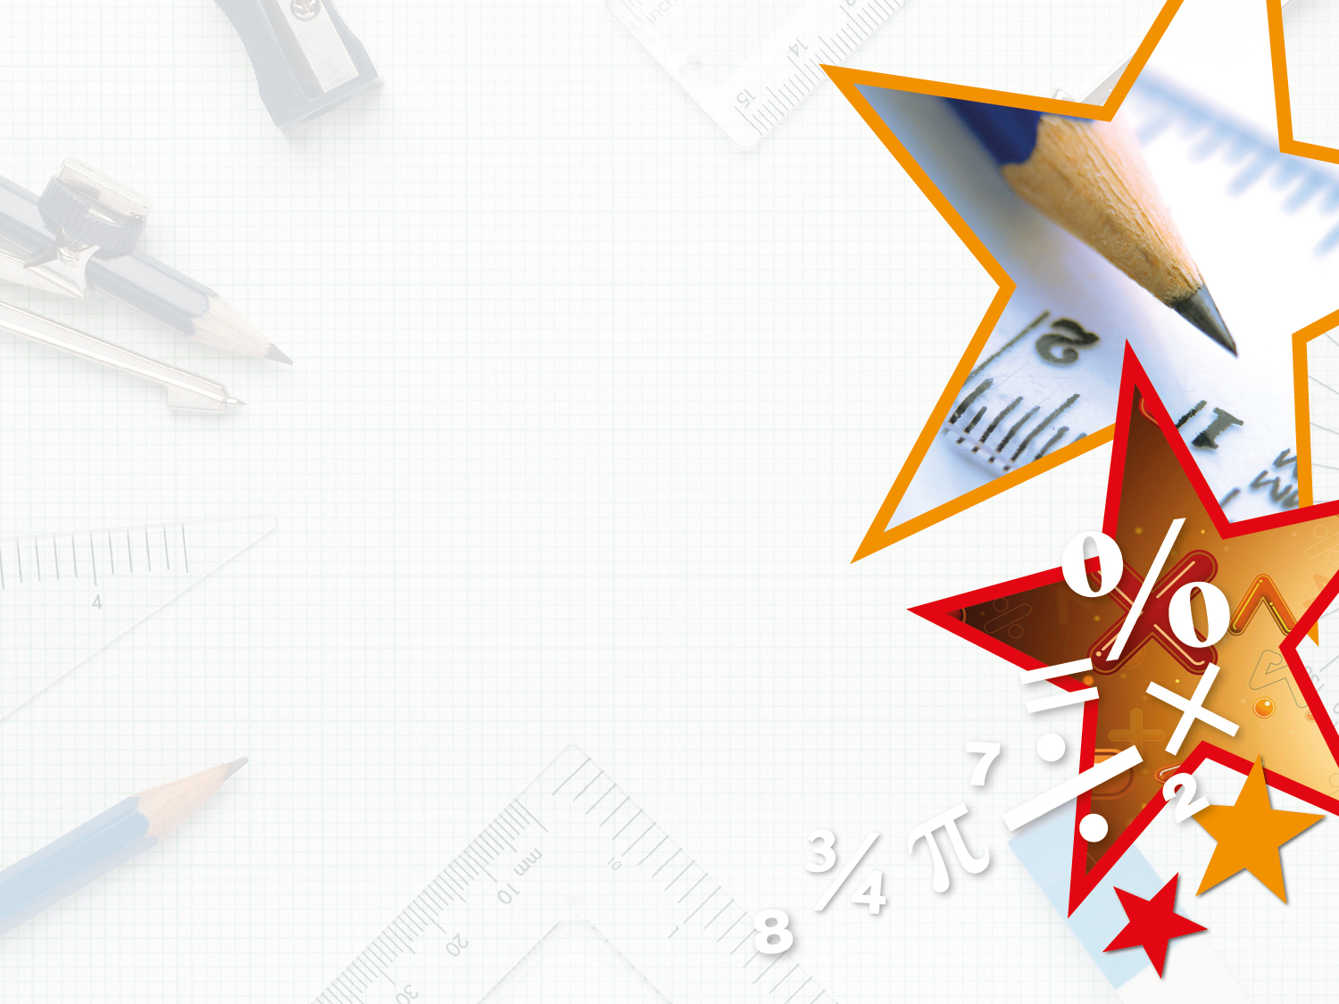

Year 6 – Spring Block 1 – Multiply Decimals by Integers
Step 4: Multiply Decimals by Integers
© Classroom Secrets Limited 2018

Slide 2
Introduction
Circle the calculations which are correct.
8.32 x 4 = 32.28 | 2.14 x 9 = 18.26 | 5.78 x 5 = 28.9
1.57 x 8 = 12.56 | 6.91 x 3 = 18.73 | 4.85 x 7 = 33.95
© Classroom Secrets Limited 2018

Slide 3
Introduction
Circle the calculations which are correct.
8.32 x 4 = 32.28 | 2.14 x 9 = 18.26 | 5.78 x 5 = 28.9
1.57 x 8 = 12.56 | 6.91 x 3 = 18.73 | 4.85 x 7 = 33.95
© Classroom Secrets Limited 2018

Slide 4
Varied Fluency 1
Match the calculations to their products.
2.75 x 5 |  | 43.26
9.43 x 4 |  | 13.75
6.18 x 7 |  | 45.72
7.62 x 6 |  | 37.72
© Classroom Secrets Limited 2018

Slide 5
Varied Fluency 1
Match the calculations to their products.
2.75 x 5 |  | 43.26
9.43 x 4 |  | 13.75
6.18 x 7 |  | 45.72
7.62 x 6 |  | 37.72
© Classroom Secrets Limited 2018

Slide 6
Varied Fluency 2
True or false?
3.97 x 8 = 30.76
© Classroom Secrets Limited 2018

Slide 7
Varied Fluency 2
True or false?
3.97 x 8 = 30.76
False, 3.97 x 8 = 31.76
© Classroom Secrets Limited 2018

Slide 8
Varied Fluency 3
Use <, > or = to complete the statements below.
8.46 x 3 |  | 25.83
15.21 |  | 1.68 x 9
© Classroom Secrets Limited 2018

Slide 9
Varied Fluency 3
Use <, > or = to complete the statements below.
8.46 x 3 | < | 25.83
15.21 | > | 1.68 x 9
© Classroom Secrets Limited 2018

Slide 10
Varied Fluency 4
Complete the bar model below.
?
5.49 | 5.49 | 5.49 | 5.49 | 5.49 | 5.49
© Classroom Secrets Limited 2018

Slide 11
Varied Fluency 4
Complete the bar model below.
5.49 x 6 = 32.94
32.94
5.49 | 5.49 | 5.49 | 5.49 | 5.49 | 5.49
© Classroom Secrets Limited 2018

Slide 12
Reasoning 1
Circle the odd one out.
6.84 x 3
4.26 x 5
3.42 x 6
Explain your reasoning.
© Classroom Secrets Limited 2018

Slide 13
Reasoning 1
Circle the odd one out.
6.84 x 3
4.26 x 5
3.42 x 6
Explain your reasoning.
The odd one out is 4.26 x 5 because…
© Classroom Secrets Limited 2018

Slide 14
Reasoning 1
Circle the odd one out.
6.84 x 3
4.26 x 5
3.42 x 6
Explain your reasoning.
The odd one out is 4.26 x 5 because this equals 21.3.
The other calculations equal 20.52.
© Classroom Secrets Limited 2018

Slide 15
Problem Solving 1
Select and arrange the cards to create a multiplication calculation.
Which cards are not needed?
6.83
44.66
6.38
54.46
7
45.46
46.46
8
 | x |  | =
© Classroom Secrets Limited 2018

Slide 16
Problem Solving 1
Select and arrange the cards to create a multiplication calculation.
Which cards are not needed?
The cards 6.83, 54.46, 45.46, 46.46 and 8 are not needed.
6.83
44.66
6.38
54.46
7
45.46
46.46
8
6.38 | x | 7 | = | 44.66
© Classroom Secrets Limited 2018

Slide 17
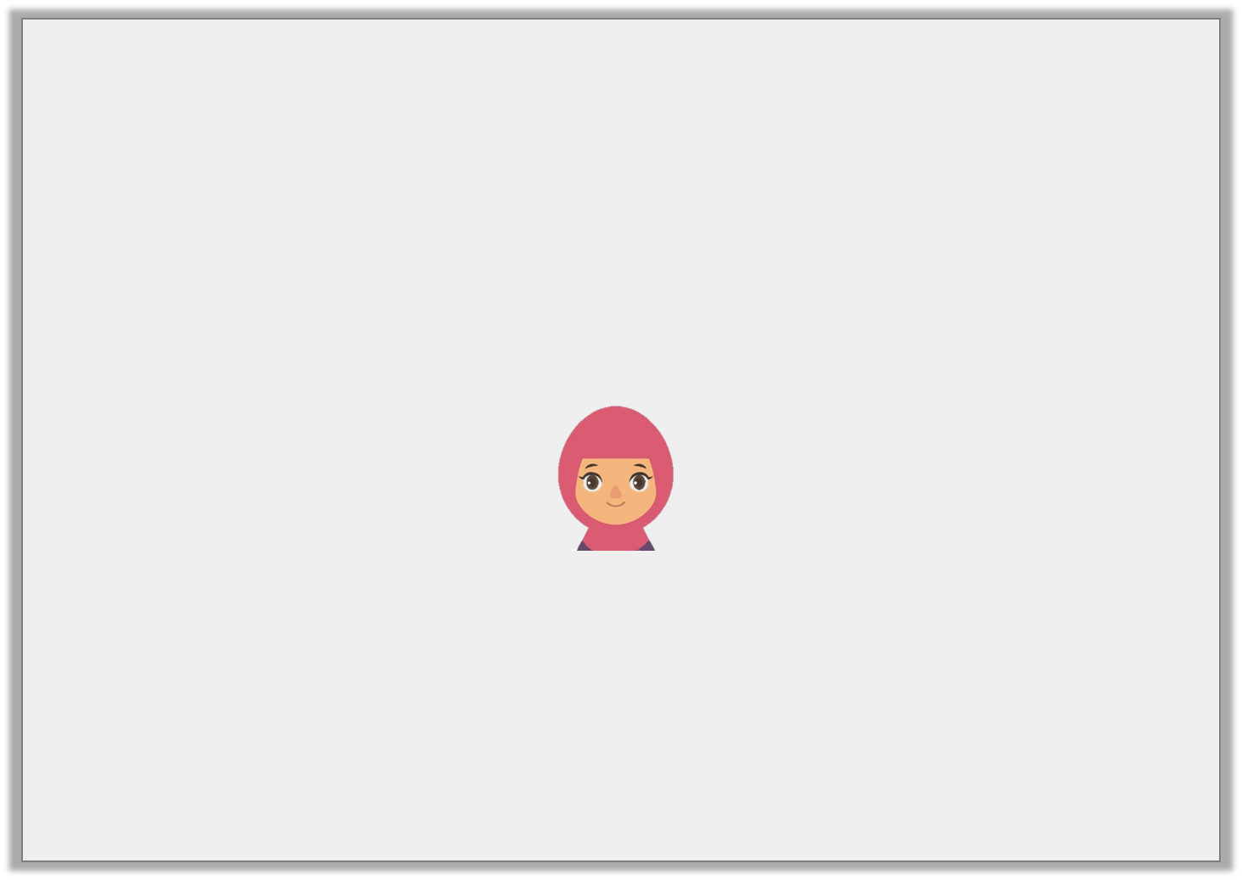
Reasoning 2
Mr Johnson shares the calculation below with Class 6:
9.13 x 5 =
Kiran says,
What mistake has Kiran made?
What is the correct answer?
The product is 45.6
© Classroom Secrets Limited 2018

Slide 18
Reasoning 2
Mr Johnson shares the calculation below with Class 6:
9.13 x 5 =
Kiran says,
What mistake has Kiran made?
Kiran has not included the hundredths in her answer.
What is the correct answer?
The product is 45.6
© Classroom Secrets Limited 2018

Slide 19
Reasoning 2
Mr Johnson shares the calculation below with Class 6:
9.13 x 5 =
Kiran says,
What mistake has Kiran made?
Kiran has not included the hundredths in her answer.
What is the correct answer?
The correct answer is 45.65.
The product is 45.6
© Classroom Secrets Limited 2018

