Slide 1



LIFE/work balance
We have started a #LIFEworkbalance campaign and we need your help to complete our LIFE/work balance survey.
We hope to publish the results soon, so please give 15 minutes of your time to help us get a true picture of school life.
Want to be a part of this campaign? Take the survey on our website and share it with your colleagues!
© Classroom Secrets Limited 2019

Slide 2
Year 6 – Autumn Block 3 – Fractions – Divide Fractions by Integers 1
About This Resource:
This PowerPoint has been designed to support your teaching of this small step. It includes a starter activity and an example of each question from the Varied Fluency and Reasoning and Problem Solving resources also provided in this pack. You can choose to work through all examples provided or a selection of them depending on the needs of your class.
National Curriculum Objectives:
Mathematics Year 6: (6F2) Use common factors to simplify fractions; use common multiples to express fractions in the same denomination​
Mathematics Year 6: (6F5b) Divide proper fractions by whole numbers [for example, 1/3 ÷ 2 = 1/6 ]
More Year 6 Fractions resources.
Did you like this resource? Don’t forget to review it on our website.
© Classroom Secrets Limited 2018

Slide 3
Year 6 – Autumn Block 3 – Fractions
Step 12: Divide Fractions by Integers 1
© Classroom Secrets Limited 2018

Slide 4
Introduction
Match the calculation to the correct answer.
52 ÷ 4 = |  | 12
48 ÷ 8 = |  | 13
36 ÷ 3 = |  | 6
56 ÷ 7 = |  | 9
72 ÷ 8 = |  | 8
© Classroom Secrets Limited 2018

Slide 5
Introduction
Match the calculation to the correct answer.
52 ÷ 4 = |  | 12
48 ÷ 8 = |  | 13
36 ÷ 3 = |  | 6
56 ÷ 7 = |  | 9
72 ÷ 8 = |  | 8
© Classroom Secrets Limited 2018

Slide 6
Varied Fluency 1
Match each calculation to the correct answer represented in the diagram.
A | 9 | ÷ | 3
 | 12
B | 4 | ÷ | 2
 | 5
C | 10 | ÷ | 5
 | 12
© Classroom Secrets Limited 2018

Slide 7
Varied Fluency 1
Match each calculation to the correct answer represented in the diagram.
A | 9 | ÷ | 3
 | 12
B | 4 | ÷ | 2
 | 5
C | 10 | ÷ | 5
 | 12
© Classroom Secrets Limited 2018

Slide 8
Varied Fluency 2
True or false?
9 | ÷ | 3 | = | 3
8 |  |  |  | 8
© Classroom Secrets Limited 2018

Slide 9
Varied Fluency 2
True or false?
True
9 | ÷ | 3 | = | 3
8 |  |  |  | 8
© Classroom Secrets Limited 2018

Slide 10
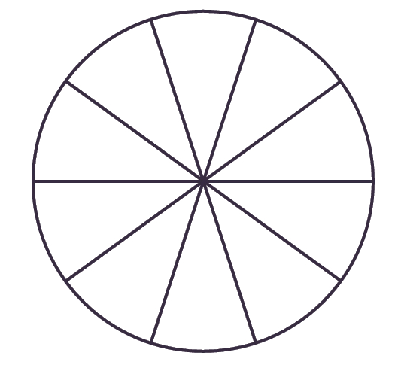
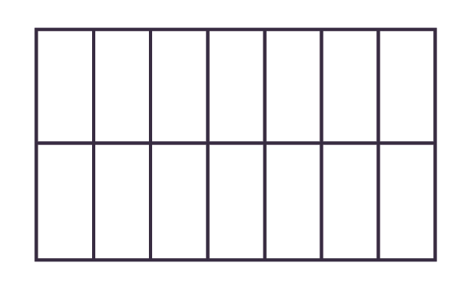
Varied Fluency 3
Calculate the following:
9 | ÷ | 3 | =
10
12 | ÷ | 3 | =
14
© Classroom Secrets Limited 2018

Slide 11
Varied Fluency 3
Calculate the following:
9 | ÷ | 3 | = | 3
10 |  |  |  | 10
12 | ÷ | 3 | = | 4 | or | 1
14 |  |  |  | 14 |  | 7
© Classroom Secrets Limited 2018

Slide 12
Varied Fluency 4
Solve the calculation to find the odd one out.
4 | ÷ | 2 | =
5
A | 2
 | 5
B
C
© Classroom Secrets Limited 2019
© Classroom Secrets Limited 2018

Slide 13
Varied Fluency 4
Solve the calculation to find the odd one out.
4 | ÷ | 2 | = | 2
5 |  |  |  | 5
A | 2
 | 5
B
C
© Classroom Secrets Limited 2018

Slide 14
Problem Solving 1
The missing digit in all the calculations is the same.
Find the missing digit.
A |  | 2 | ÷ | 2 | = | 1
 |  |  |  |  |  | 3
B |  | 12 | ÷ |  | = | 4
 |  |  |  |  |  | 3
 |  | 3
C |  |  | ÷ | 3 | = | 1
 |  |  |  |  |  | 5
 |  | 5
© Classroom Secrets Limited 2018

Slide 15
Problem Solving 1
The missing digit in all the calculations is the same.
Find the missing digit.
A |  | 2 | ÷ | 2 | = | 1
 |  |  |  |  |  | 3
 |  | 3
B |  | 12 | ÷ | 3 | = | 4
 |  |  |  |  |  | 3
 |  | 3
C |  | 3 | ÷ | 3 | = | 1
 |  |  |  |  |  | 5
 |  | 5
© Classroom Secrets Limited 2018

Slide 16

Reasoning 1
Josh and Ben are calculating ÷ 3.
Who is correct?
Explain how you know.
12
15
The answer is .
4
15
Josh
The answer is .
4
5
Ben
© Classroom Secrets Limited 2018

Slide 17
Reasoning 1
Josh and Ben are calculating ÷ 3.
Who is correct?
Explain how you know.
Josh is correct because…
12
15
The answer is .
4
15
Josh
The answer is .
4
5
Ben
© Classroom Secrets Limited 2018

Slide 18
Reasoning 1
Josh and Ben are calculating ÷ 3.
Who is correct?
Explain how you know.
Josh is correct because Ben has divided both the numerator and denominator by 3 but only the numerator should be divided.
12
15
The answer is .
4
15
Josh
The answer is .
4
5
Ben
© Classroom Secrets Limited 2018

Slide 19

Problem Solving 2
Steph has of her birthday cake left.
She wants to share it between herself and
two friends.
Write the calculation.
What fraction of cake does each child get?
6
10
© Classroom Secrets Limited 2018

Slide 20
Problem Solving 2
Steph has of her birthday cake left.
She wants to share it between herself and
two friends.
Write the calculation.
What fraction of cake does each child get?
Each child gets or of the cake.
6
10
6 | ÷ | 3 | = | 2
10 |  |  |  | 10
2
10
1
5
© Classroom Secrets Limited 2018

