Slide 1


Year 6
LO: To work out percentages from missing values
© Classroom Secrets Limited 2019

Slide 2
Introduction
Match the fractions, decimals and percentages.
0.25
3
4
75%
0.75
1
4
10%
0.1
1
10
25%
© Classroom Secrets Limited 2019

Slide 3
Introduction
Match the fractions, decimals and percentages.
0.25
3
4
75%
0.75
1
4
10%
0.1
1
10
25%
© Classroom Secrets Limited 2019

Slide 4
Varied Fluency 1
Find the whole by using the bar model below to help you.
20%
12 | 6 | 6
© Classroom Secrets Limited 2019

Slide 5
Varied Fluency 1
Find the whole by using the bar model below to help you.
The whole is 120.
20%
12 | 6 | 6
10%
5%
5%
© Classroom Secrets Limited 2019

Slide 6
Varied Fluency 2
Circle the two facts that could help you complete the calculation below.
45% | of | 76 | =
A. | 10% of 76 = 7.6
B. | 45% < 76%
C. | 5% is half of 10%
© Classroom Secrets Limited 2019

Slide 7
Varied Fluency 2
Circle the two facts that could help you complete the calculation below.
45% | of | 76 | = | 34.2
A. | 10% of 76 = 7.6
B. | 45% < 76%
C. | 5% is half of 10%
© Classroom Secrets Limited 2019

Slide 8
Varied Fluency 3
Find the missing values.
15 | % | of | 30 | =
30 | % | of |  | = | 6
61 | % | of | 80 | =
75 | % | of |  | = | 15
© Classroom Secrets Limited 2019

Slide 9
Varied Fluency 3
Find the missing values.
15 | % | of | 30 | = | 4.5
30 | % | of | 20 | = | 6
61 | % | of | 80 | = | 48.8
75 | % | of | 20 | = | 15
© Classroom Secrets Limited 2019

Slide 10
Varied Fluency 4
A gardener grows tulips and sunflowers in his garden.
There are 150 flowers in his garden altogether, and 52% of those are tulips.
How many sunflowers does he have?
© Classroom Secrets Limited 2019

Slide 11
Varied Fluency 4
A gardener grows tulips and sunflowers in his garden.
There are 150 flowers in his garden altogether, and 52% of those are tulips.
How many sunflowers does he have?
72
© Classroom Secrets Limited 2019

Slide 12
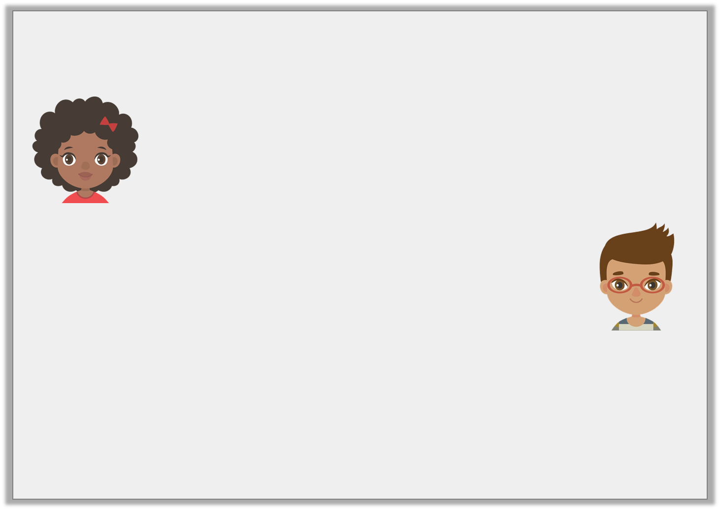
Reasoning 1
The children disagree about how to find 35% of 380.
Who is correct? Explain why.
I’ve found that 38 = 10%, so 35% must be 133.
Angel
I’ve found that 19 = 5%, so 35% must be 114.
Patrick
© Classroom Secrets Limited 2019

Slide 13
Reasoning 1
The children disagree about how to find 35% of 380.
Who is correct? Explain why.
Angel is correct…
I’ve found that 38 = 10%, so 35% must be 133.
Angel
I’ve found that 19 = 5%, so 35% must be 114.
Patrick
© Classroom Secrets Limited 2019

Slide 14
Reasoning 1
The children disagree about how to find 35% of 380.
Who is correct? Explain why.
Angel is correct. Although Marcus has worked out 5% of 380 correctly, he has used this fact to help him work out 30%, not 35%.
I’ve found that 38 = 10%, so 35% must be 133.
Angel
I’ve found that 19 = 5%, so 35% must be 114.
Patrick
© Classroom Secrets Limited 2019

Slide 15
Problem Solving 1
What could the missing values be? Find 2 possible solutions.
B.
 | ? % of
32% of | ? | = ?
 | = 18
A.
© Classroom Secrets Limited 2019

Slide 16
Problem Solving 1
What could the missing values be? Find 2 possible solutions.
Various answers, for example:
B.
B.
 | 10% of
32% of | 180 | = 57.6
 | = 18
 | 20% of
32% of | 90 | = 28.8
 | = 18
A.
A.
© Classroom Secrets Limited 2019

Slide 17

Problem Solving 2
300 people fill in an online survey.
How many people run?
How many people exercise in a gym?
80% of people reported exercising regularly each week.
Of those people, 65% ran and 35% exercise in a gym.
© Classroom Secrets Limited 2019

Slide 18
Problem Solving 2
300 people fill in an online survey.
How many people run?
How many people exercise in a gym?
80% of 300 = 240 people who exercise regularly.
156 people run (65% of 240).
84 people exercise in a gym (35% of 240).
80% of people reported exercising regularly each week.
Of those people, 65% ran and 35% exercise in a gym.
© Classroom Secrets Limited 2019

