Slide 1
English
Wednesday 10th February, 2021

Slide 2
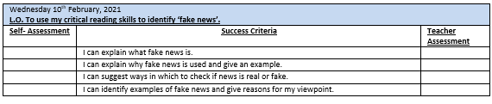

Slide 3
If you did not watch the video at the end of yesterday’s lesson – log in to Espresso and watch it now
https://central.espresso.co.uk/espresso/primary_uk/subject/module/video/item874806/grade2/module858868/index.html
What are the main types of news/ newspapers are there in the UK?

Slide 4
Different types of newspapers/news
Broadsheets e.g. The Financial Times, The Observer – more serious news stories
Tabloids e.g. The Sun, The Daily Mail, The Daily Express – serious news articles but also gossip, celebrity news
Digital e.g. BBC 24 News; Sky News – 24 hr a day – fast!

Slide 5
Is everything you read/hear real?
NO – not everything you read is true
Digital technology has made it easy to mislead, misinform = LIES

Slide 6
Fake News:
Fake news – completely made up stories disguised as news and made go viral for commercial or political gain
It is lies or propaganda told for a political or commercial purpose which deploys digital technology
Misinformation that leads to people being misinformed, not knowing who or what to believe – confusion
Problem because it can influence how people make decisions

Slide 7
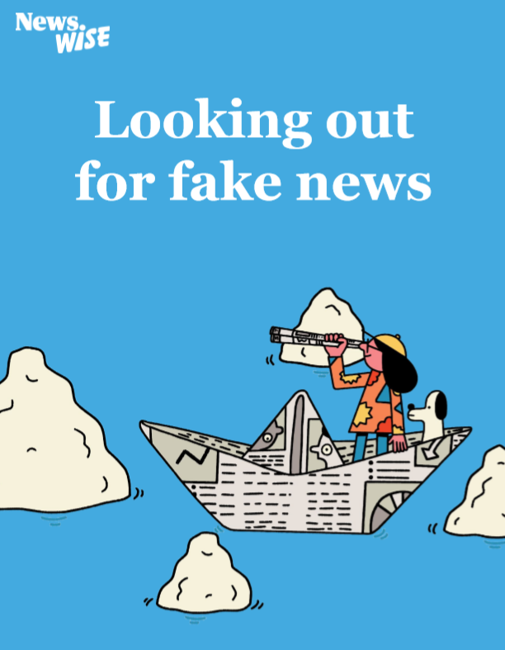

Slide 8
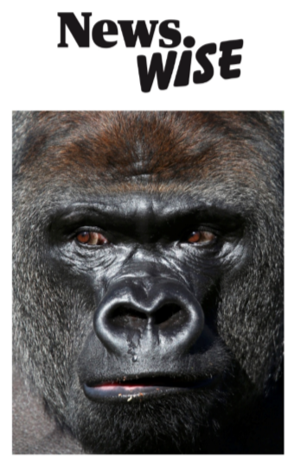
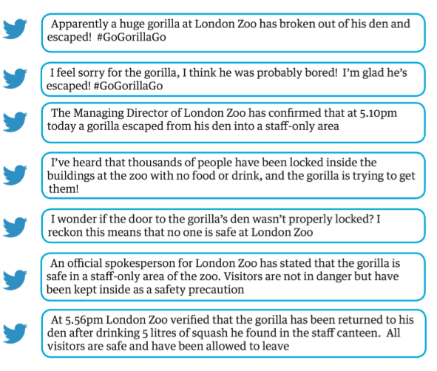
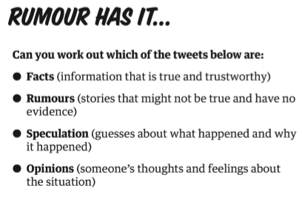

Slide 9
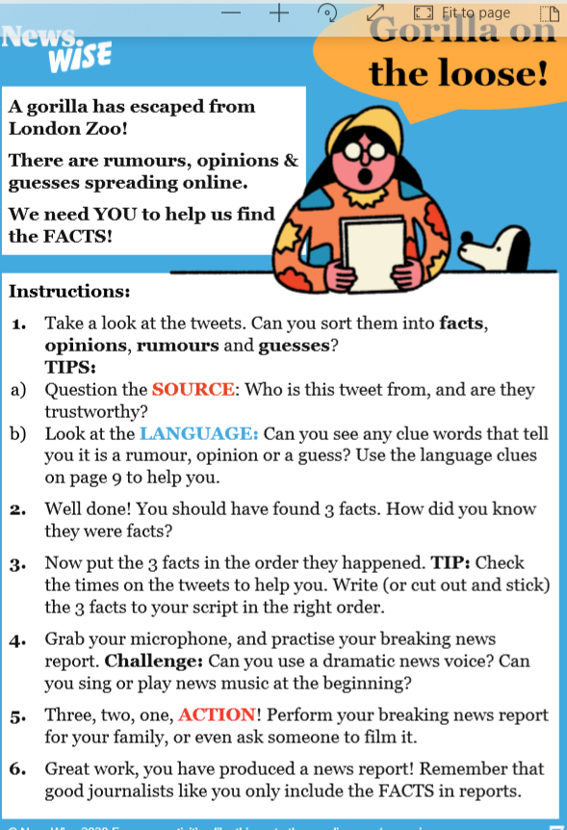
Top Tips for sorting Tweets

Slide 10
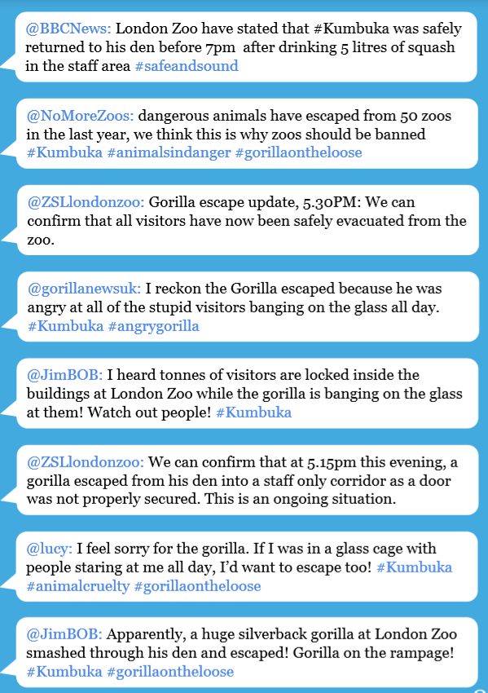
Check the source and the language!

Slide 11
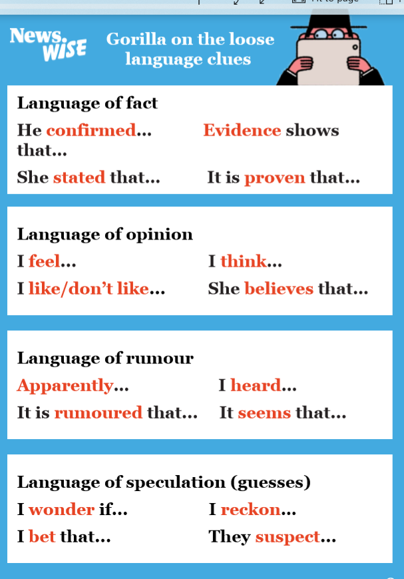

Slide 12
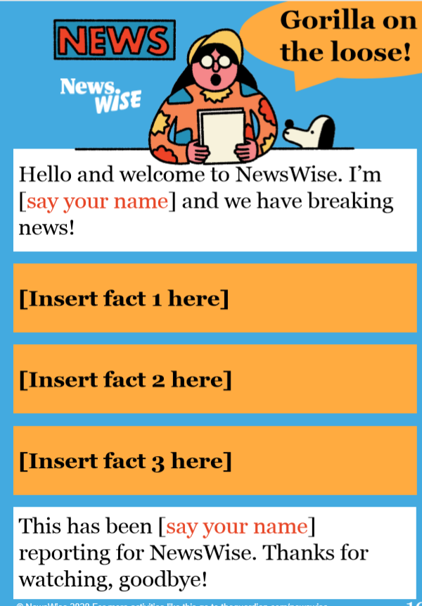
Today’s Task:
Year 4: Using the language clues, identify the three facts from the list
Decide which order they need to be in
Practise reading your news report

Slide 13
Today’s Task:
Year 5: Complete the fact/opinion sheet Y5.
Year 6: Using the News stories on the website and the evidence given – decide if these stories are real or false. Give reasons for your point of view.
Extension: Complete one of the real or fake sheets

Slide 14
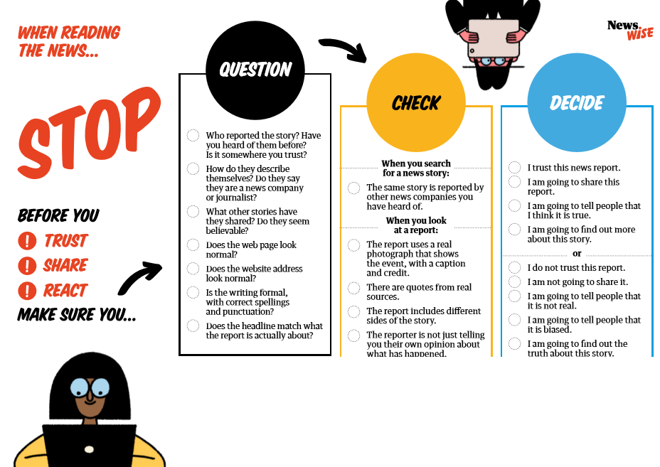

Slide 15
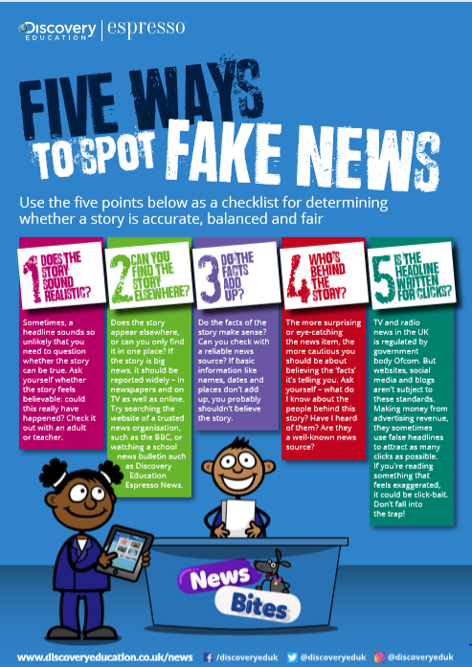
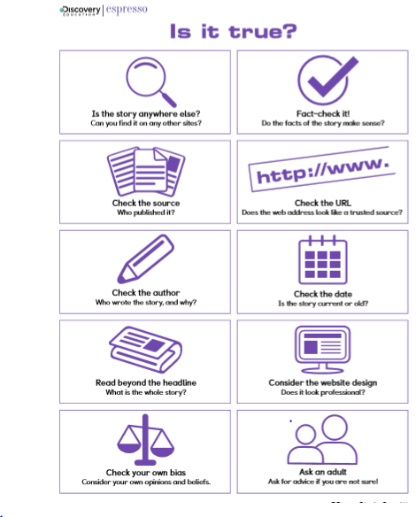

Slide 16
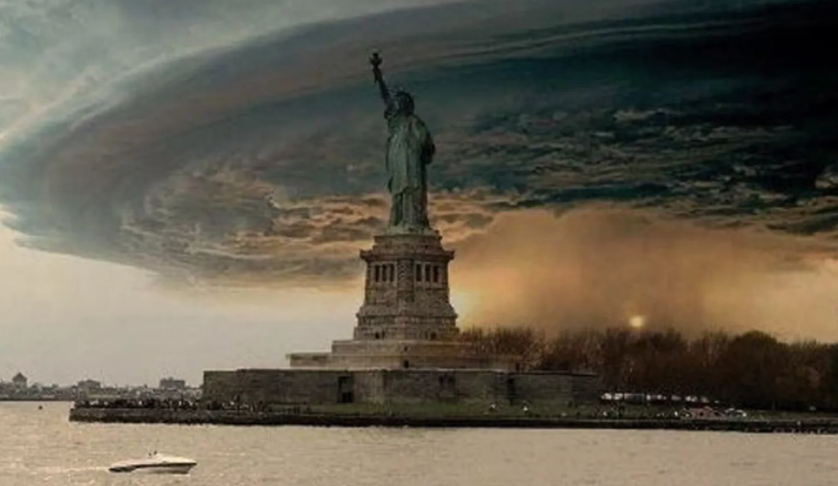
Can you trust pictures on the internet? Why/why not?
Check images using ‘reverse image search’ or www.tineye.com

