Slide 1
English Lesson
Thursday 11th February, 2021

Slide 2
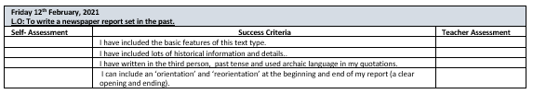

Slide 3
What is a newspaper headline?
A headline is the main title of a newspaper story usually printed in large letter at the top of a story. For children to interpret news accurately it’s important that they understand what newspaper headlines are and how they are written.
Headlines are designed to grab a reader’s attention and hook them into the story. The job of a headline is to ultimately “tell and sell” so it must tell the reader enough to attract their attention but leave them wanting to know more so they read the full story.

Slide 4
How do you write a newspaper headline?
The perfect headline is short, accurate and attention grabbing.
A headline should sum up the news story in as few words as possible; every word counts in a headline and any unnecessary words are left out e.g.
A baby is found alive two days after the earthquake in Turkey
Journalists play with the language in the headline to grab attention.
Tricks of the headline-writing-trade include puns, rhymes, well-known phrases, clichés, song references, alliteration and assonance.
Rhythm and punctuation also play an important role in making a good headline.

Slide 5
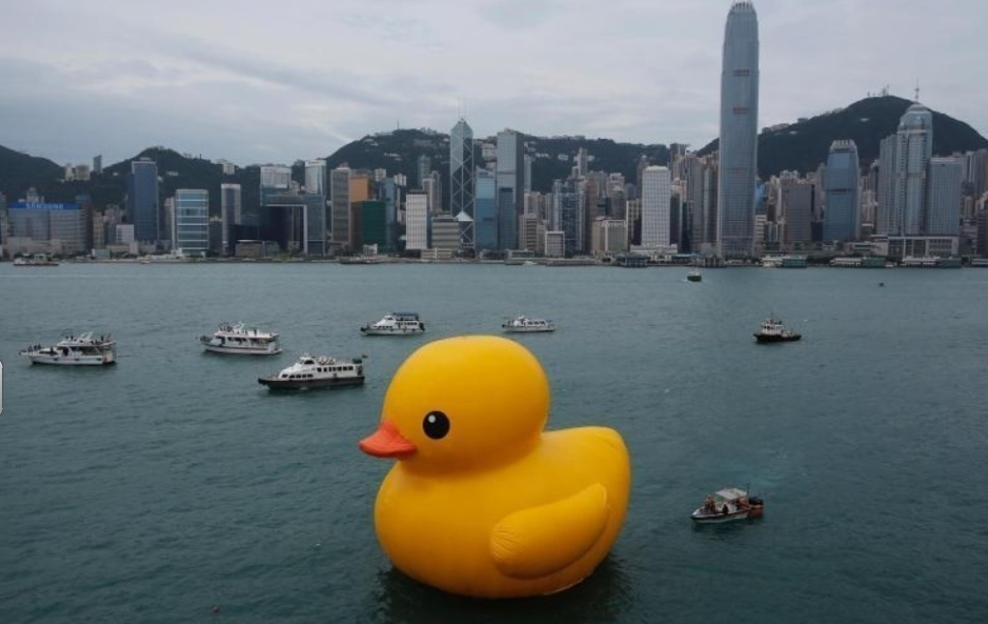
What could the headline be?

Slide 6
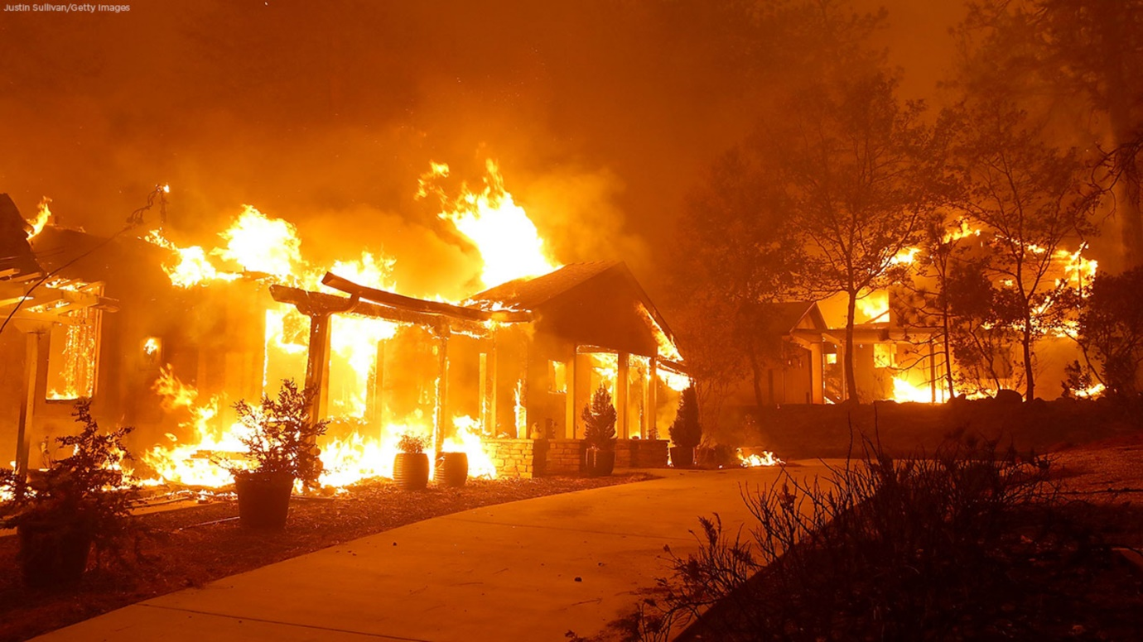
This headline?

Slide 7
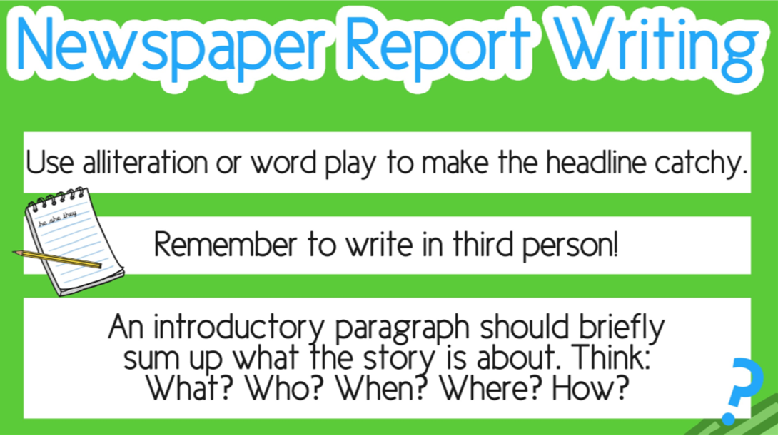

Slide 8
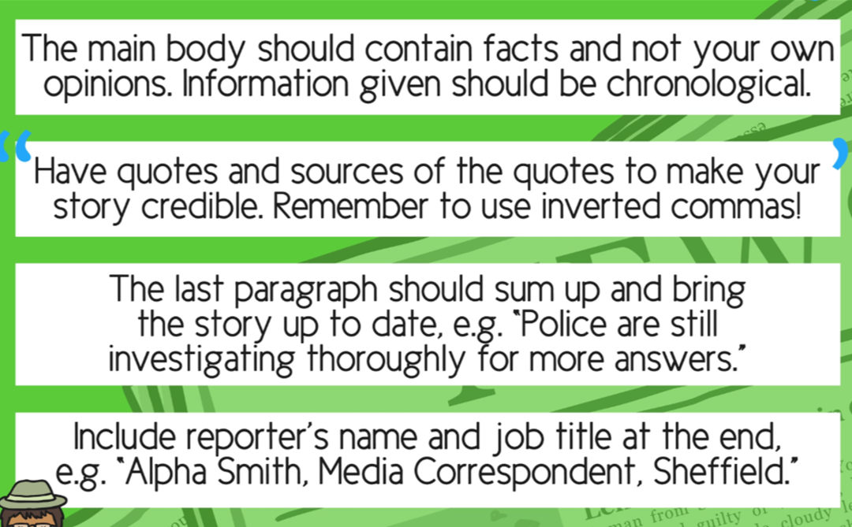

Slide 9
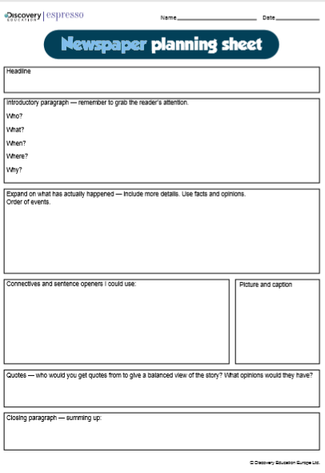
Today’s Task:
You are going to plan a newspaper article that will show how much you have learned about this term’s topic.
Opposite are some of the things you will need to include but you will also have to make sure your report contains lots of facts about this term’s topic.
Use two pages of your writing book.

Slide 10

Success Criteria:
Also remember to include historical details that you learned in topic e.g. where the fire started; or the symptoms of the plague.
Archaic language, historical objects.
Remember a newspaper report is written in the past tense, third person.
Your report needs a clear beginning and end.

