Slide 1
Exciting Writing
Friday 12th February

Slide 2
Try to include as many details as possible from this term’s topic work.
This is your opportunity to show how much you have learned.
Use two full pages of your book (a double spread).
Include:
Archaic language
Historical details e.g. the year, key events, people and places.
Historical objects e.g. what people ate, wore and did
Great Fire of London plague Stuart ablaze burning River Thames
Pudding Lane Thomas Farrinor Bethnal Green Moorfields King Charles II
St Paul’s Cathedral Tower Hill Samuel Pepys London Bridge Guildhall

Slide 3
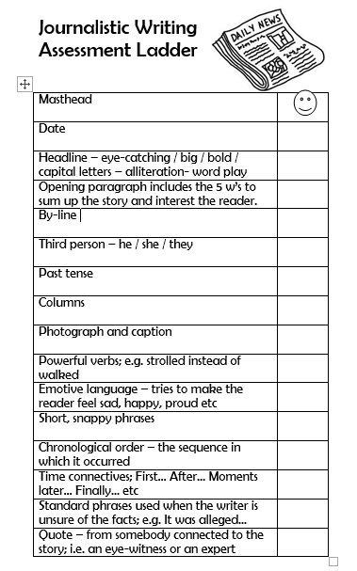
Remember to include:
Features opposite.
What will you include instead of photographs?

Slide 4

As well as your own notes and research, a copy of this text is on the website.

