Slide 1
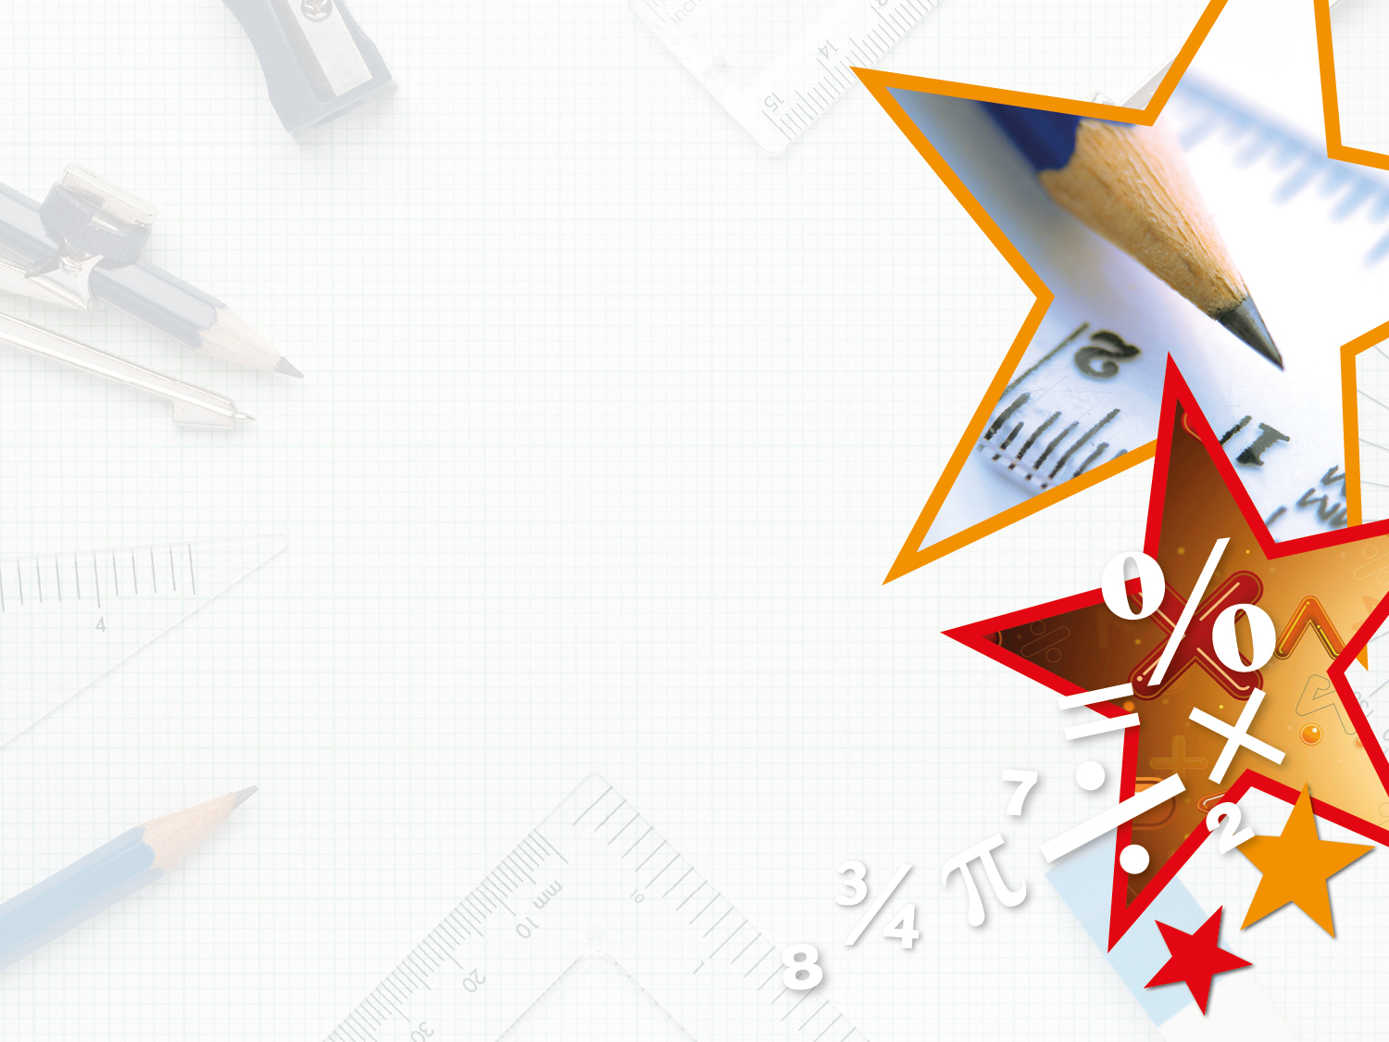

Multiply 4-Digits by 2-Digits
REASONING AND
PROBLEM SOLVING
© Classroom Secrets Limited 2018

Slide 2
Problem Solving 1
Use all of the digit cards in the calculation below to make the closest possible number to 86,000.
1
2
3
 | 7 |  |  |  |  | 5
x |  |  |  |  | 1
© Classroom Secrets Limited 2018

Slide 3
Problem Solving 1
Use all of the digit cards in the calculation below to make the closest possible number to 86,000.
7,135 x 12 = 85,620
1
2
3
 | 7 |  | 1 |  | 3 | 5
x |  |  |  |  | 1 | 2
© Classroom Secrets Limited 2018

Slide 4
Reasoning 1
Harry has worked out the answer to 2,526 x 21 below.
Is he correct? Explain your answer.
 |  | 2 | 5 | 2 | 6
x |  |  |  | 2 | 1
 |  | 2 | 5 | 2 | 6
 | 5 | 0 | 4 | 2 | 0
 | 5 | 2 | 9 | 4 | 6
1
1
© Classroom Secrets Limited 2018

Slide 5
Reasoning 1
Harry has worked out the answer to 2,526 x 21 below.
Is he correct? Explain your answer.
Harry is not correct because…
 |  | 2 | 5 | 2 | 6
x |  |  |  | 2 | 1
 |  | 2 | 5 | 2 | 6
 | 5 | 0 | 4 | 2 | 0
 | 5 | 2 | 9 | 4 | 6
1
1
© Classroom Secrets Limited 2018

Slide 6
Reasoning 1
Harry has worked out the answer to 2,526 x 21 below.
Is he correct? Explain your answer.
Harry is not correct because he has not used the one hundred carried over from the 12 tens in the answer to 2 tens x 2 tens.
 |  | 2 | 5 | 2 | 6
x |  |  |  | 2 | 1
 |  | 2 | 5 | 2 | 6
 | 5 | 0 | 4 | 2 | 0
 | 5 | 2 | 9 | 4 | 6
1
1
© Classroom Secrets Limited 2018

Slide 7
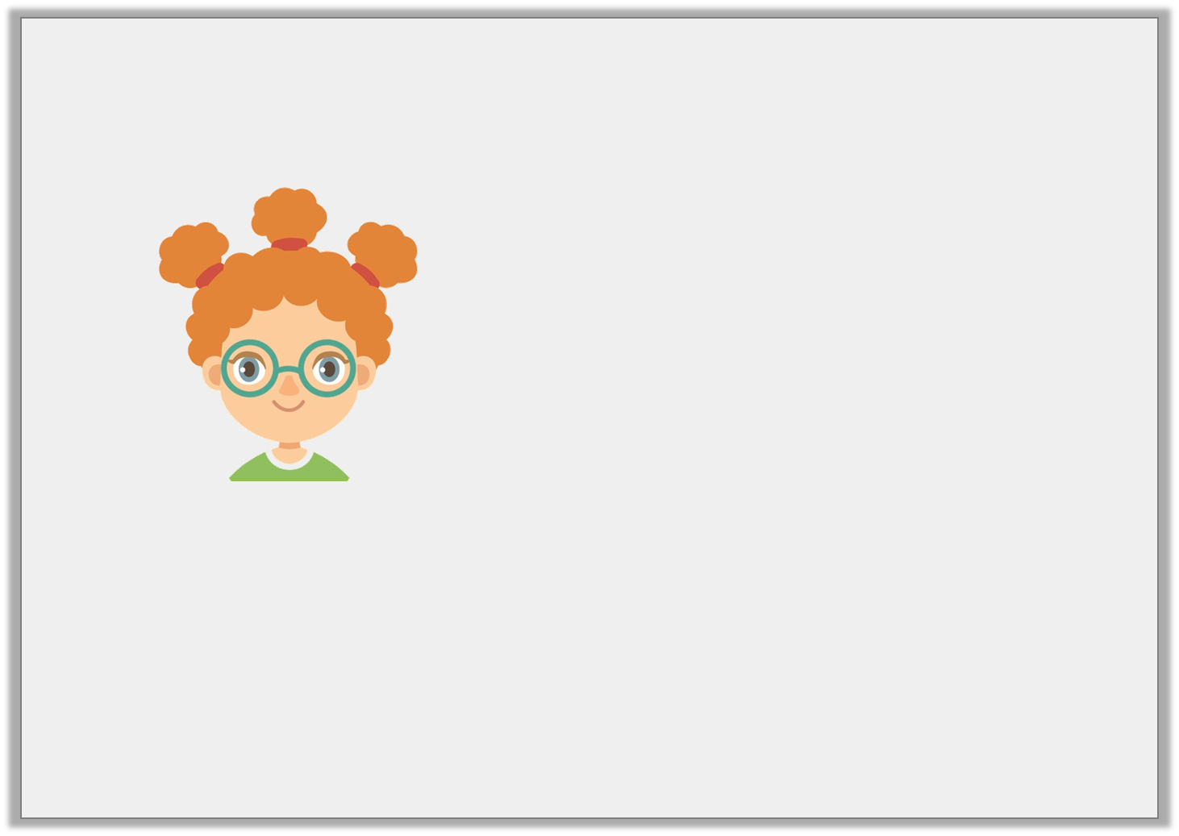
Problem Solving 2
Ellie says,
What could Ellie’s number be?
Find two possible numbers.
I am thinking of a 4-digit number less than 3,000.
Only one of the digits in my number is greater than 3.
If I multiply my number by 21, I get an answer between 30,000 and 35,000.
© Classroom Secrets Limited 2018

Slide 8
Problem Solving 2
Ellie says,
What could Ellie’s number be?
Find two possible numbers.
Various answers, for example:
1,521 x 21 = 31,941 and 1,522 x 21 = 31,962
I am thinking of a 4-digit number less than 3,000.
Only one of the digits in my number is greater than 3.
If I multiply my number by 21, I get an answer between 30,000 and 35,000.
© Classroom Secrets Limited 2018

