Slide 1


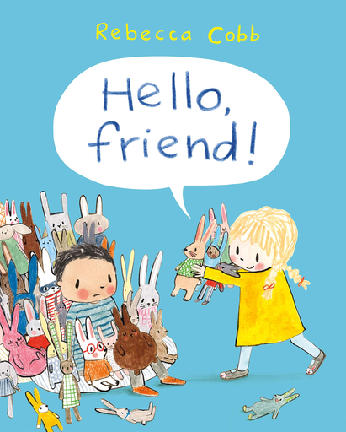

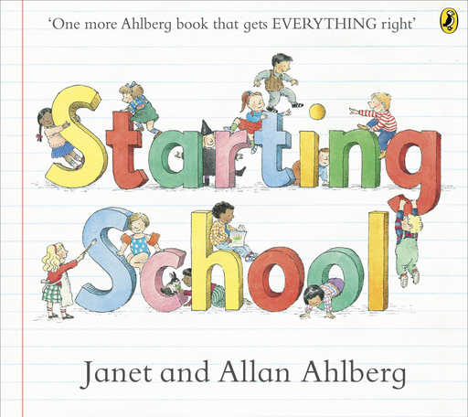





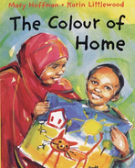






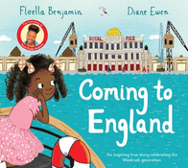


PSHE overview
Autumn term 2026
Reception
Learning expectations:
  talk about their likes and dislikes and how they are different from or similar to other children
  set a simple goal and work towards it.
  wait for what they want.
  give focussed attention to the teacher and other adults in school.
  follow instructions containing several ideas or actions.
  talk about rules and why we have them in the classroom.
  follow simple rules
  identify appropriate and inappropriate behaviour in school.
Making relationships
The children will explore how they are all uniquely special, which will
include discussing their likes and dislikes and the things they are able
and are learning to do, and what they would like to learn next. They will
examine, and learn to value and respect, similarities and differences
between themselves and their peers.
Myself and my relationships
Learning expectations
  be able to describe some of the qualities of friendship and skills for making friends.
  have developed some strategies for managing when friendships are difficult.
  understand that there are different family patterns.
  be able to describe what is special about their own family and its members, and about other people they know.
Year
1 & 2
The children will explore the importance of respecting others by exploring others that are different to ourselves and using the conventions of courtesy and manners.
They will investigate the characteristics of friendships and the importance in making us feel happy and secure. The children will be equipped with adice to keep themselves safe.
Year
3 & 4
Myself and my relationships
Learning expectations
  be able be able to describe some of the qualities of a good friend, and to have developed strategies for making and keeping friends on and offline.
  understand and be able to cope with changes in friendship patterns and know some ways to resolve conflict in friendships.
  be able to describe some emotions felt by people experiencing friendship challenges and the causes of these.
  be able to describe some ways families offer support in tough times.
  be able to identify special people in their networks and know from whom and how to access support.
Children will have the opportunity to contribute to creating a
safe and happy classroom through developing ground rules. They will also
experience activities designed to build positive relationships in the class.
They will explore what it feels like to be in new situations, how to identify their own support networks.
Year
5 & 6
Myself and my relationships
Learning expectations
  describe aspects of healthy and unhealthy relationships, online and offline.
  have developed ways of beginning new friendships and maintaining existing ones, on and offline.
  have strategies for managing some of the pressures in friendships and family relationships.
  be able to explain what is meant by mental wellbeing, and describe how mental health can vary and how common mental ill health is.
  be able to describe some self care strategies, and say which ones tend to work for them.
Children will develop confidence, resilience and a sense of belonging within their class, school and wider community. Through discussion, collaborative activities and literature, children explore what helps people feel welcomed, valued and included, while learning how their own actions can positively affect others. Children will also explore themes of migration, belonging, identity and inclusion. These stories encourage children to consider a range of life experiences and develop understanding, compassion and respect for others.

Slide 2


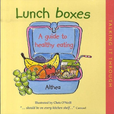




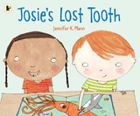

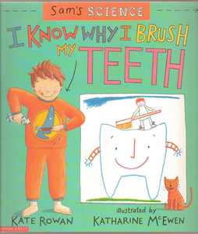
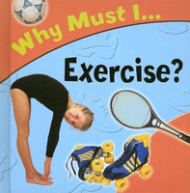

PSHE overview
Spring term 2027
Reception
Health and self care
Learning expectations
This unit will provide opportunities for children to develop their skills,
knowledge, understanding and attitudes within the following areas
of learning and development and related Early Learning Goals:
Physical development
  Health and self-care
Personal, Social and emotional development
  Self-confidence and self-awareness
Communication and language
  Listening and attention
  Understanding
  Speaking
The children will understand the importance of what our bodies need to be healthy and what activities children need to do to maintain
a healthy body. They will understand the healthy choices available to them and equip them with the skills to make their own decisions.. The children will
explore, through a variety of activities, how, in order to keep healthy, they will need a balanced diet, rest, sleep and regular exercise.
Year
1 & 2
Learning expectations
  be able to give examples of how to be healthy and to reflect on their own lifestyles and choices.
  be able to explain why healthy eating and physical activity are both important.
  know the difference between being active and inactive, and give some examples.
  be able to say what changes physically and emotionally when they are active.
  be able to talk about food likes and dislikes and give reasons.
  understand that food can be divided into different groups and know
  that for good health we need a balanced diet.
Healthy lifestyles
Continuing to develop children’s awareness, knowledge and understanding of the importance of being healthy and how we can contribute to maintaining their health. As well as physical
health, we also will look at mental health and having a growth mindset. This compliments with the previous topic of myself and my relationships.
Healthy lifestyles
Learning expectations
  know that they can make choices which are healthier or less healthy and reflect on their own lifestyle.
  know that eating a balanced diet, being active and sleeping all contribute to a healthy lifestyle.
  understand some of the reasons people sometimes make less healthy choices.
  be able to talk about some of the physical and mental benefits of exercise.
  understand why our bodies need foods from each of the food groups and be able to suggest daily menus or meals.
  know how much sleep we need and be able to talk about what happens if we don’t get enough.
  know why dental hygiene is important and how they can look after their teeth.
Year
3 & 4
Children explore a range of factors which contribute to a healthy lifestyle,
including healthy eating, physical activity, sleep and use of free time.
We will revisit the Eatwell Guide and using it to plan healthy, balanced meals. Children will learn about the physical and mental benefits of regular exercise and will consider the relationship between physical activity and nutrition. They will develop an awareness of factors which influence people’s food choices
and think about the benefits to our health of different kinds of food. They will also be given the opportunity to plan and prepare
healthy snacks taking responsibility for their choices.
Year
5 & 6
Learning expectations
  understand that there are a range of factors which contribute to a healthy lifestyle, including a healthy balanced food intake and physical activity.
  be able to explain that different kinds and amounts of food provide different amounts of energy and be able to plan an appropriate energy balance for themselves, including explaining the possible consequences of an imbalance.
  understand the benefits of physical activity for promoting health and the risks of not participating.
  be able to explain why some online apps and games are age restricted, and how online behaviour can affect physical & mental health.
  explain that a healthy lifestyle includes physical, social and mental health and how they can take responsibility for their own health.
Healthy lifestyles
Children will look at a range of physical and mental aspects of healthy living. Encouraging children to think more widely about choices others make in relation to a balanced diet and exercise, as well as applying it directly to their own lives. Children will learn about the different substances food contains, including nutrients and their benefits, and will consider ways
of achieving an energy balance which helps them to stay healthy and be active. They will learn about the signs of physical illness and how they might respond.

Slide 3







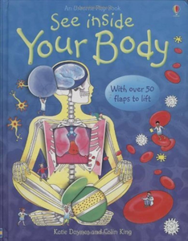





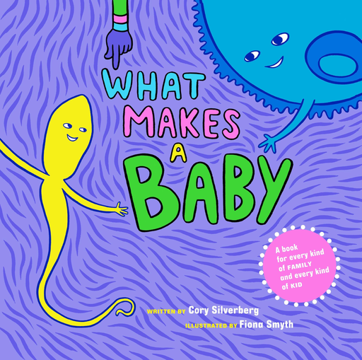


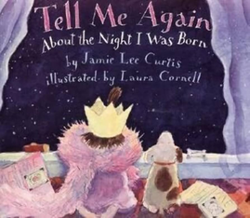
PSHE overview
Summer term 2027
Reception
Growing and changing
Learning expectations
  be able to use a range of words to describe their own appearance.
  be able to describe ways their body has changed since they were a baby.
  be able to talk positively about some of their body’s capabilities.
  be able to name a sex specific body part using scientific vocabulary.
  be able to wash their hands at school.
  be able to explain when they might need help to take care of themselves.
  be able to talk about ways people in families look after each other.
  be able to describe a feeling they associate with growing up.
Children will learn to recognise and know the scientific names for the external sexual parts of the body. The children will learn to appreciate the things that they can do with their bodies, how they have changed physically since they were very young and how they will continue to
grow and change all their lives. The children
will continue to develop basic hygiene routines, including toileting and washing, and will also learn about the importance of good hygiene and cleanliness for preventing the spread of illness.
Growing and changing
Learning expectations
  be able to recognise names for the main external parts of the body.
  be able to name the sexual parts with growing confidence using colloquial and usually scientific words with trusted adults.
  be able to describe what their bodies can do and understand how amazing their body is.
  show some understanding that their body belongs to them.
  be able to describe some basic personal hygiene routines and understand how these can prevent the spread of disease.
Year
1 & 2
Children will build upon understanding the scientific names for the external sexual parts of the body. They will consider the amazing nature of their bodies, with a view to developing respect for their bodies and develop an understanding of how important it is to look after their body. Children will also consider simple hygiene practices and their levels of responsibility for these.
RSE
Learning expectations
  be able to use the scientific terms penis, testicles, breast and vagina and explain which parts are male and which are female.
  be able to give several examples of the capabilities of their own bodies.
  be able to describe familiar hygiene routines and understand the reasons for doing these things.
  be able to anticipate new responsibilities for their personal hygiene.
  be able to explain how common illnesses are spread and be able to describe how they can prevent the spread of one such illness.
Year
3 & 4
Children will continue to use scientific names for parts of the body, they will also begin to explore changes in the body whilst they grow. They will consider what they think
it means to be ‘grown up’. They will then look at their responsibilities and
the responsibilities parents and carers have for babies and children. The themes covered in this unit are ‘the human lifecycle’, growing up’, ‘personal responsibilities’ and ‘parents, carers and families’.
RSE
Learning expectations
  be able to describe the main stages of sexual reproduction, using some scientific vocabulary.
  be able to describe some emotions associated with the onset of puberty and have strategies to deal with these positively.
  understand that puberty affects people in different ways, both physically and emotionally.
  understand that the way they behave affects others and that they have some responsibility to others to make sure they are not hurt.
  describe some characteristics of loving, trusting relationships.
  understand a few reasons a couple might choose to have children.
  show awareness of some family arrangements which are different from their own.
Year
5 & 6
Children will examine how puberty brings about changing feelings and relationships with friends and family and consider ways to manage emotions so that they are able to express their feelings and concerns positively. They will explore the meaning of love and consider their responsibilities to care for themselves and others. They will consider the need for trust and love relationships. The themes covered in this
unit are ‘the human lifecycle’, growing up’, ‘reproduction’, personal responsibilities’ and
‘parents, carers and families’.

